Slide 1
After the Theft
CERL Collection Security Summer School
6 September 2017

Slide 2
After the theft (Q 15-17)

Slide 4
Report to the police

Slide 5
What to report?
A lot of questions to be asked:
What happened?
When did it happen?
Do you know who did it?
Do you know what you are missing?
Did you secure evidence?
Etc

Slide 6
Proof?

Slide 7
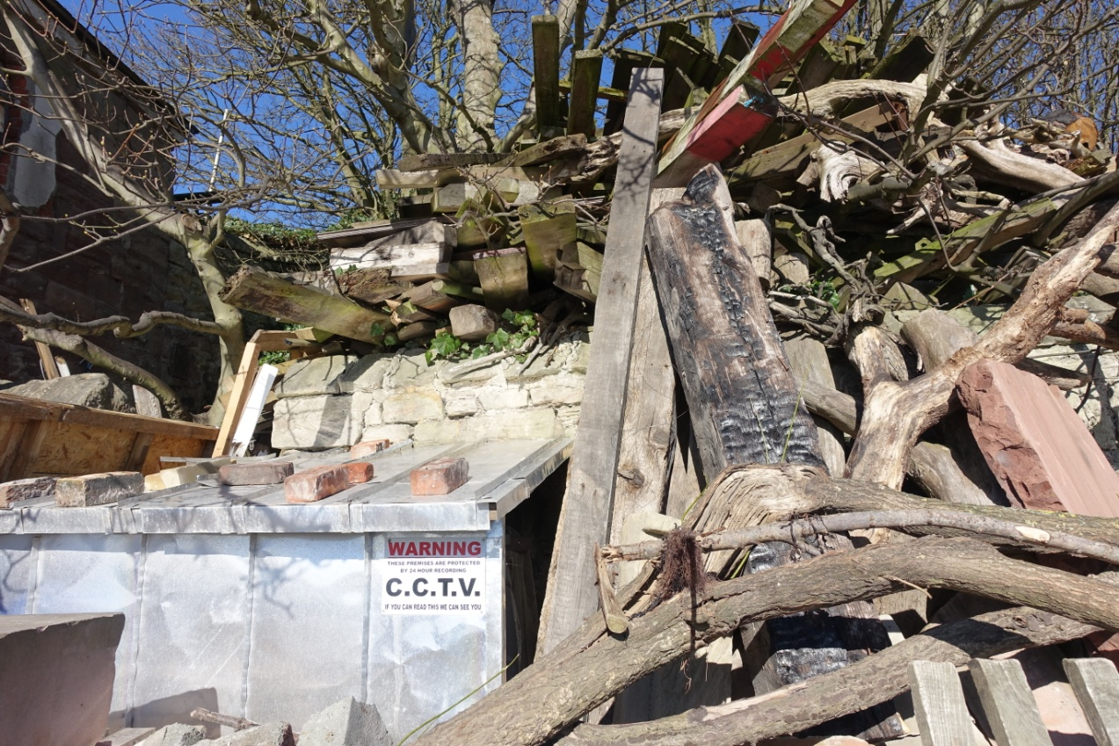
Proof
Obvious things like CCTV images, witnesses

Slide 8
Proof
Good, complete descriptions
Digital copies
DNA marking
Other copy related information:
Identification marks, bindings, but also wormholes, foxing, etc.

Slide 9
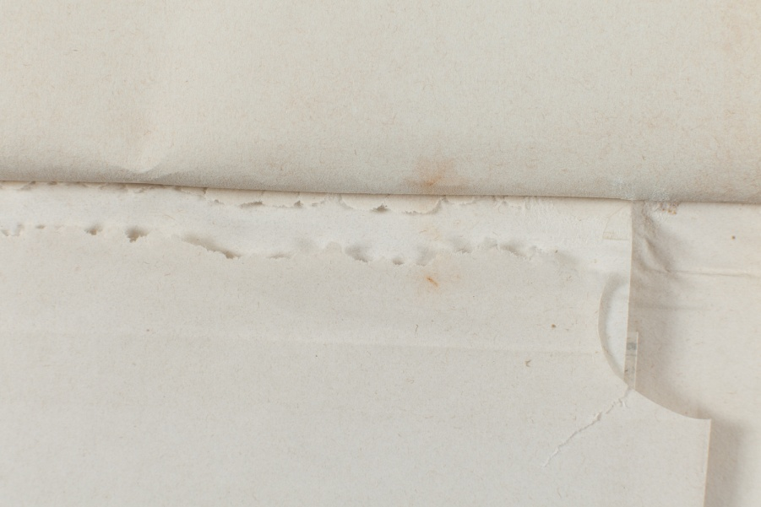
Proof

Slide 10
Other things to be done
All depending on the kind of theft, and the extent:
Inform the trade
Inform colleagues
Inform the press

Slide 11
Contact colleagues

Slide 12
Be open

Slide 13
Martin Finkelnberg
Art Crime, The Dutch Perspective

