Slide 1
Provenance evidence in book history Whatever it takes!
CRISTINA DONDI, 30 SEPT. 2021

Slide 2
The reconstruction of the life of a book
From the time and place where it was written or printed
To the time it entered the current collection
or, for historical copies
To the time and place where it was last recorded

Slide 4
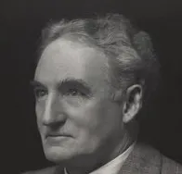
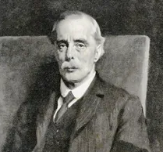
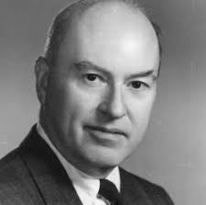
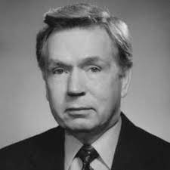
Analytical Bibliography
Ronald McKerrow (1872 – 1940)
Alfred Pollard (1859 – 1944)
Walter Greg (1875 – 1959)
Fredson Bowers (1905 – 1991)
Thomas Tanselle (1934-)

Slide 5
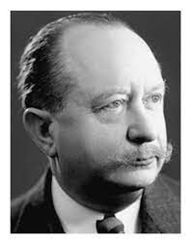
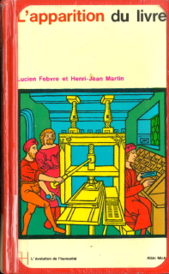
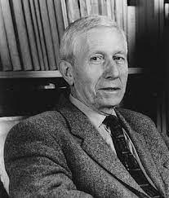
Lucien Febvre and Henri-Jean Martin, L’apparition du livre, 1957
Trans. English 1976
Trans. Italian 1977
Lucien Febvre (1878-1956)
Henri-Jean Martin (1924 – 2007)
L’apparition du livre, 1958
Trans. Spanish 1962
Trans. English 1976
Trans. Italian 1977

Slide 6
QUESTIONS
EVIDENCE
METHODOLOGY

Slide 7
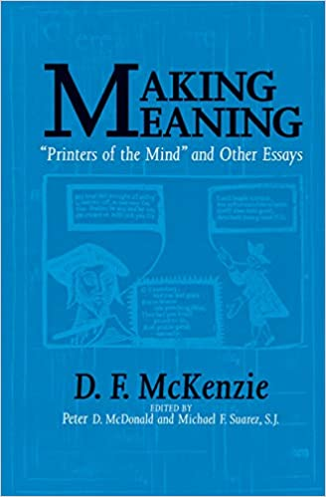
“Use all relevant evidence”
Don McKenzie (1931-1999)

Slide 8
“Whatever it takes”

Slide 9
https://www.cerl.org/publications/new_sources_for_book_history

Slide 11
Internal evidence
Textual (ex: liturgical use and saints in calendars)
Decoration
Binding
Ownership mark
Marginal annotations
Sale marks

Slide 12
External evidence
Historical library catalogues
Documentary (ex: BL internal reports, confiscation lists)
Bibliographical: booksellers’ and auctions’ catalogues, bibliographical studies

Slide 13
TThe History of Each Book
The History of Each Copy

Slide 14
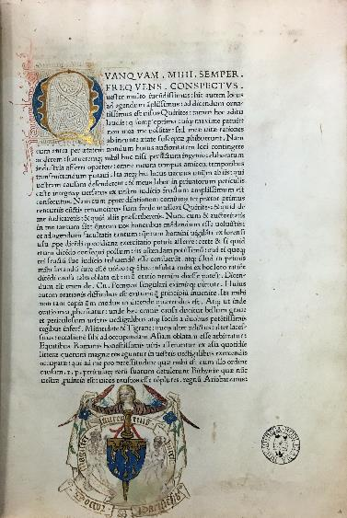
Cicero, Orationes. Venice: Christophorus Valdarfer, [not after 9 Nov.] 1471 Oxford, Bodleian Library, Auct. L 3.1.

Slide 15
First owner
Ego Renobertus de Campo Dolanus has orations tullianas emi Me=
diolani precio ducatorum iii 9 solidi anno domini millesimo cccc.mo lxxii
ii mayi ad laudem…
I, Renoberto de Campo, of Dole [France], purchased these orations of Cicero in Milan at the price of 3 ducats and 9 soldi in the year 1472, 2 May…

Slide 16
Entry in MEI

Slide 17
1.Venice 1471 > 2.Milan 1472 > 3.Dole 1472

Slide 18
Second owner
Et ego frater Jacobus Benedictus…ordinis Carmelitarum Cabilonensis…emi precio trium scutorum…1479…

Slide 19
3.Dole > 4.Chalon-sur-Saone

Slide 20
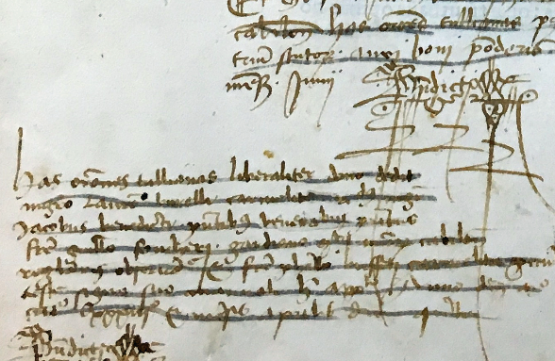
Third owner: Dijon
…dono dedit magistro Laurentio Burello carmelitano…

Slide 21
3.Dole > 4.Chalon-sur-Saone > 5.Dijon

Slide 22
5.Dijon > 6.Paris

Slide 23
6.Paris > 7.Amsterdam > 8.Oxford

Slide 24
Visualization of its circulation

Slide 25
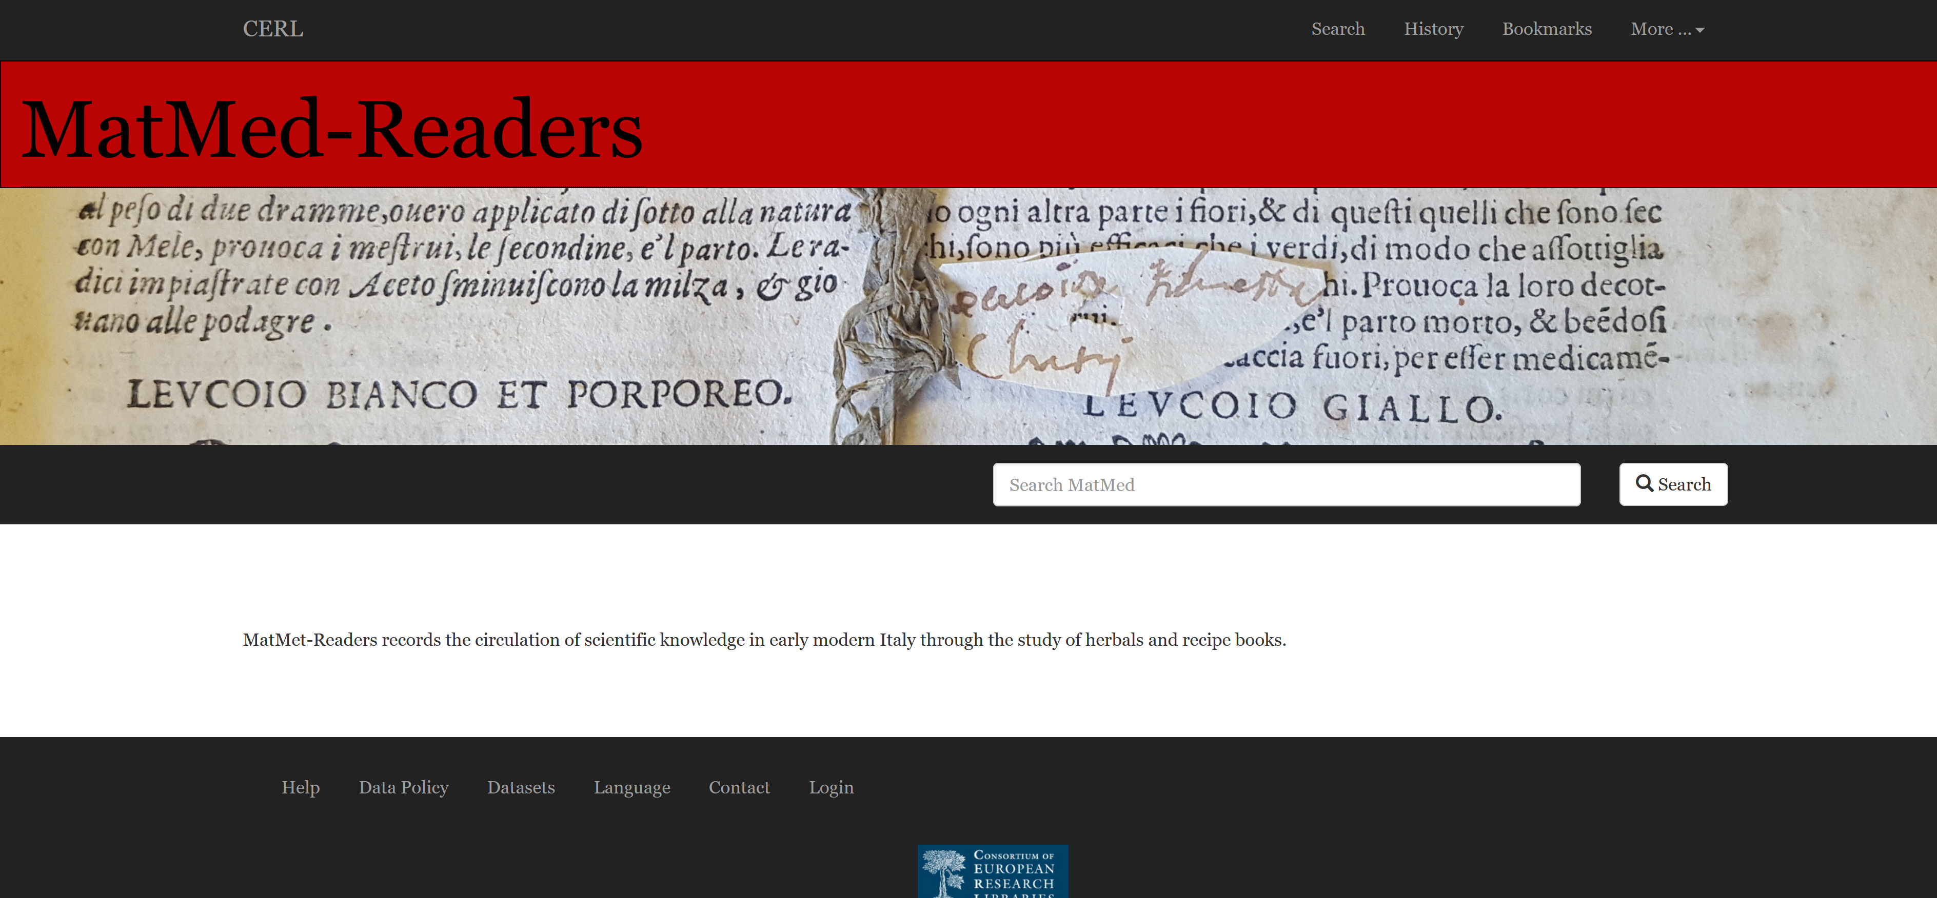

Slide 27
CERL’s PROVENANCE DIGITAL ARCHIVE

Slide 30
Pinelli’s dispersed collection

Slide 31
Pinelli’s post-incunabula

Slide 32
Book survival, disposal, destruction

Slide 33
‘Institutional transfer’

Slide 34
THE HISTORICAL QUESTION:
HOW DID EUROPEAN SOCIETY, TRANSITIONING FROM THE MIDDLE AGES TO THE EARLY MODERN PERIOD, REACT TO TECHNOLOGICAL CHANGE?
How did an invention become a revolution?

Slide 35
15cBOOKTRADE Project: An evidence-based assessment and visualisation of the distribution, sale, and reception of books in the Renaissance
http://15cbooktrade.ox.ac.uk

Slide 36
Where incunabula are today

Slide 37
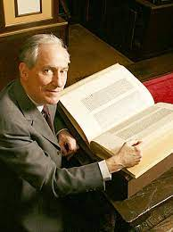
What is the History of Books?
Books and society in history. Papers of the Association of College and Research Libraries rare books and manuscripts preconference, 24-28 June, 1980, ed. Kenneth E. Carpenter (Boston, Mass., 1983)
Daedalus, 111 (1982), pp. 65-83

Slide 38
THANK YOU
c.dondi@cerl.org

