Slide 1
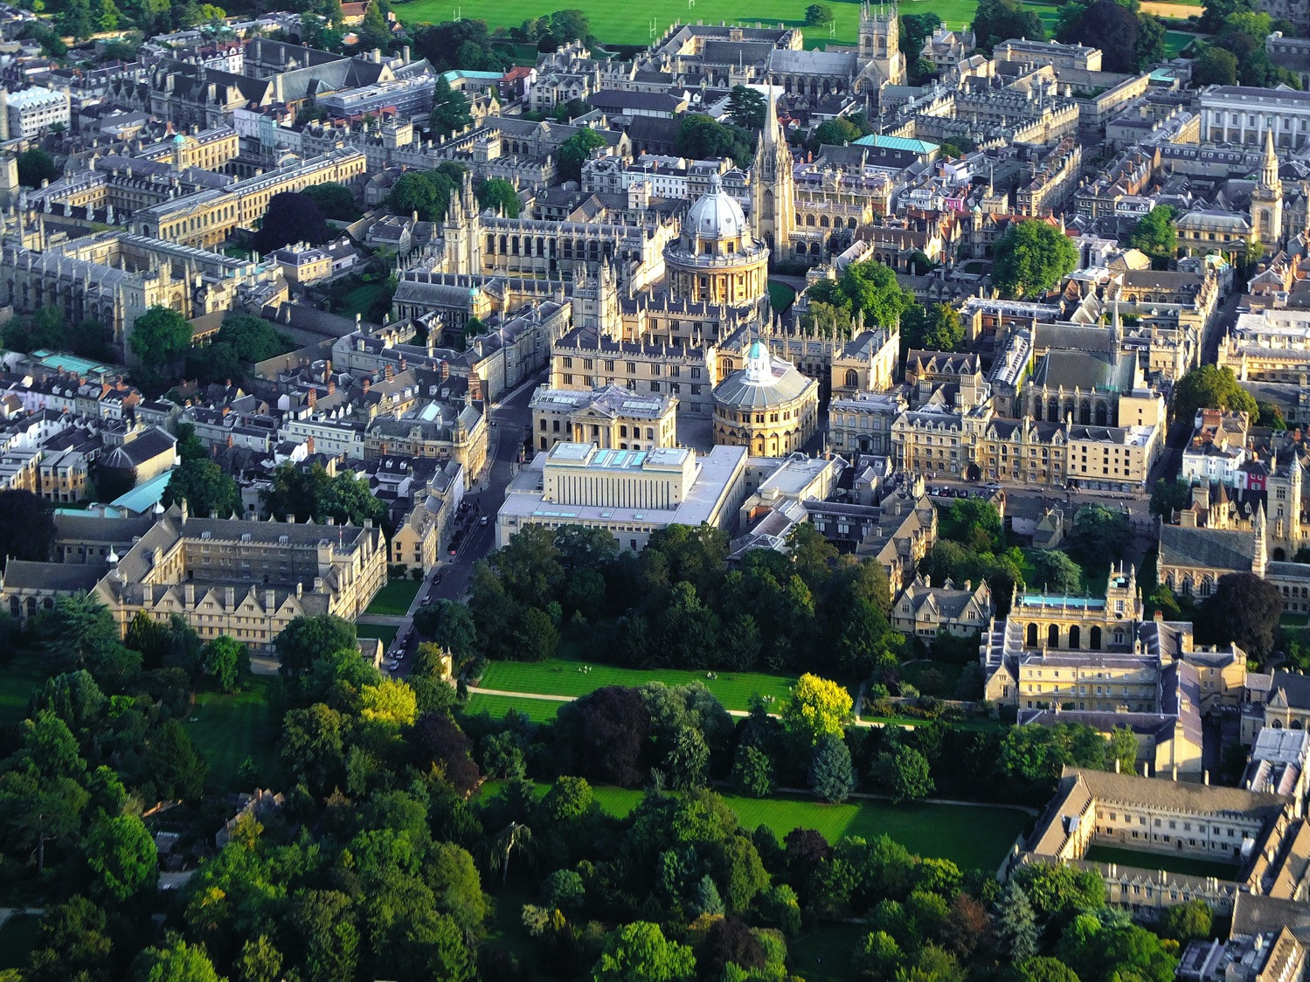
Working together with Museums GLAM at Oxford
Richard Ovenden
Bodley’s Librarian

Slide 2
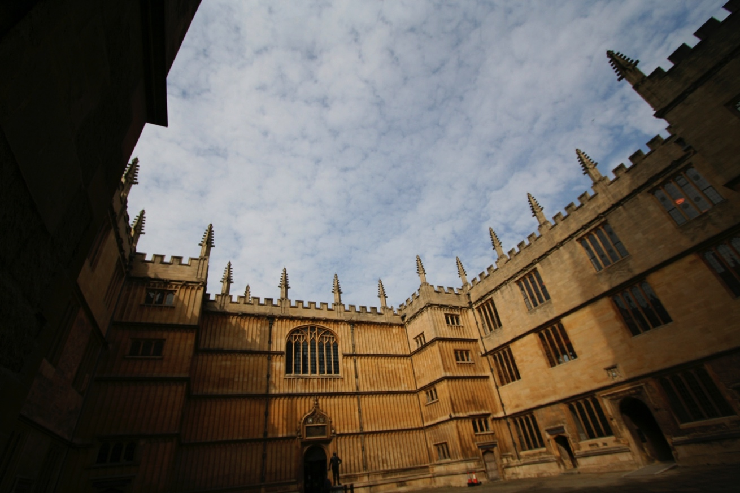
Notes:
As have our buildings: we have complex of ancient and modern buildings, but we continue to curate the spaces which students and researchers use. They remain incredibly popular.
In the seventeenth century the poet Abraham Cowley dedicated a volume of his poetry to the Bodleian:
Hail Learnings Pantheon! Hail the sacred Ark Where all the World of Science do’s imbarque!

Slide 3
Notes:
Graduate students camp out in the Bod

Slide 4
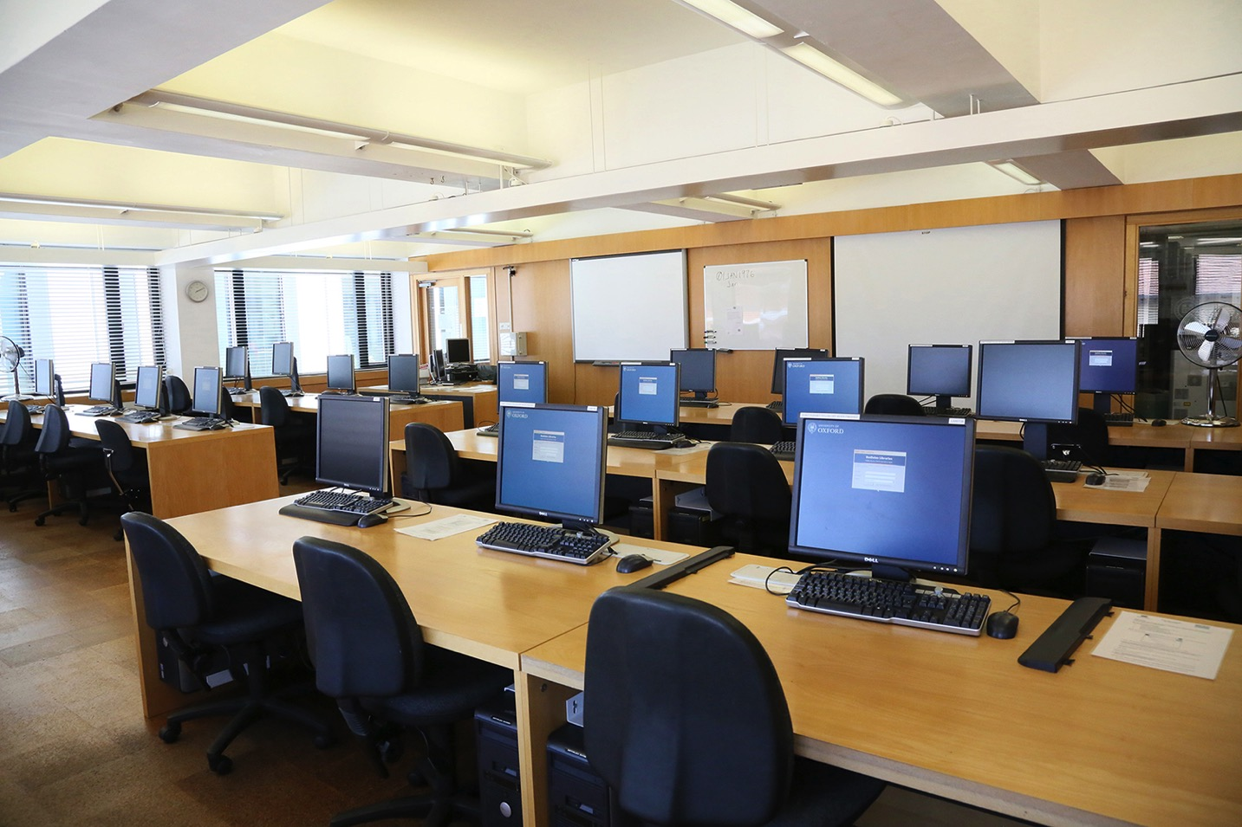

Slide 5
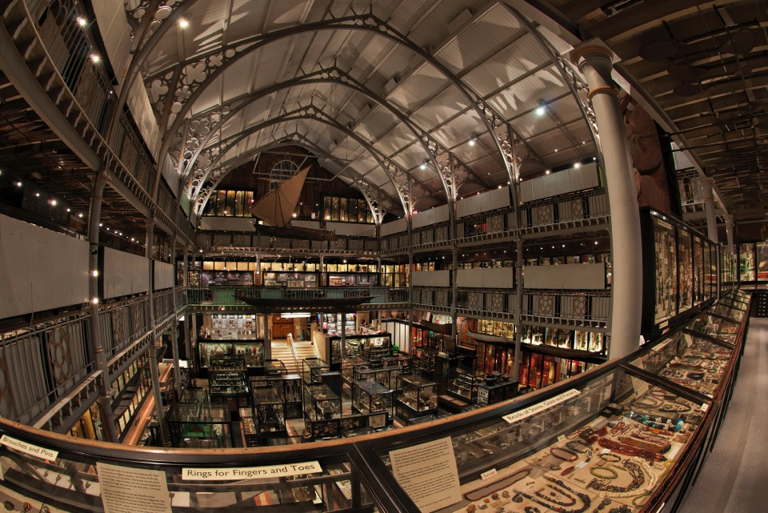

Slide 6
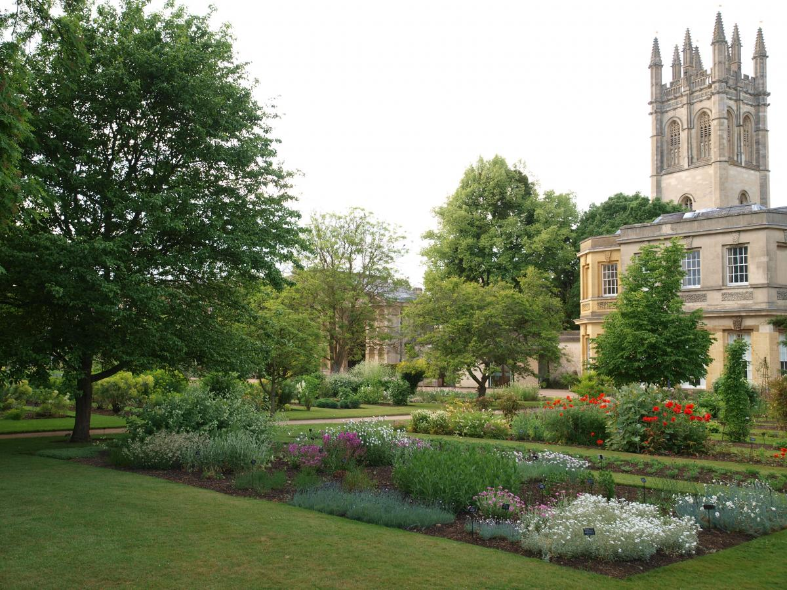

Slide 7
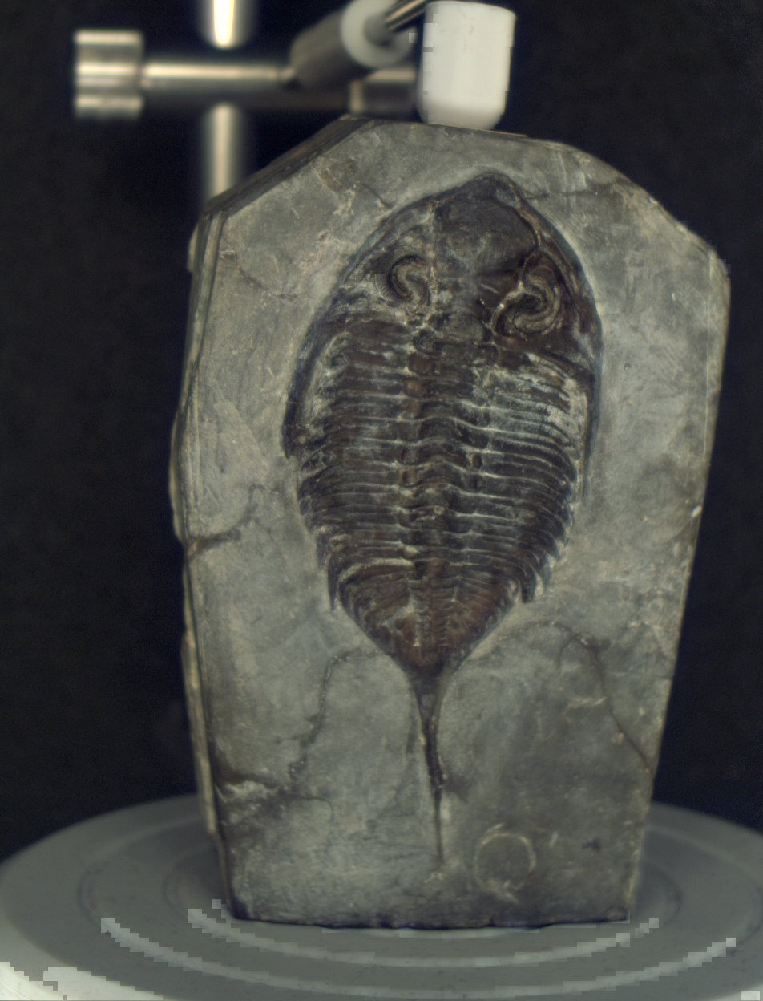

Slide 8
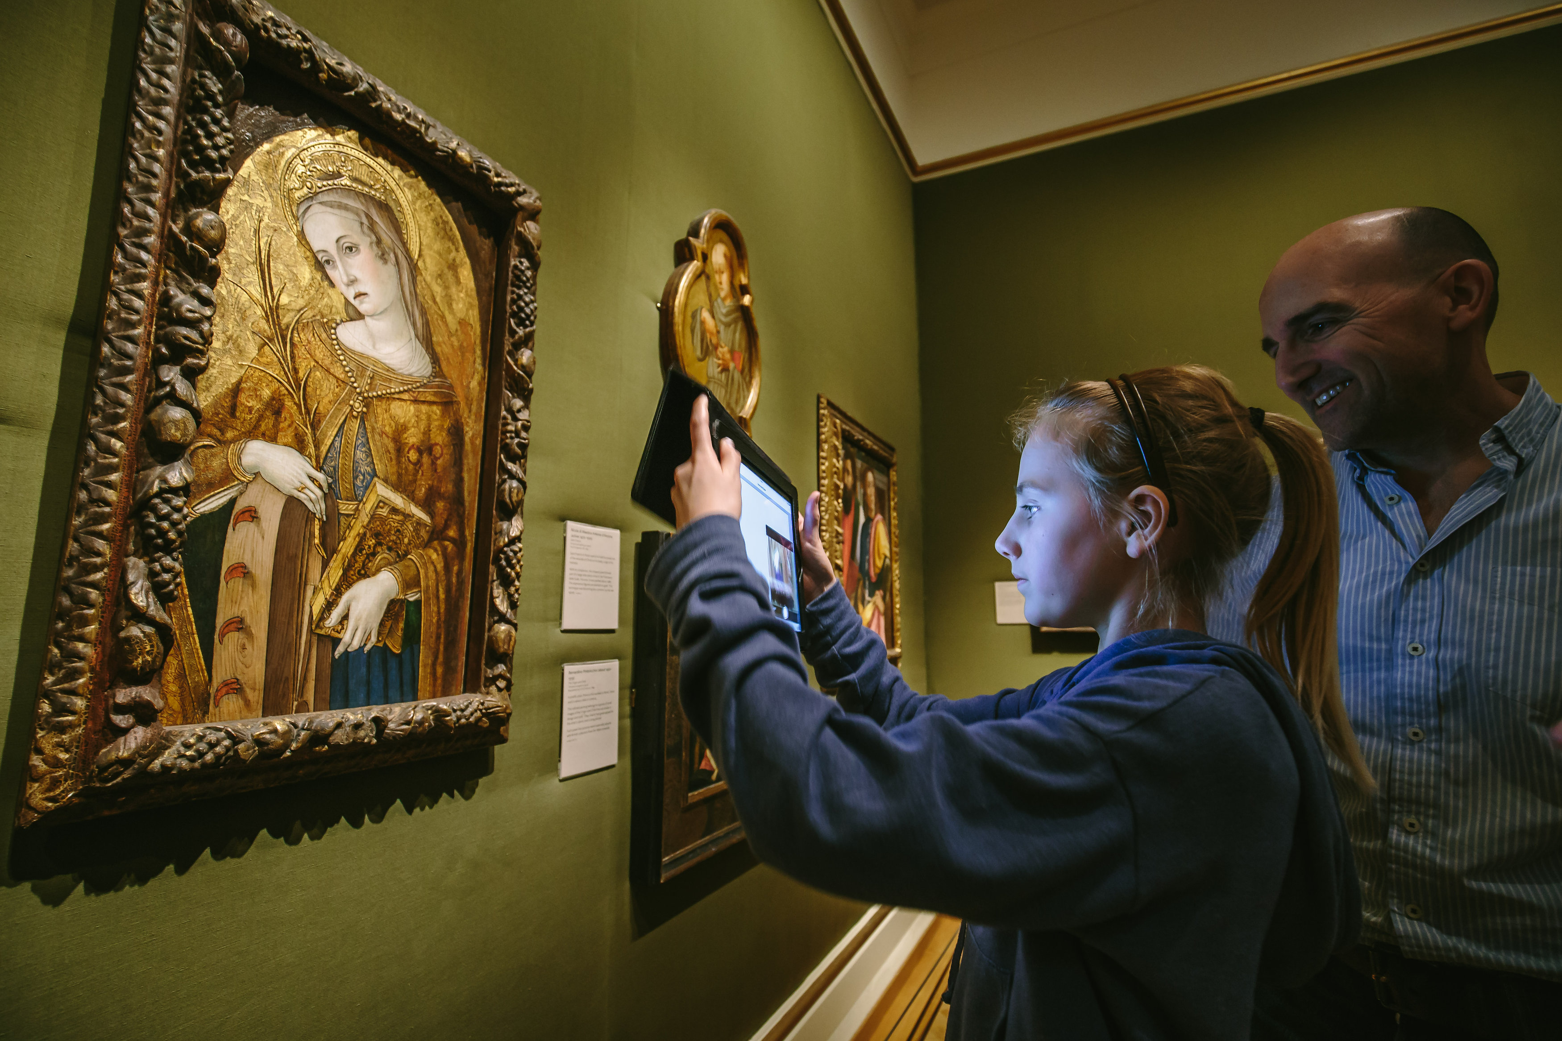

Slide 9
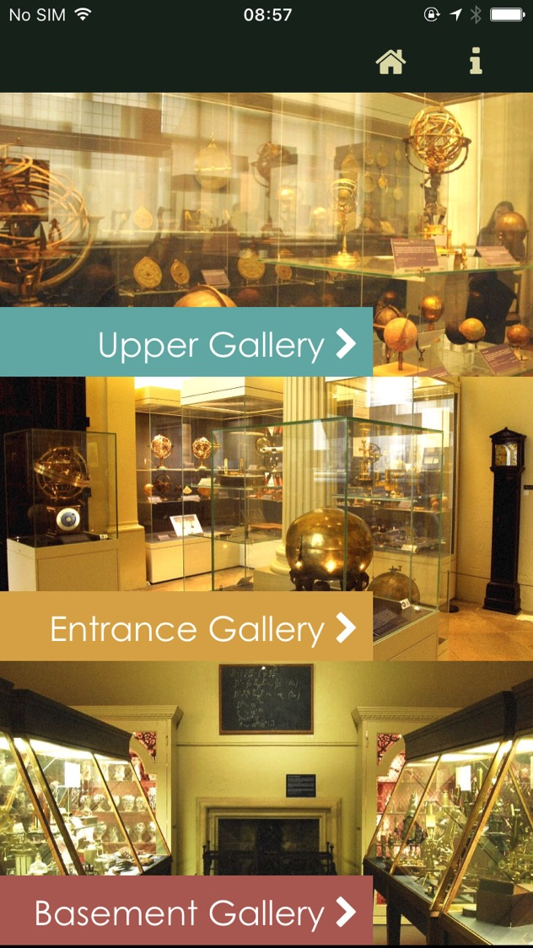

Slide 10
Storage

Slide 11
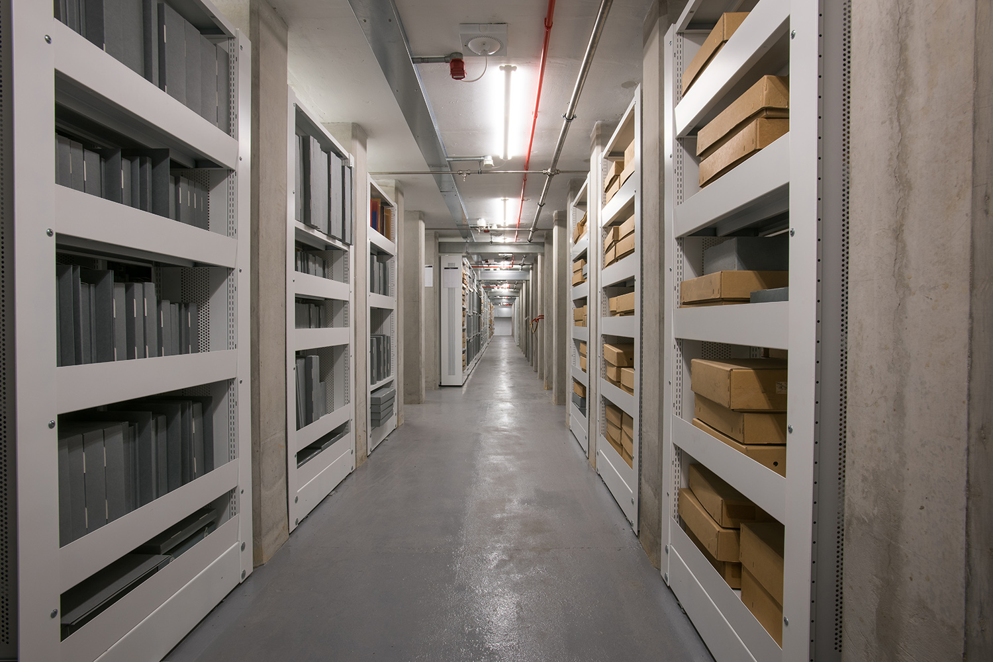
and new libraries…
Notes:
To improve our ‘Digital Estate’ by building bigger and more robust and resiliant infrastructure

Slide 12
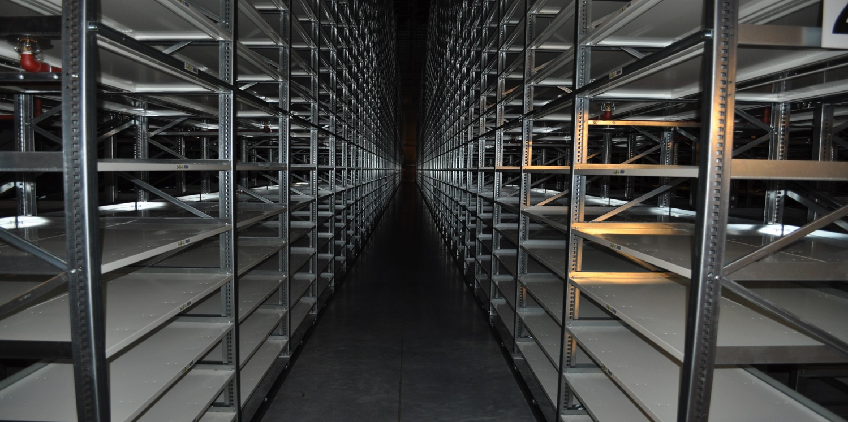

Slide 13
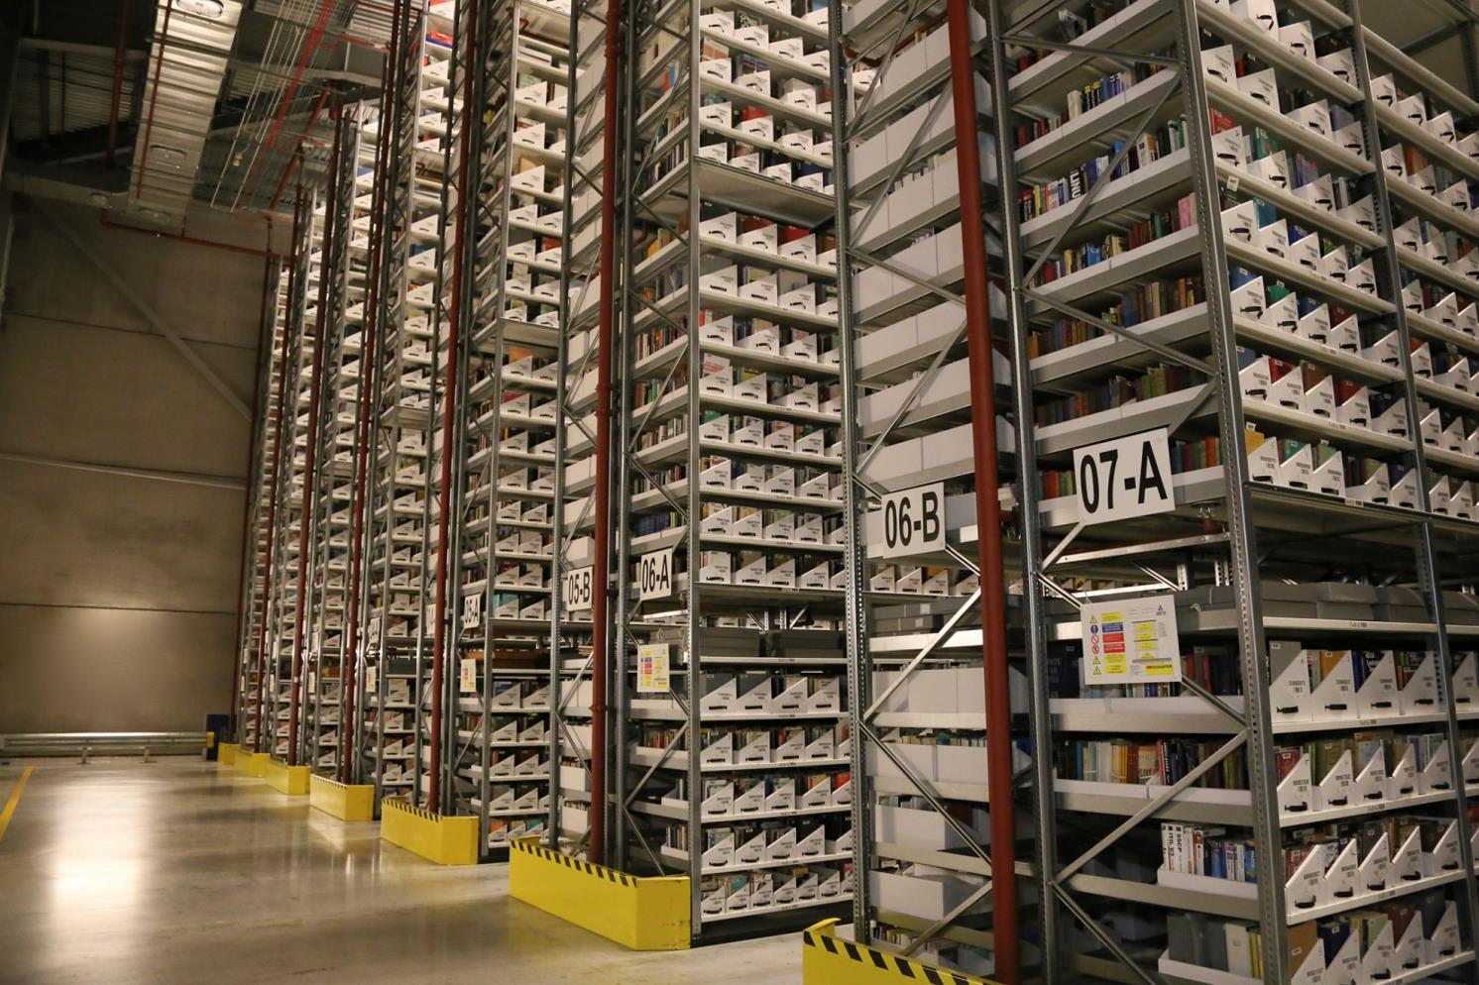
Notes:
BSF 5th Birthday

Slide 14
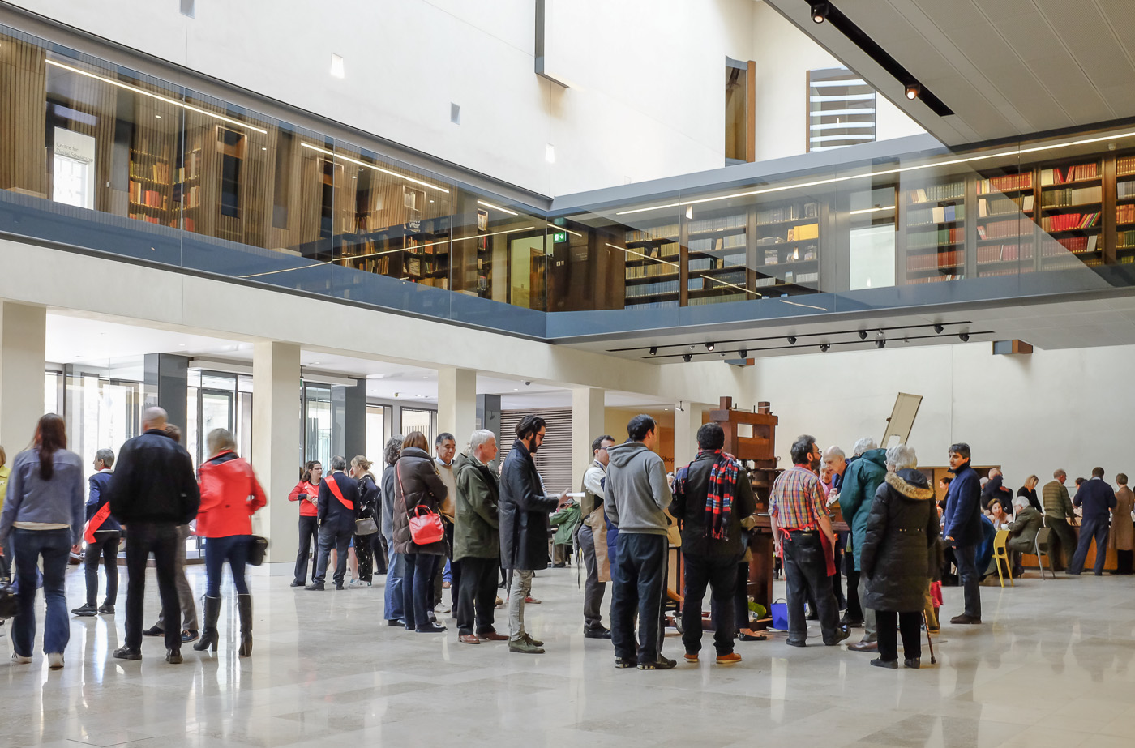

Slide 15
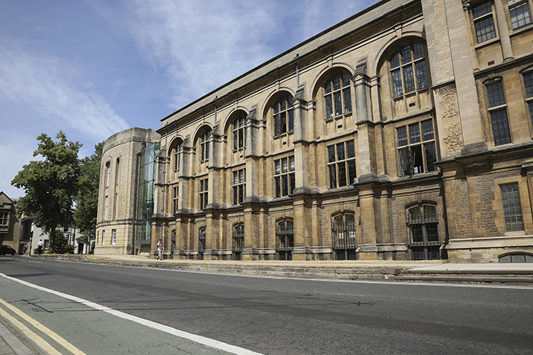

Slide 16
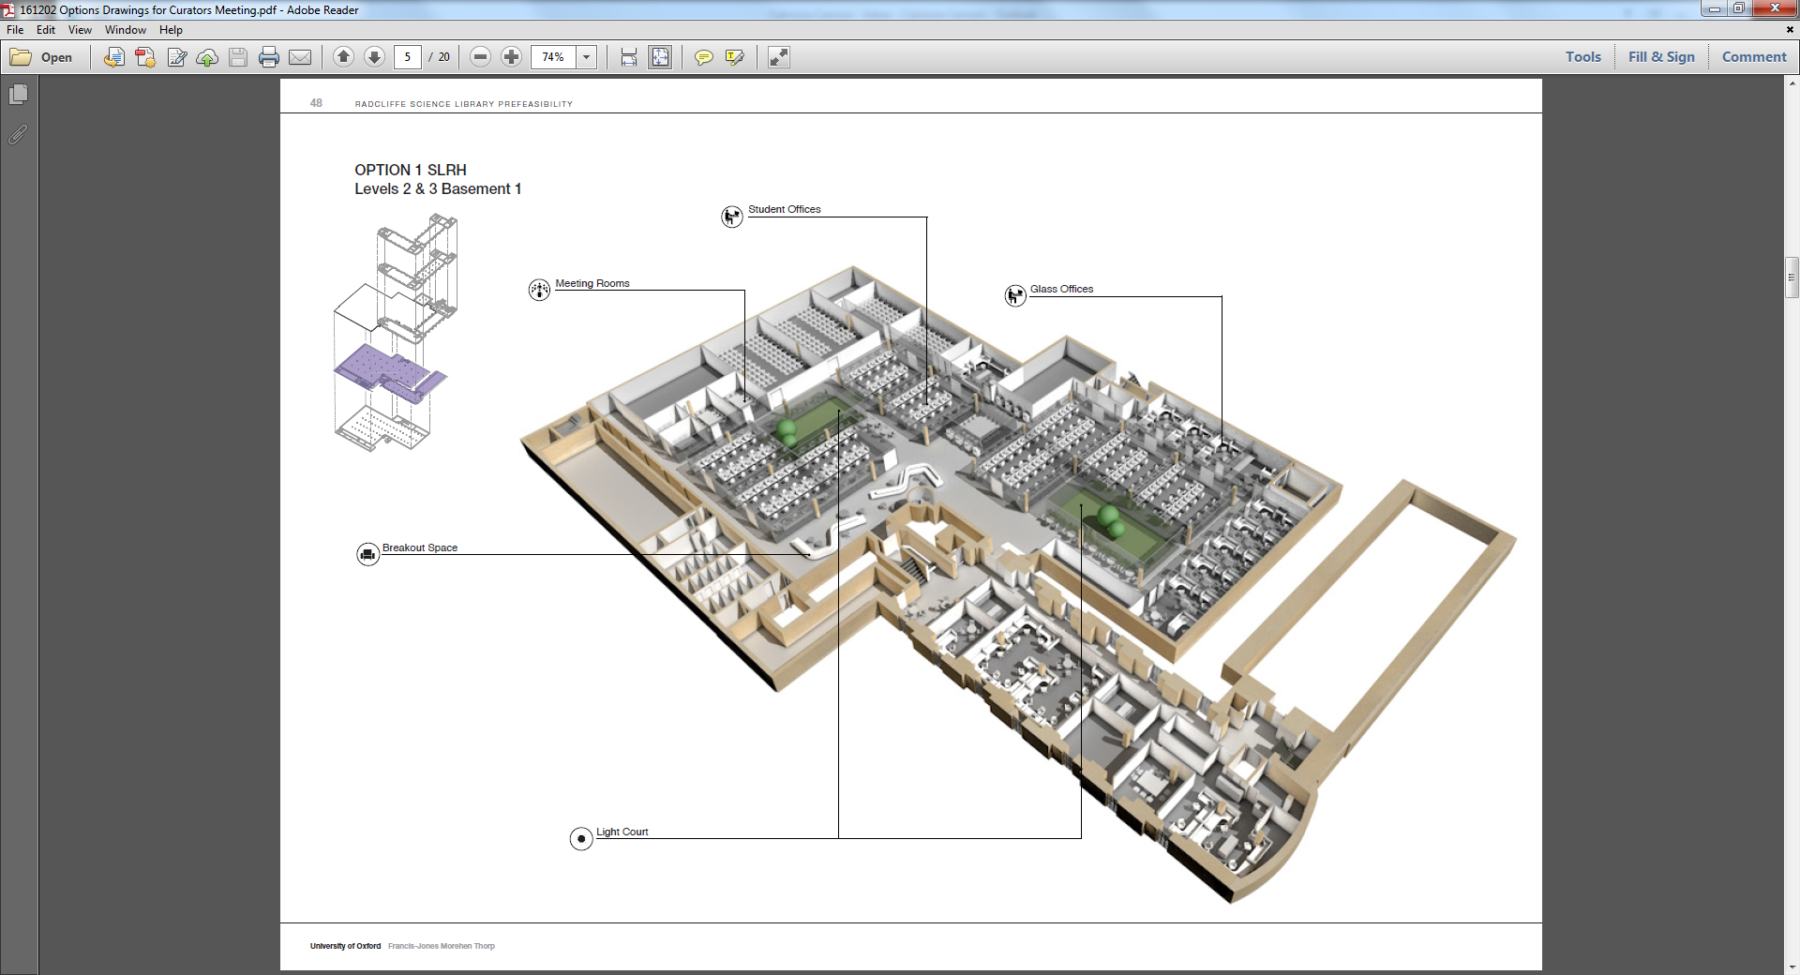

Slide 17
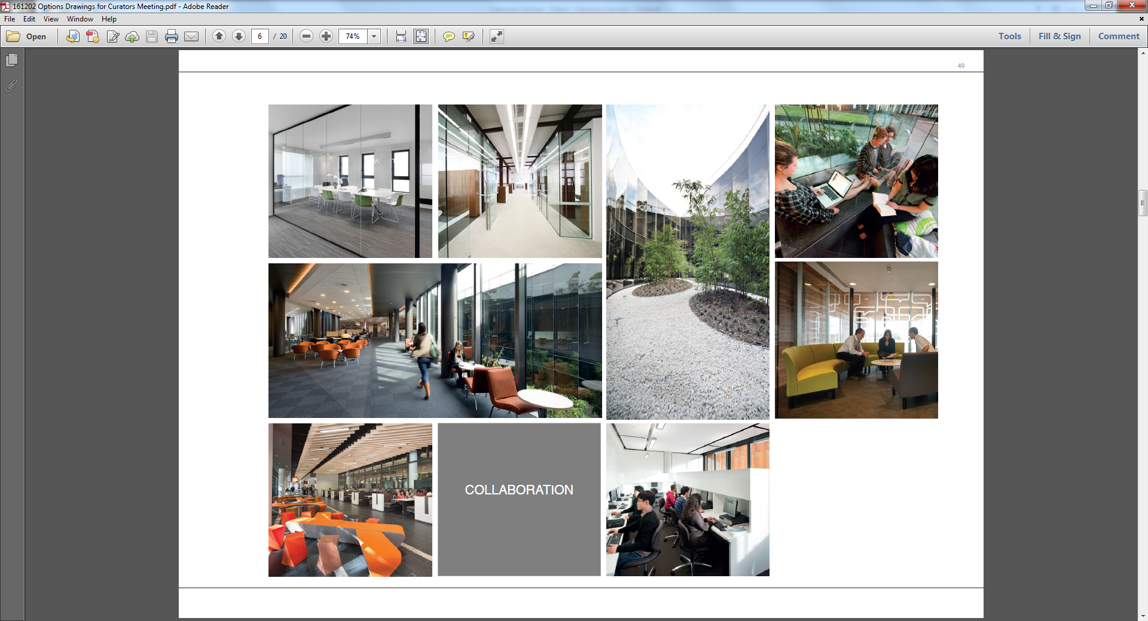

Slide 18
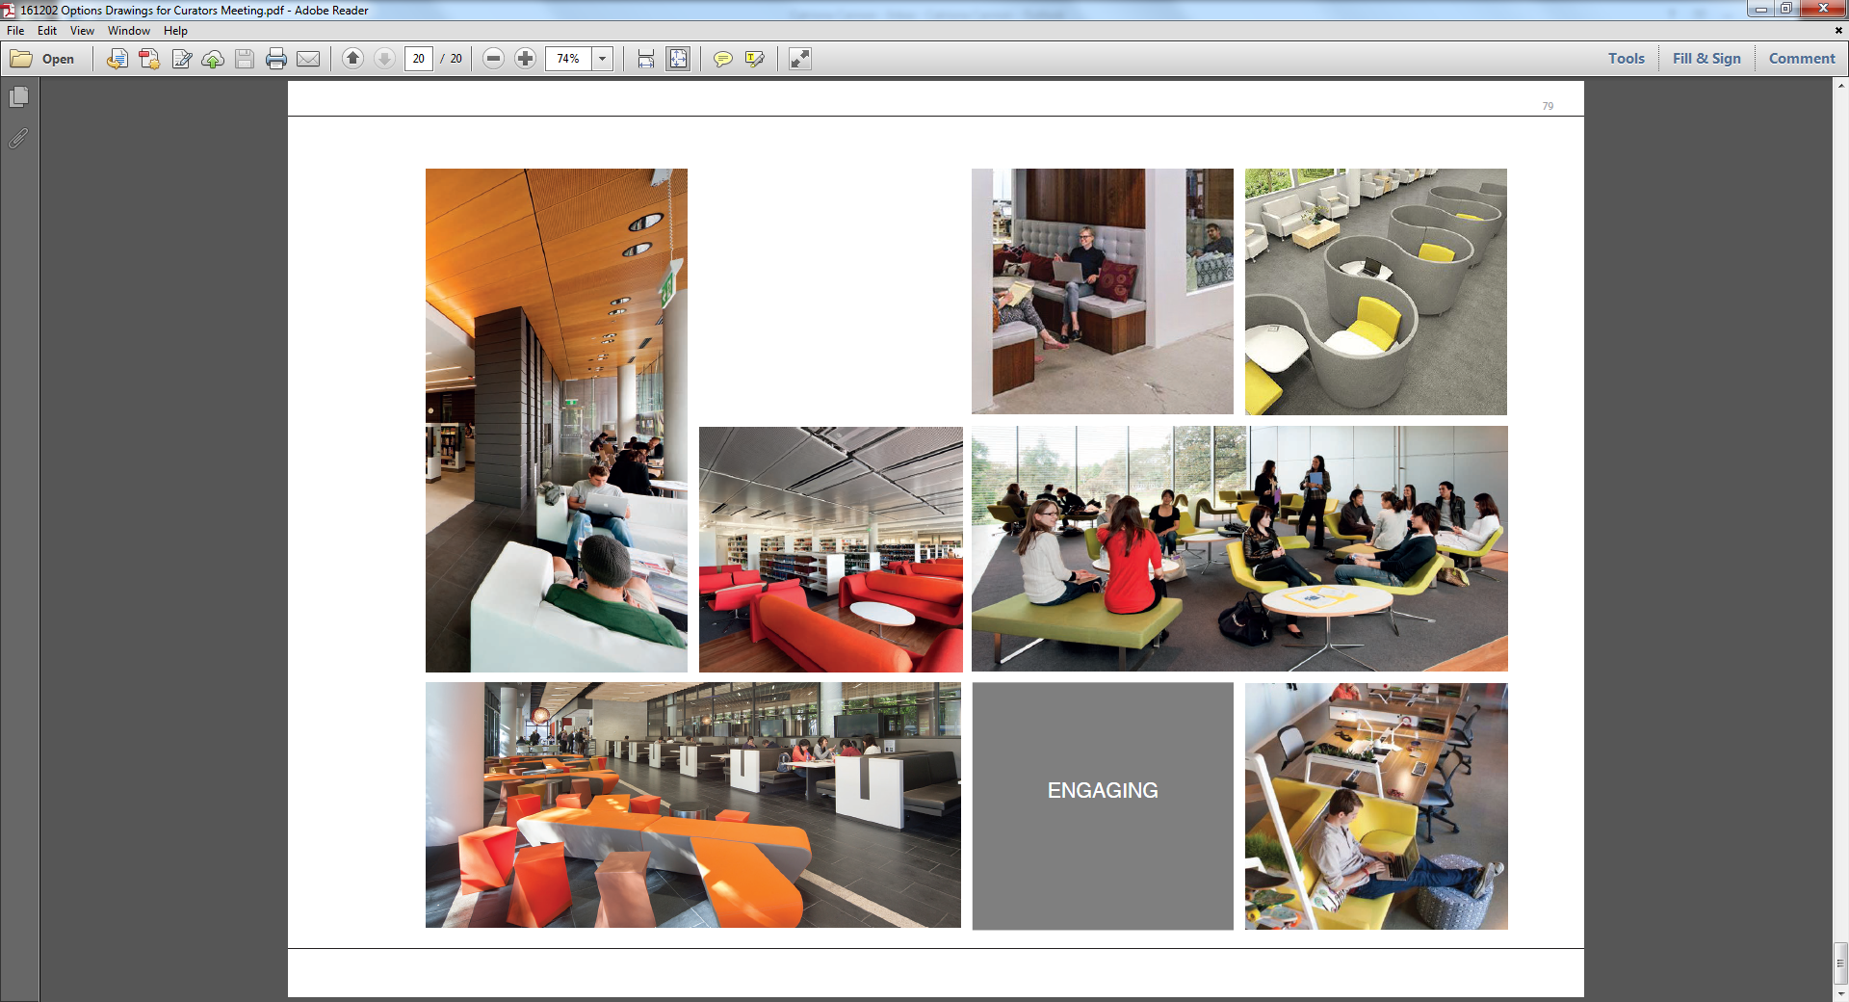

Slide 19
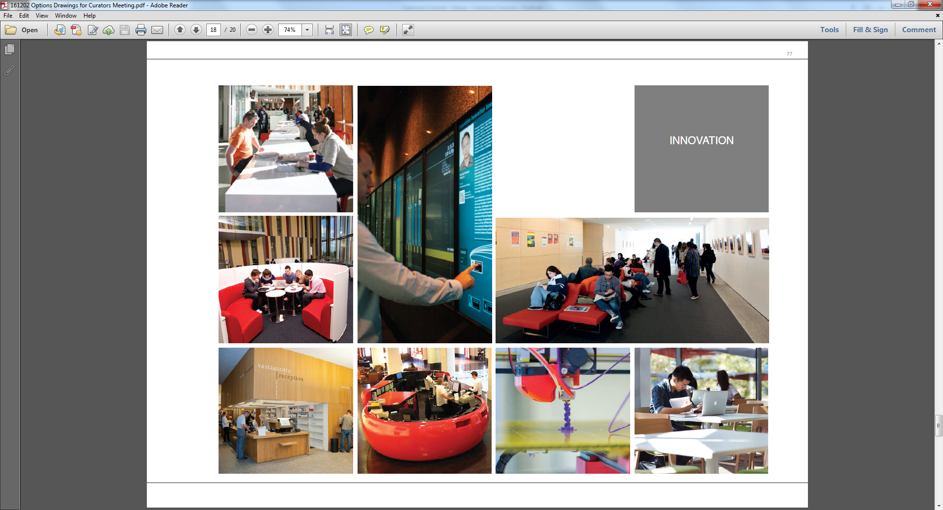

Slide 20
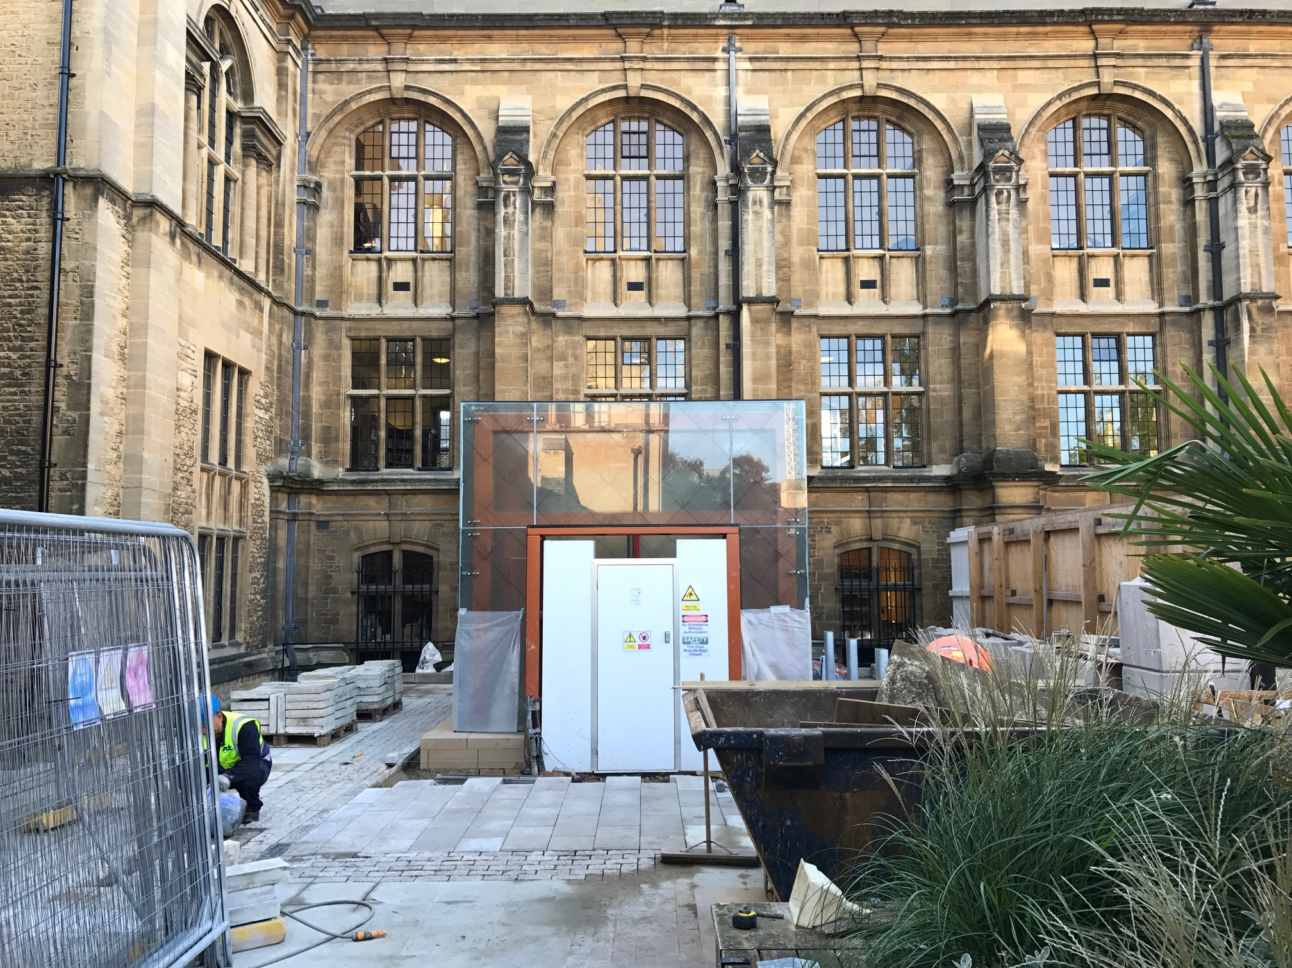

Slide 21
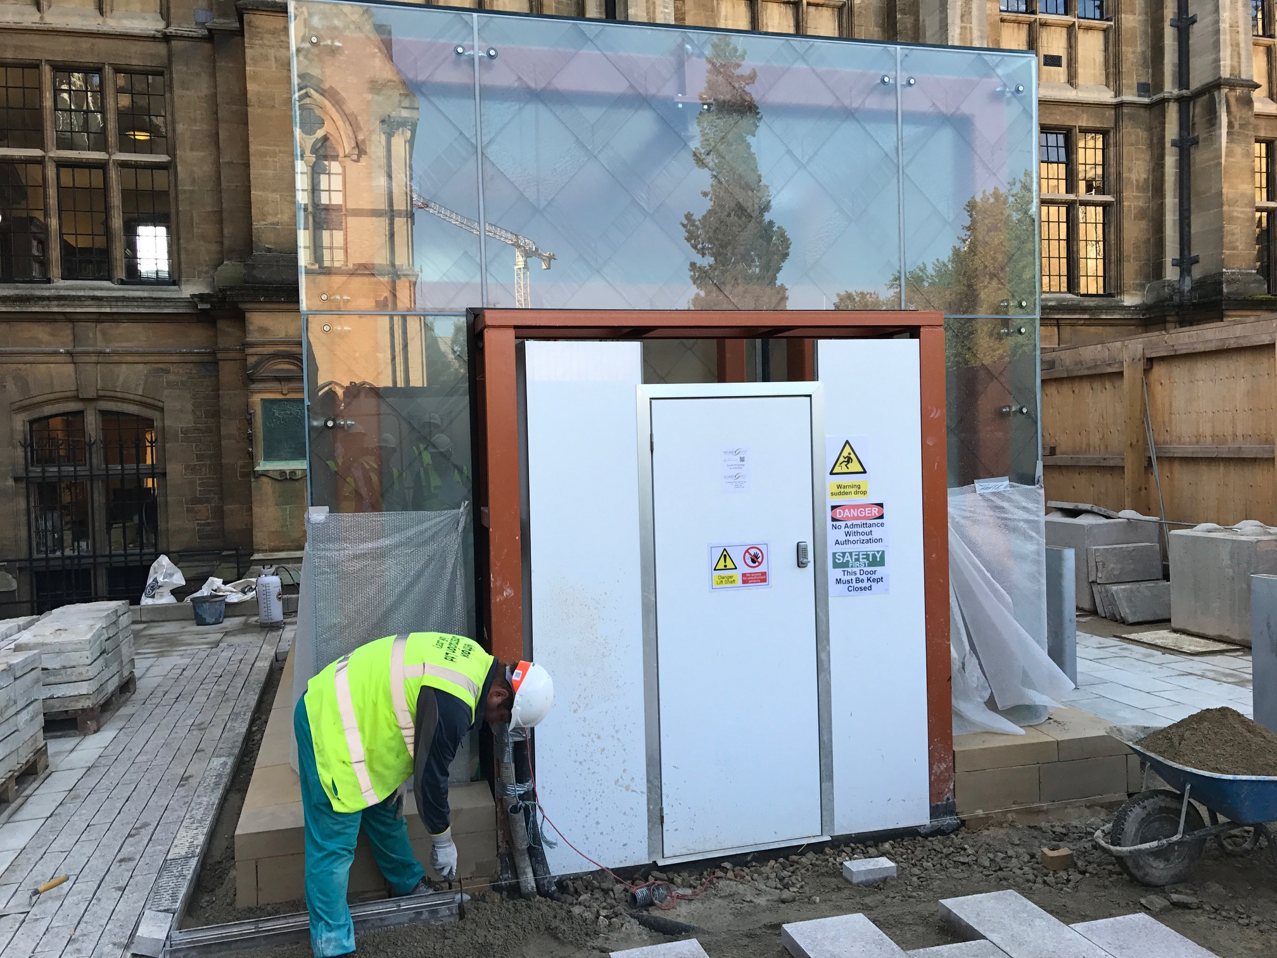

Slide 22
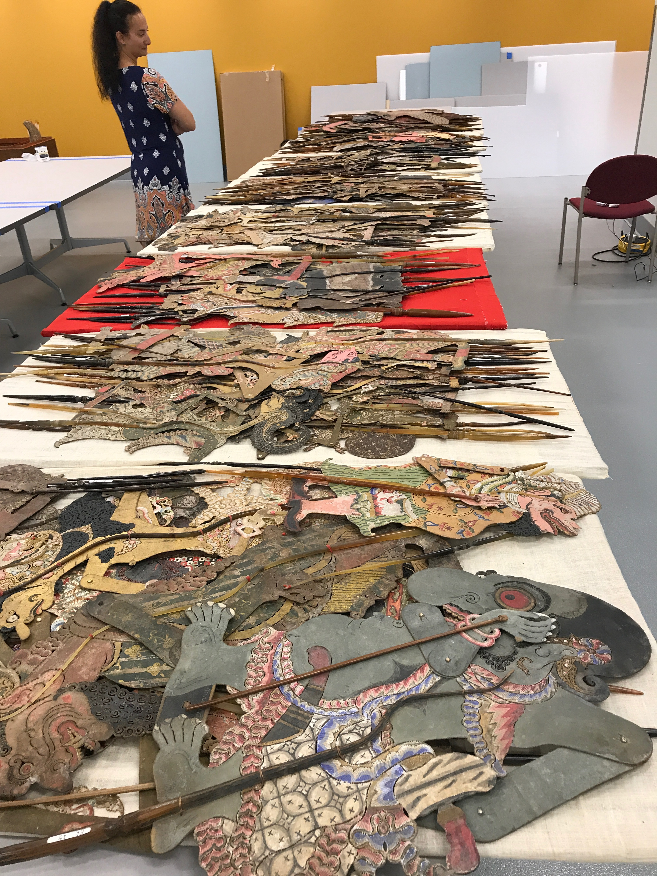

Slide 23
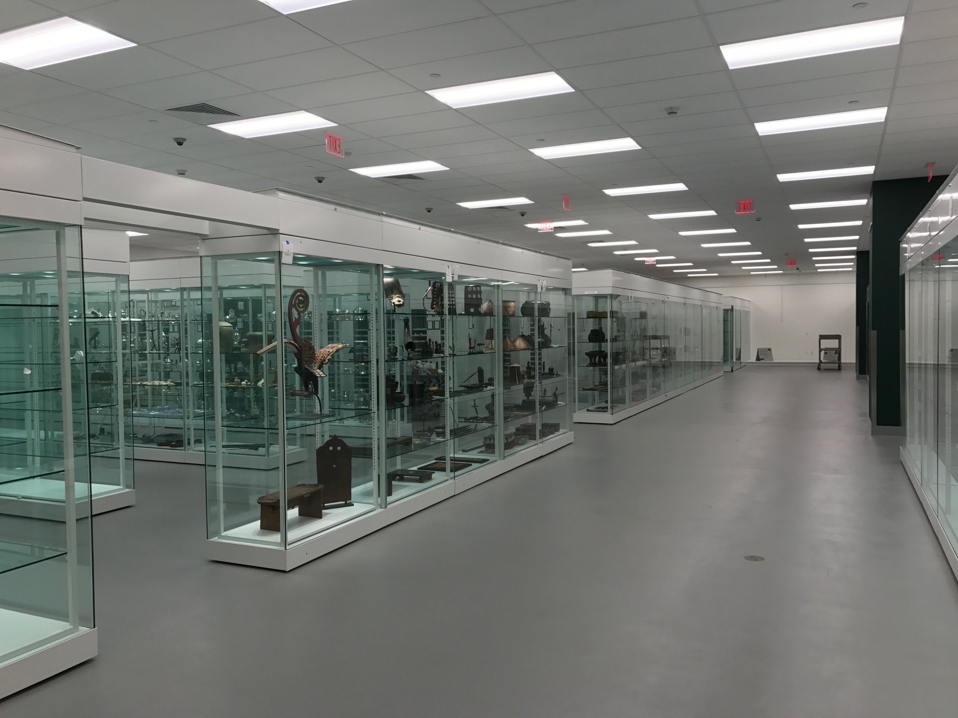

Slide 24
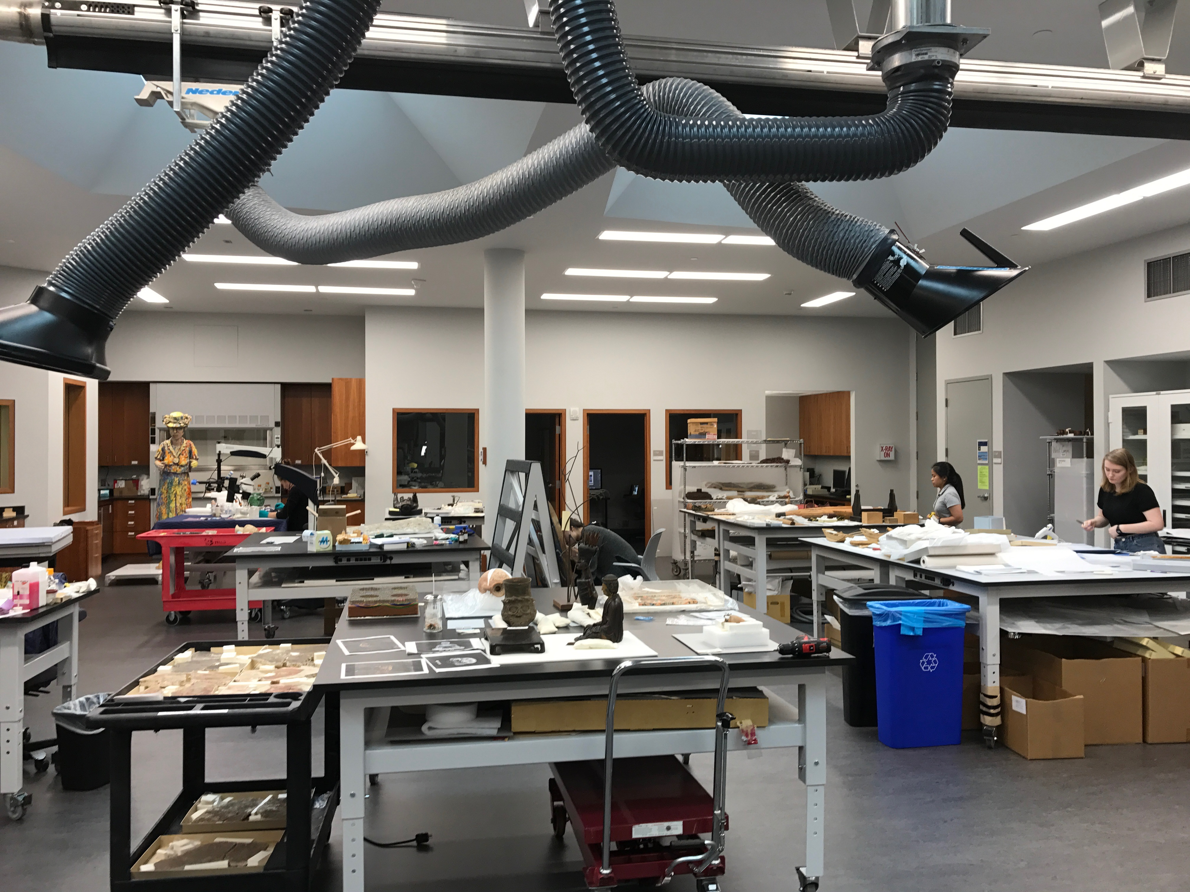

Slide 25
COLLECTIONS

Slide 26
The collections
Oxford University’s collections comprise:
13m Library printed books, 22km archives and manuscripts
8.5m museum objects
These collections are of global significance, representing the history, science, culture and knowledge of all major world civilisations
They are resources of cultural, intellectual and scientific material for research, scholarship and education in the broadest sense.

Slide 27
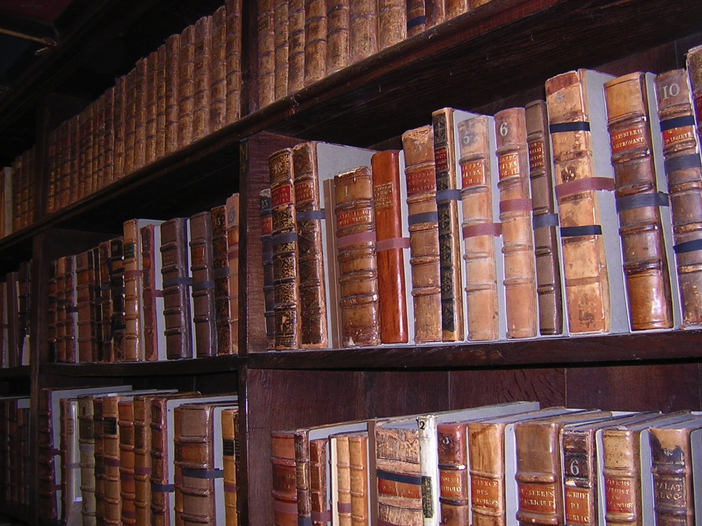
Notes:
The Bodleian, was founded in 1602 by an Elizabethan merchant and diplomat, Sir Thomas Bodley, who was also an Oxonian: Magdalen College, class of 1563, becoming a fellow of Merton the following year.
The Bodleian was a relatively small library when it was founded, with only 4,000 books in its collection, but it grew phenomenally from 1610, when Sir Thomas Bodley brokered an arrangement with a guild in London called the Company of Stationers, whose members held the monopoly on printing and publishing.
From 1610 the Bodleian received copies of all books printed and published by members of the company, free of charge, brought direct from Stationers Hall in London

Slide 28
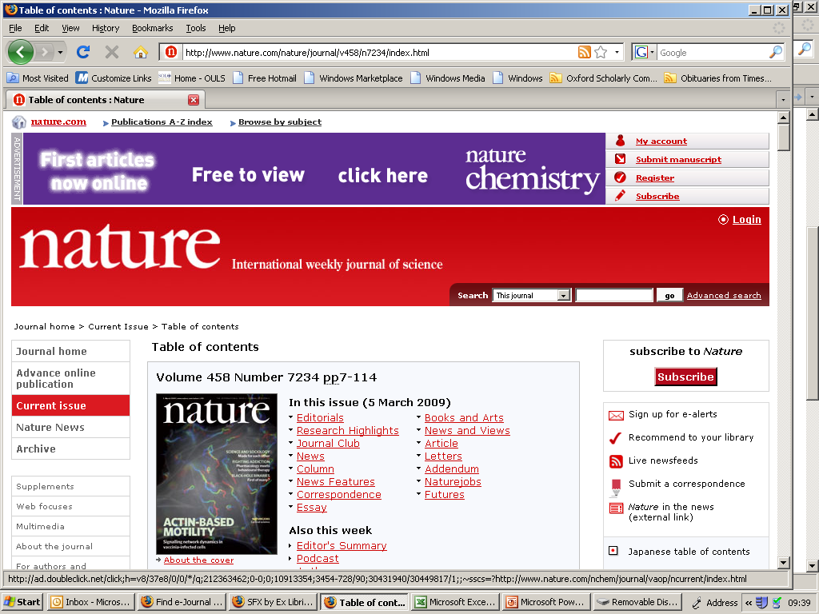

Slide 29
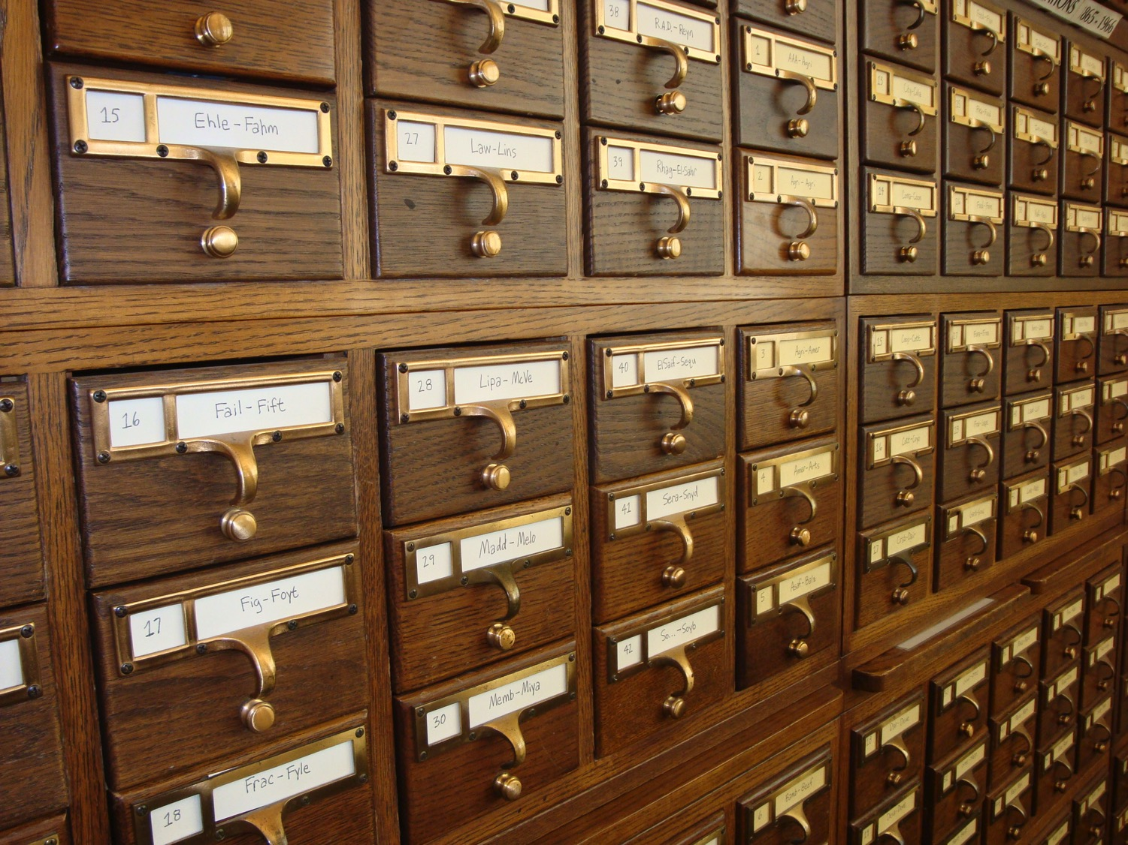
Notes:
Key elements are: converting manual catalogues and funding aids/ consolidating existing catalogues

Slide 31
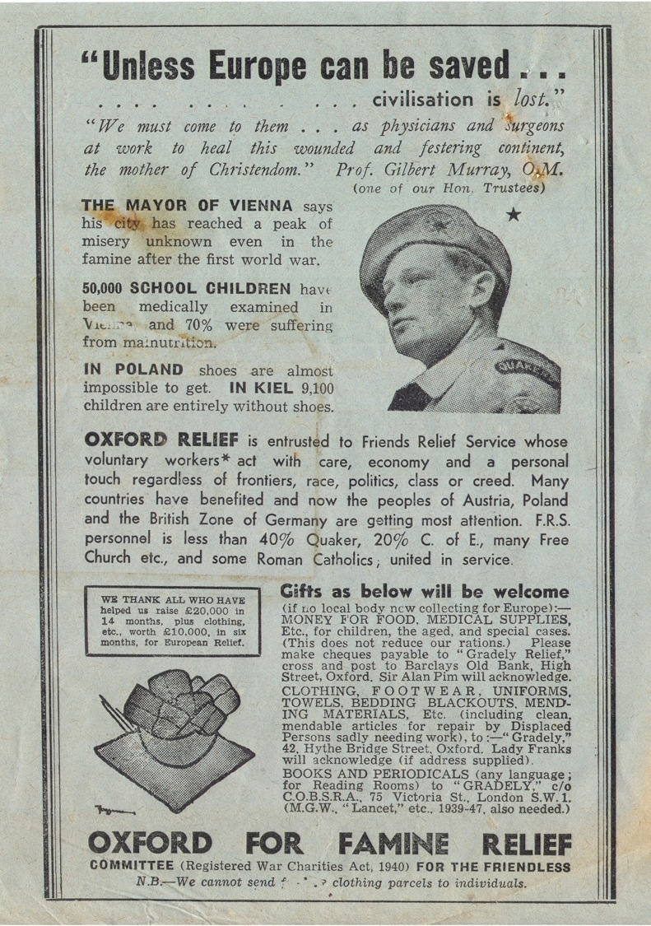
Notes:
New collections continue to be donated to Oxford – like the archive of Oxfam

Slide 32
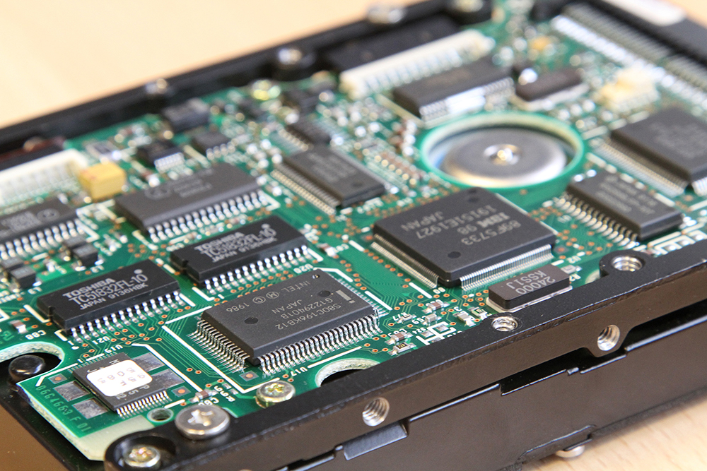

Slide 34
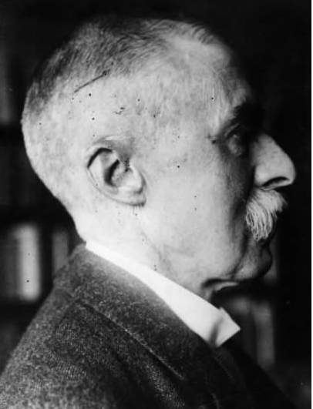

Slide 35
DIGITAL

Slide 36
GLAM Digital Strategy
Search &
Discovery
Research
Teaching
Digitisation
Develop infrastructure that enables effective digital scholarship, exploiting new digital and data—intensive methods
Develop services and tools to support teaching, making the full range of collections as accessible as text is currently
Transformation of collections metadata into digital form and provision or digital surrogates for unique collections
Provide hi-quality, user-friendly, mobile-enabled access to resources
Estate
Modern, expansive, scalable and robust infrastructure
Preservation
Ensure secure and safe storage and management of digital assets, ensuring integrity, authenticity and validation
Engagement
Offer meaningful digital curation, interpretation and services around the collections, providing access to a broad local, national and international audience

Slide 37
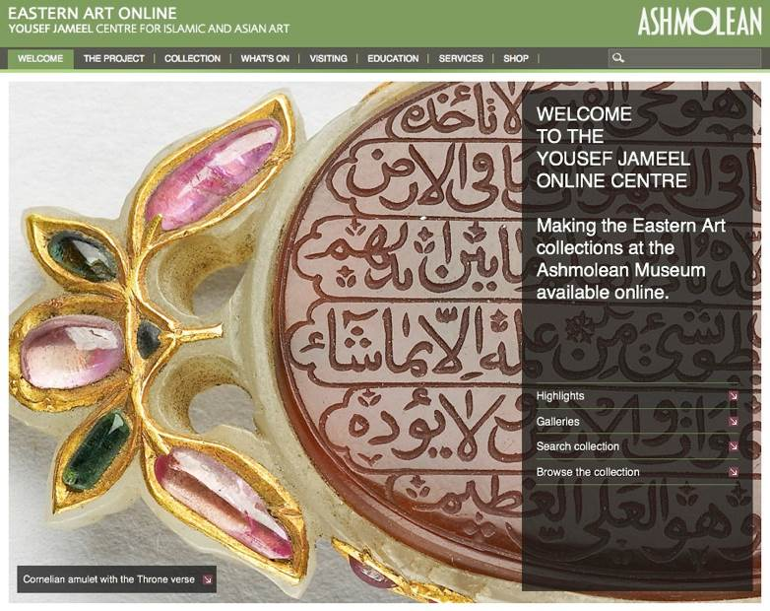
Notes:
High level of attainment already by GLAM institutions. Seek to build on this.

Slide 38
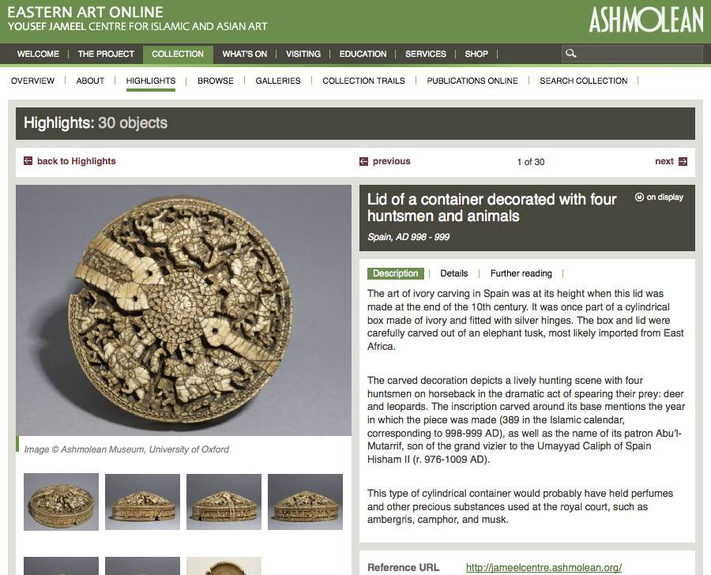

Slide 39
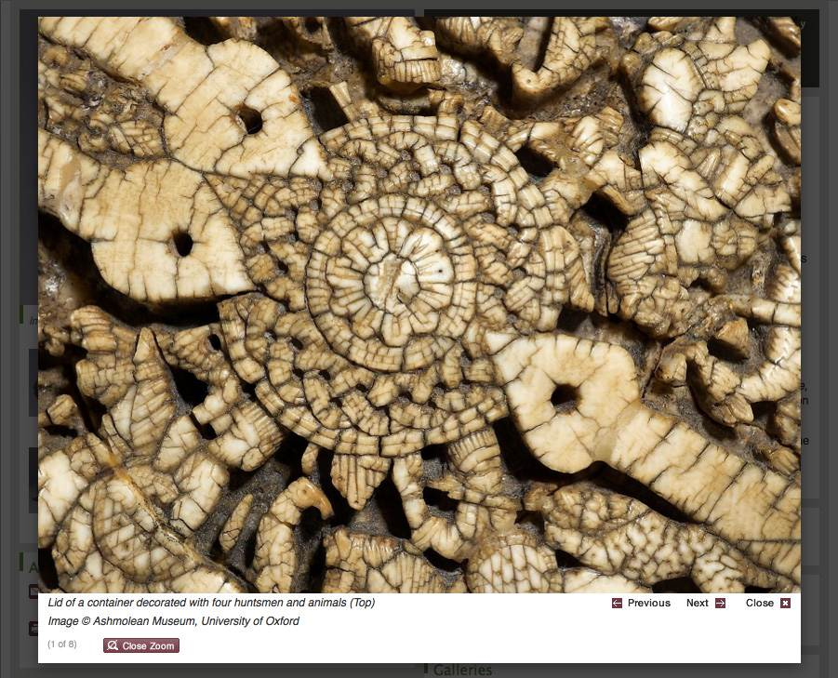

Slide 40
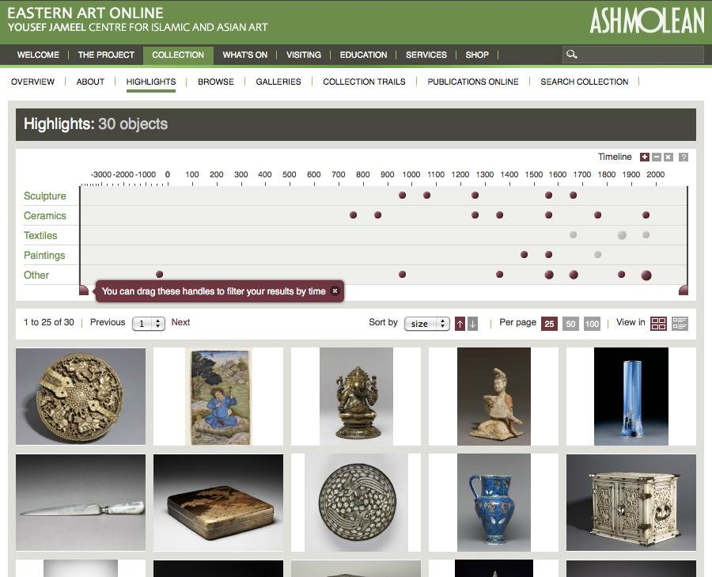

Slide 41
What are the issues which need to be addressed?
Complete the conversion of metadata into digital form
Institutions are at different levels of completeness for metadata
Mixture of conversion/editing and original cataloguing
Progress digitization of originals
Expose collections in resource discovery systems
Develop further programmes for engagement with researchers, students, and public

Slide 42
What are the issues that need to be addressed?
Keep resulting digital files in robust and resilient preservation infrastructure
Resource these activities adequately
Funding for capital improvement
Strategic project development
Increase / prioritise recurrent funding
Sustainability plan

Slide 45
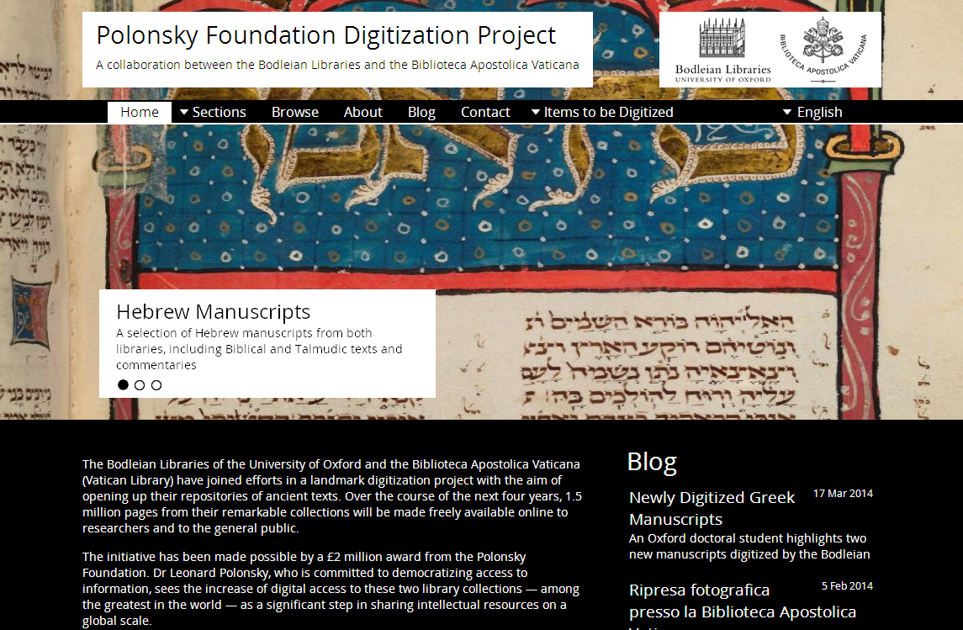
Notes:
We have been digitizing our collection as part of a global movement to share library and archival holdings with researchers of all ages and all stages. Our current prestige project is that with the Vatican Library, generously supported by the Polonsky Foundation

Slide 46
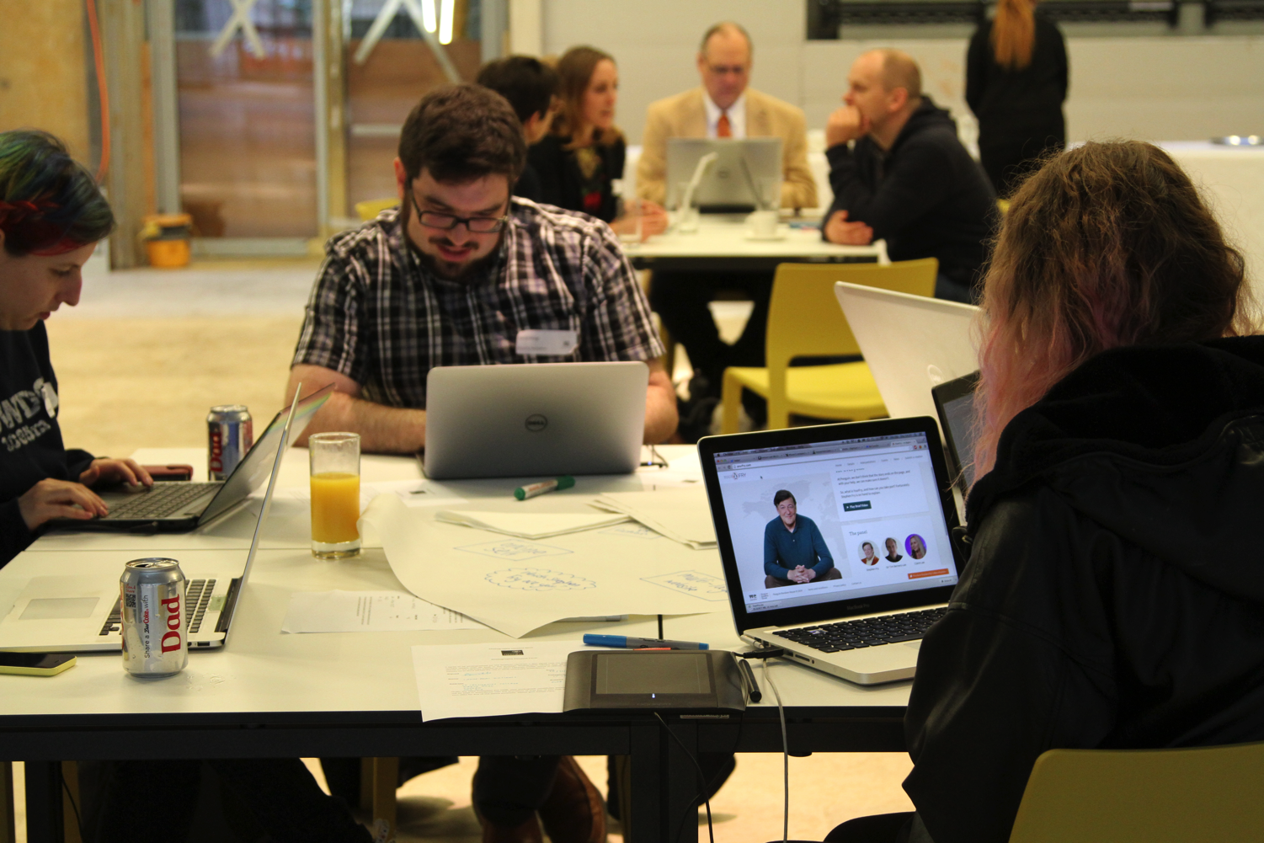

Slide 47
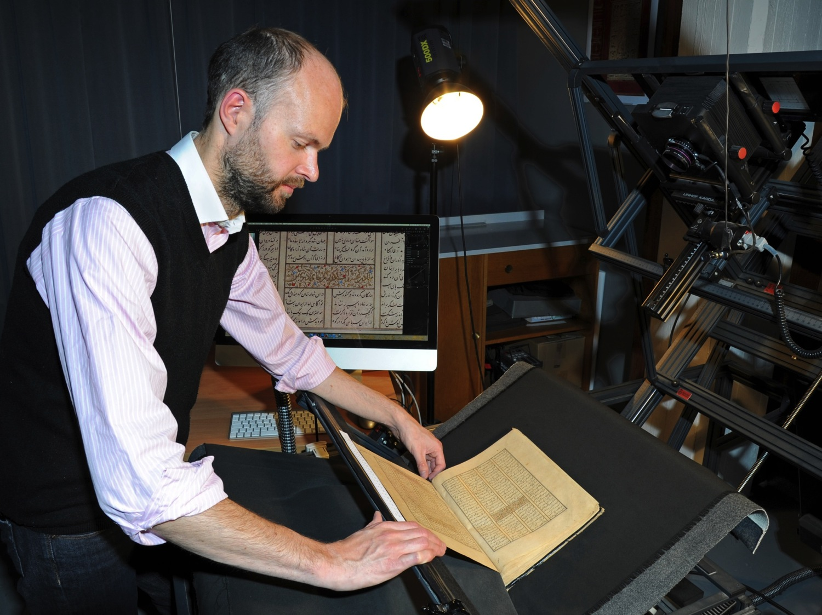
Notes:
Undertaking digitisation, and increasing capacity to do more than we currently can, and to foster across GLAM digitization plans

Slide 48
TEACHING

Slide 49
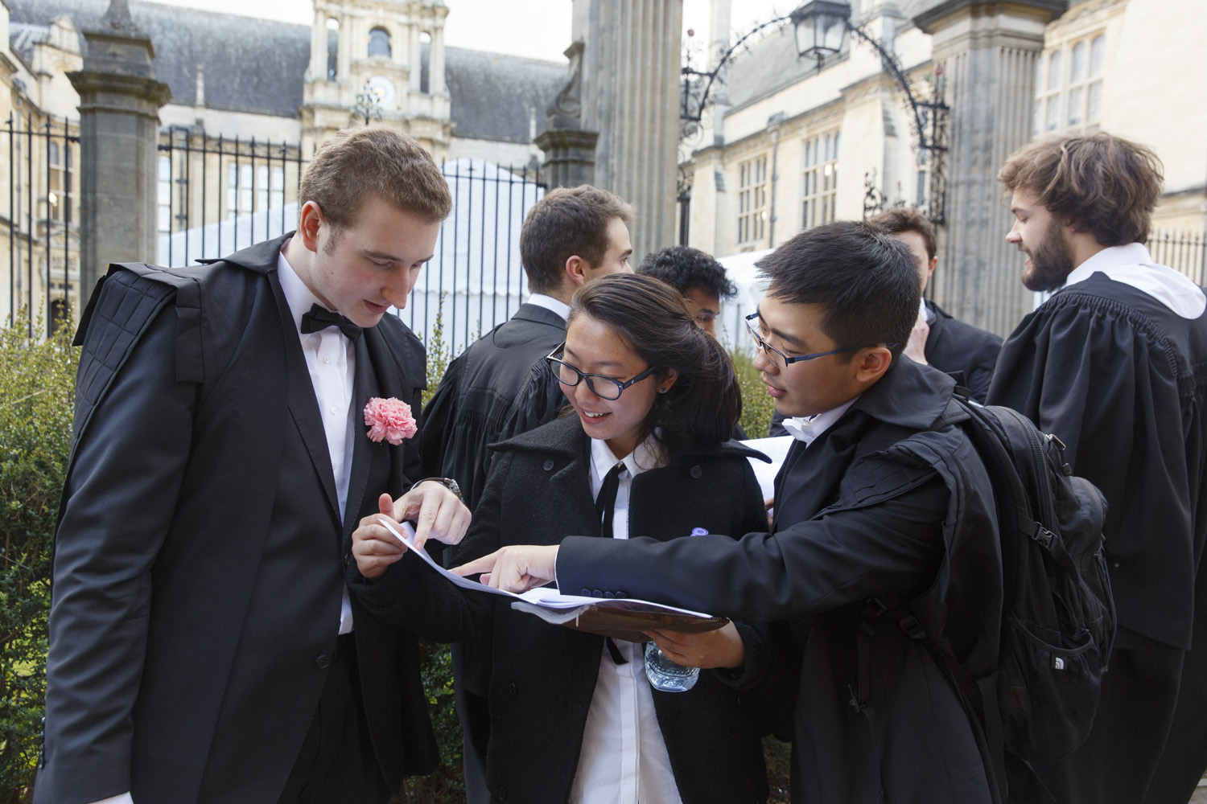

Slide 50
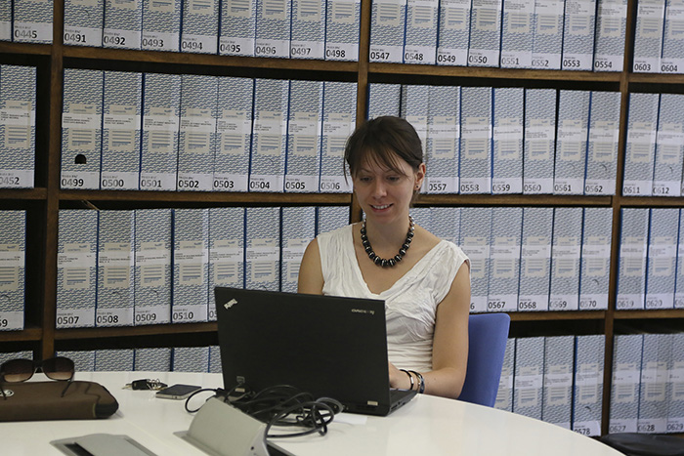

Slide 51
RESEARCH

Slide 52
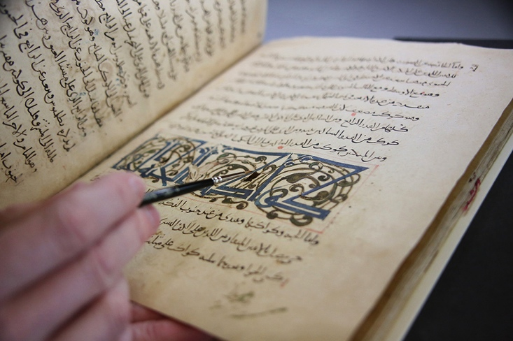

Slide 53
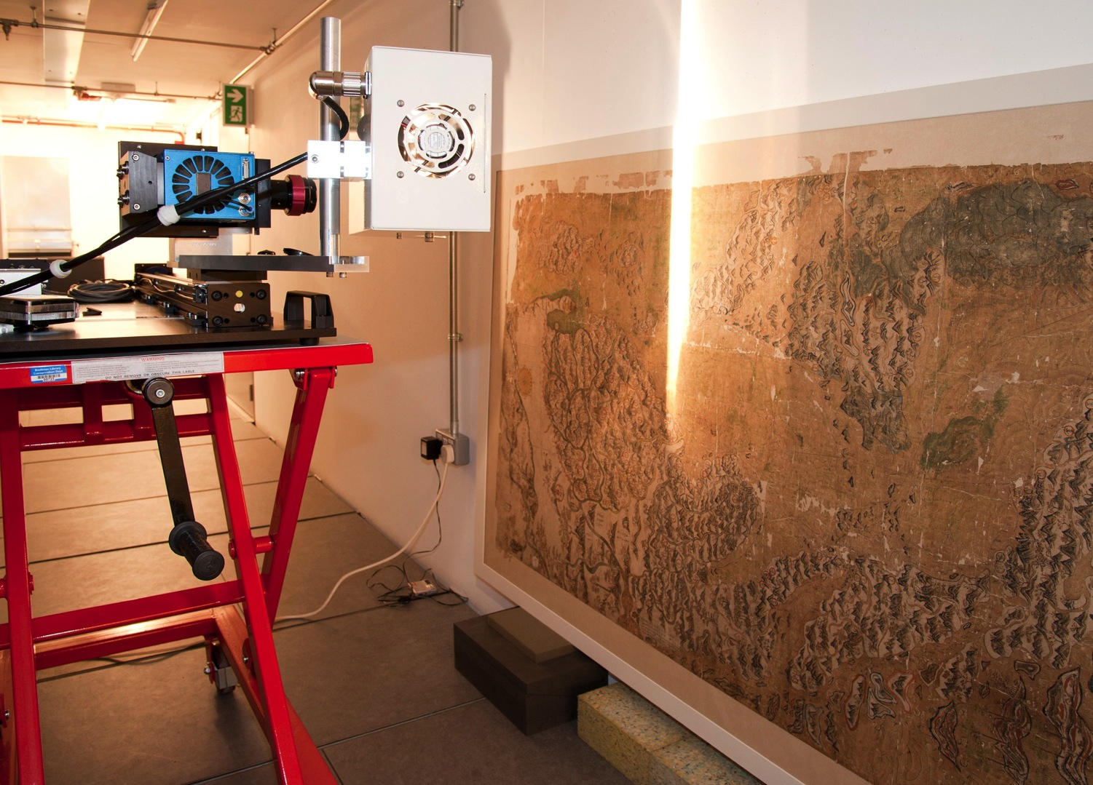
Notes:
This is the hyperspectral imaging equipment being used to scan the Gough map in the stack at Weston. A special rig was constructed to cope with the size and orientation of the map. In this conformation the sensor/camera moves and the object is stationary The stack was chosen because of the ideal lighting and environmental conditions.

Slide 54
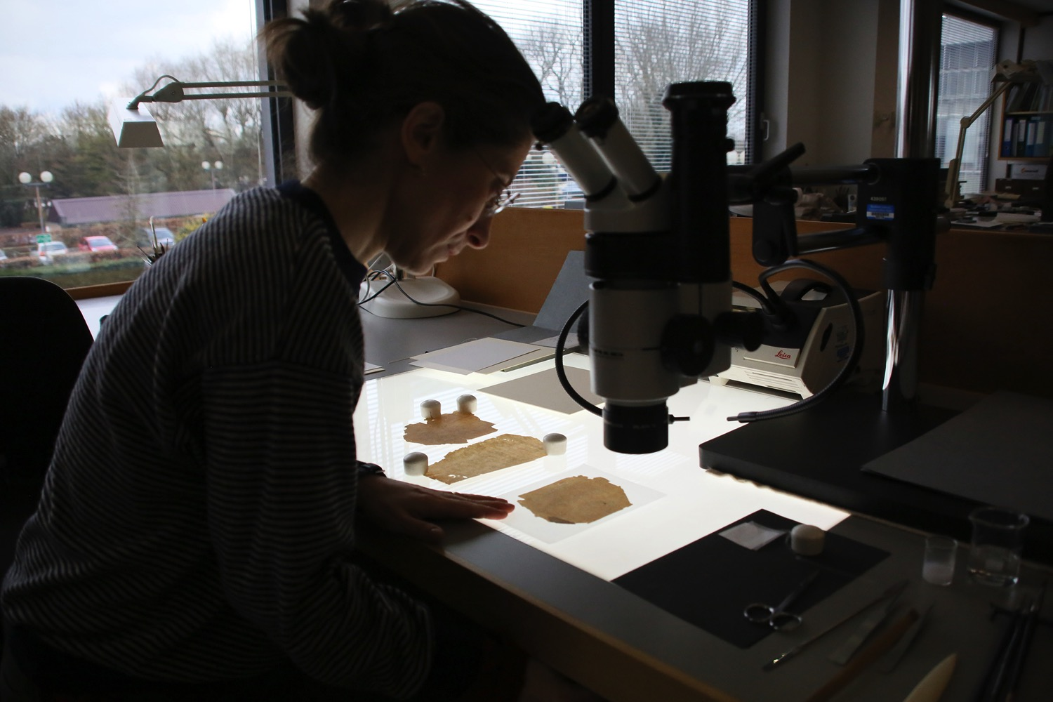

Slide 55
Public Engagement

Slide 56
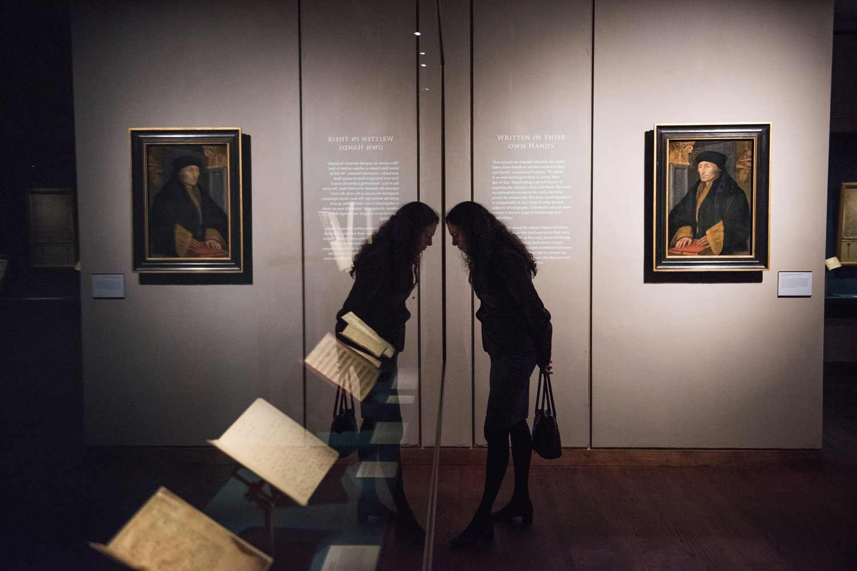

Slide 57
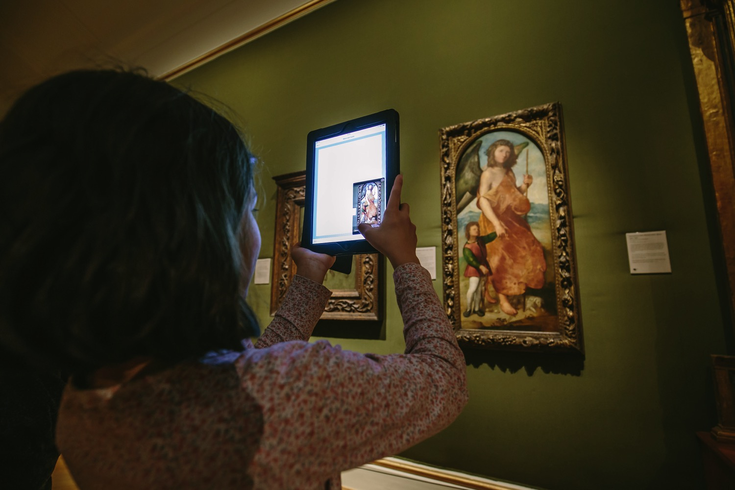

Slide 58
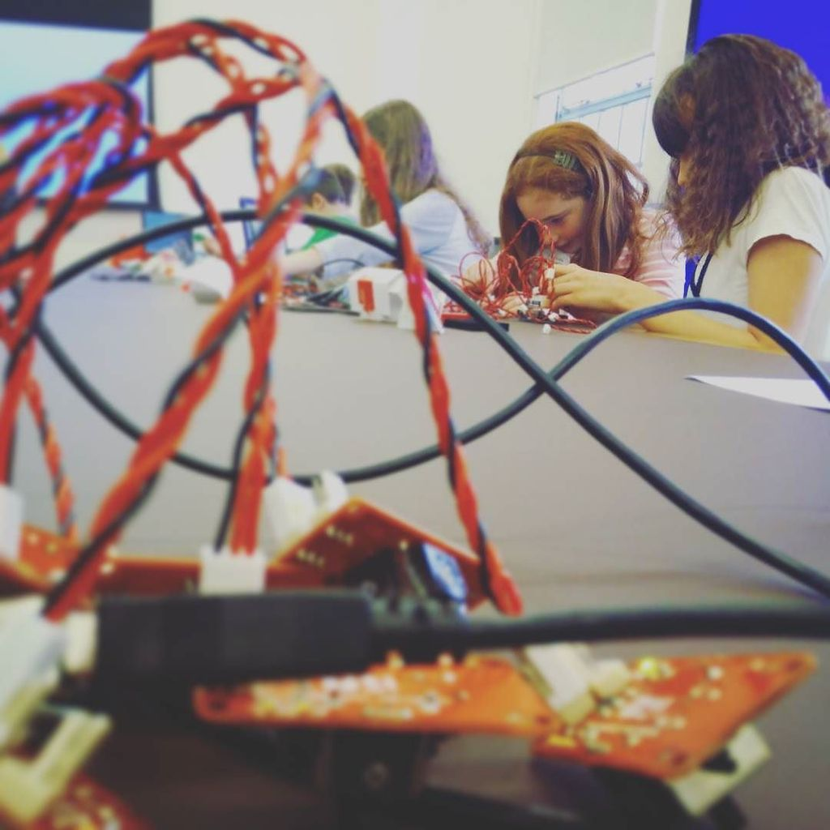

Slide 59
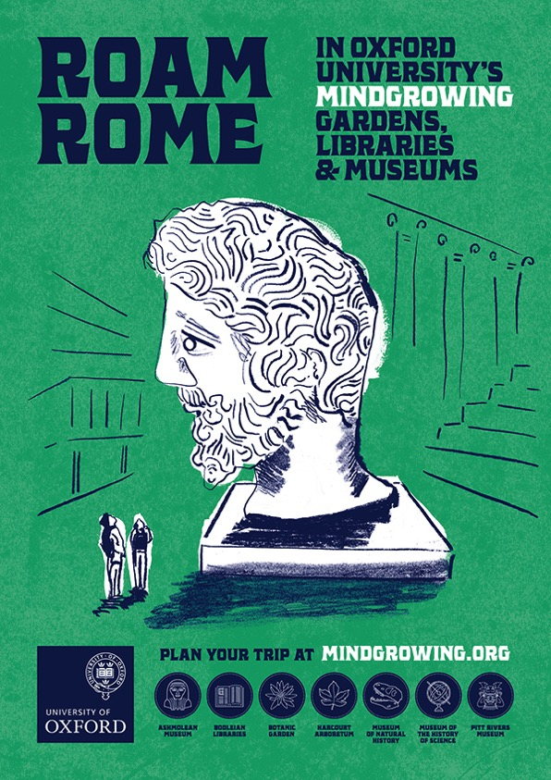

Slide 60
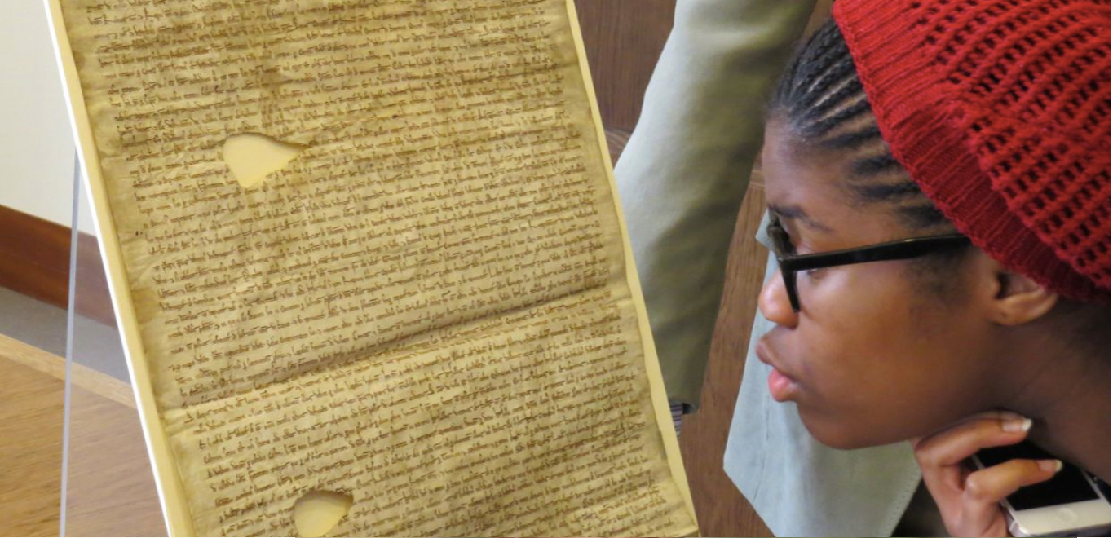

Slide 61
Next?

Slide 63
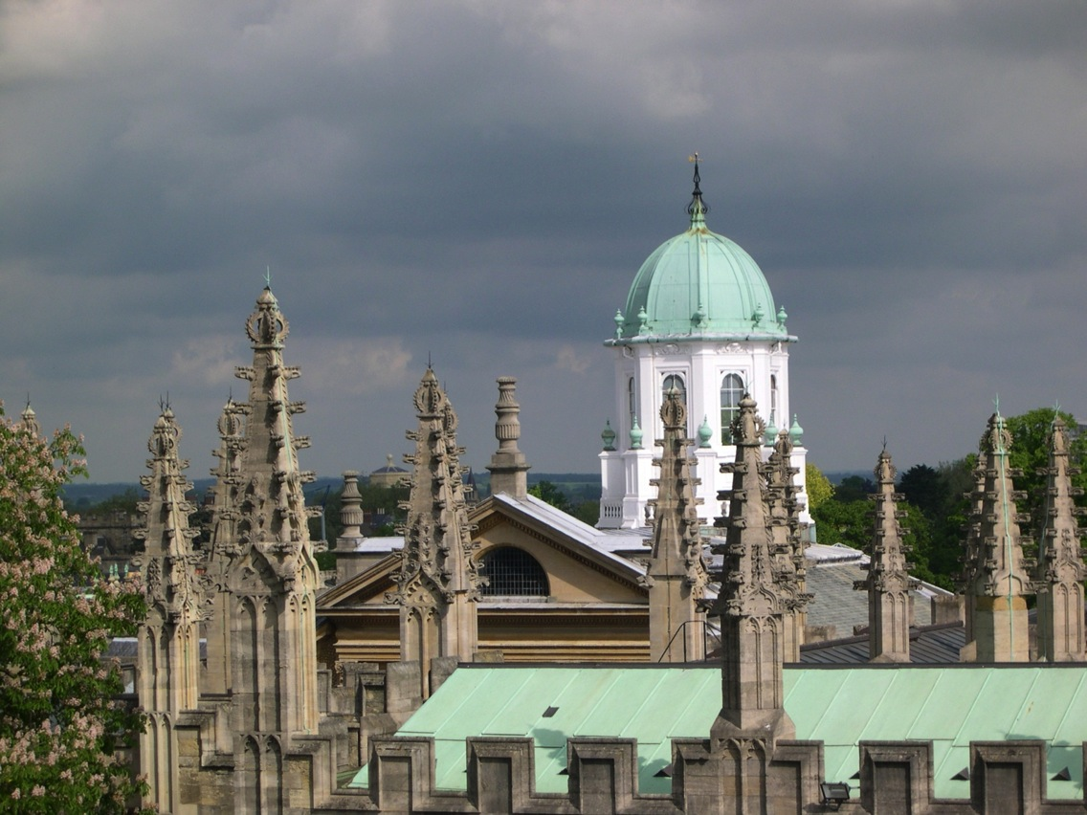
Richard Ovenden
Bodley’s Librarian
@richove
richard.ovenden@bodleian.ox.ac.uk
+44 1865 277158

