Slide 1
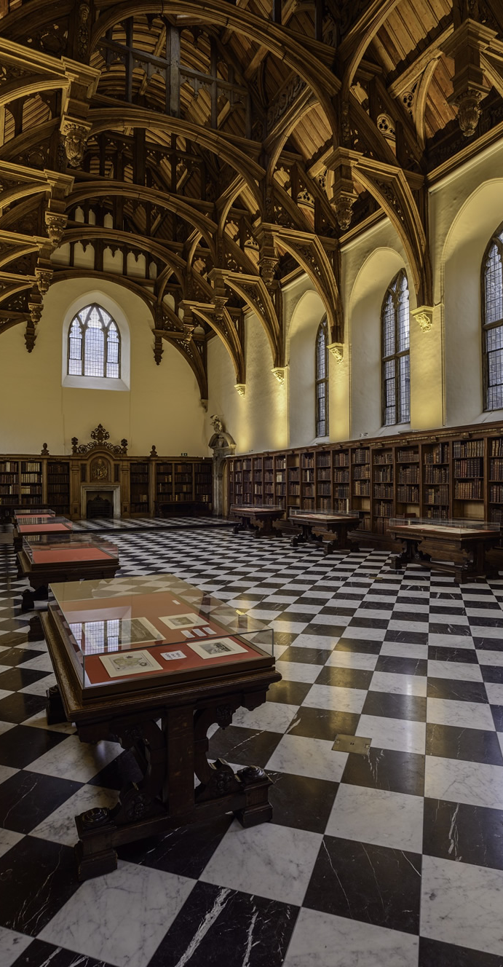
Cataloguing the incunabula collection of Lambeth Palace Library in the Material Evidence in Incunabula (MEI) database, 2014/15 and later projects
Angéline Rais, Post-doctoral Research Fellow
Institute of English Studies, School of Advanced Study, University of London

Slide 2
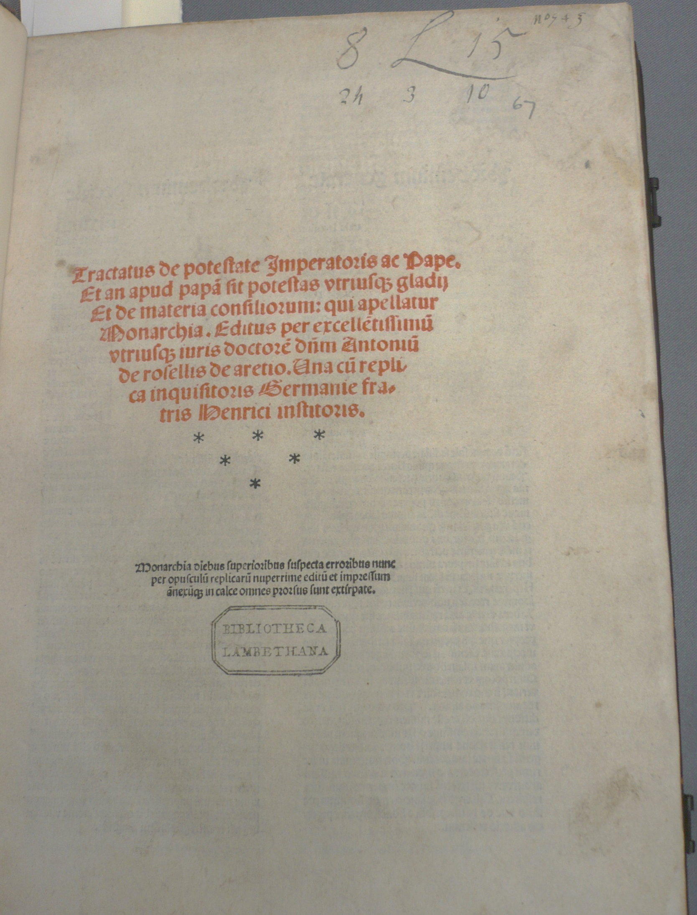
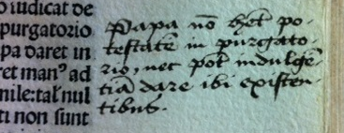
Antonius de Rosellis, Monarchia, sive De potestate Imperatoris ac Papae (Venice: Hermannus Liechtenstein, 23 June 1487) bound with Henricus Institoris, In errores Monarchiae Antonii de Rosellis (Venice: Jacobus Pentius, de Leuco, for Peter Liechtenstein, 27 July 1499) London, Lambeth Palace Library, [ZZ] 1487.3.01 and 02. ISTC ir00327000 and ii00161000. MEI 02010078 and 02010079

Slide 3
Augustinus de Ancona, Summa de potestate ecclesiastica (Augsburg: [Johann Schüssler], 6 March 1473) London, Lambeth Palace Library, [ZZ] 1473.1. ISTC ia01363000. MEI 02010132

Slide 4
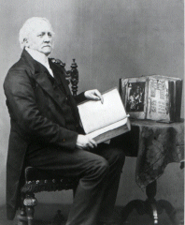
The trade in rare books in Switzerland in the first half of the nineteenth century: Sir Thomas Phillipps’s purchases and their dispersal

Slide 5
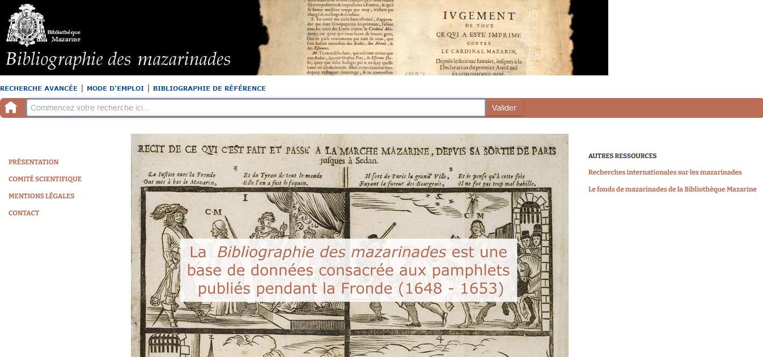
Bibliographie des mazarinades Paris, Bibliothèque Mazarine https://mazarinades.bibliotheque-mazarine.fr/

Slide 6
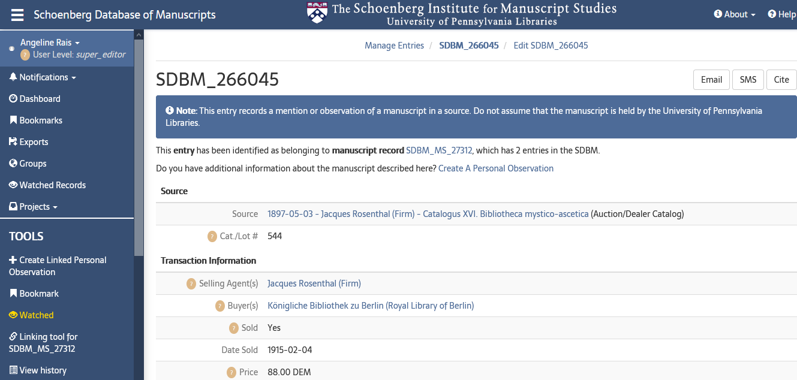
CULTIVATE MSS Project: Cultural Values and the International Trade in Medieval European Manuscripts, c. 1900-1945 IES, SAS, University of London https://www.ies.sas.ac.uk/research-projects-archives/cultivate-mss-project
Schoenberg Database of Manuscripts The Schoenberg Institute for Manuscript Studies, University of Pennsylvania Libraries https://sdbm.library.upenn.edu/

