Slide 1
The creation of a Digital Humanities Forum at Uppsala University
Per Cullhed
Uppsala University Library

Slide 2
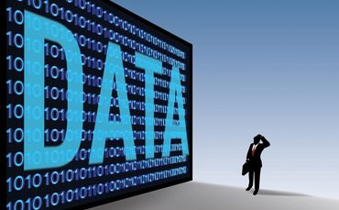
Salt of the digital earth
Data is discoverability

Slide 3
Requirements for DH
www.alvin-portal.org
Uppsala University Library in
collaboration
with the university libraries
in Lund and Göteborg, Linköping City Library,
and others
Digital
repository
One shared repository for
Archives, images, maps, manuscripts, books,
objects, sound, music, video, software and misc.

Slide 4
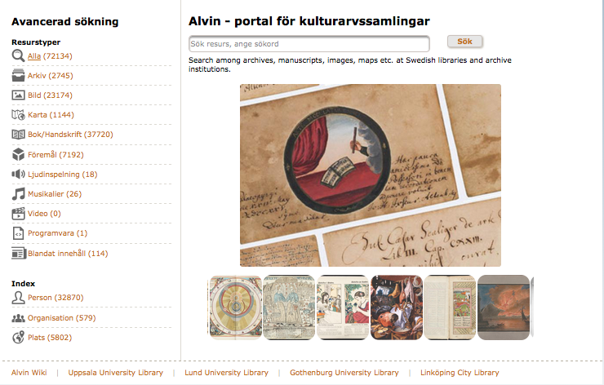
Alvin repository
June 2016
72134 records and growing…
December 2014
2541 archival records and no images
Linking, downloading, API…

Slide 5
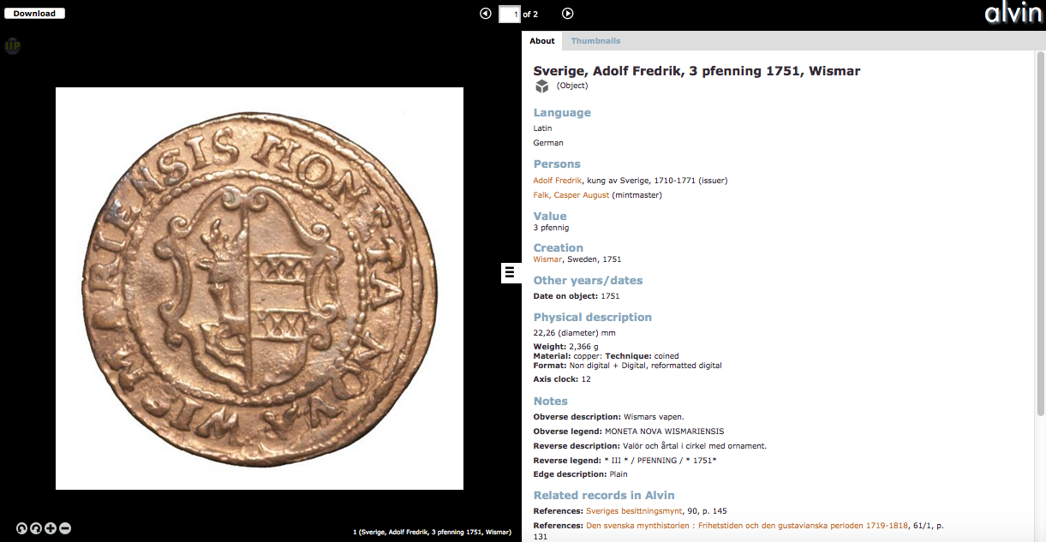
Objects…

Slide 6
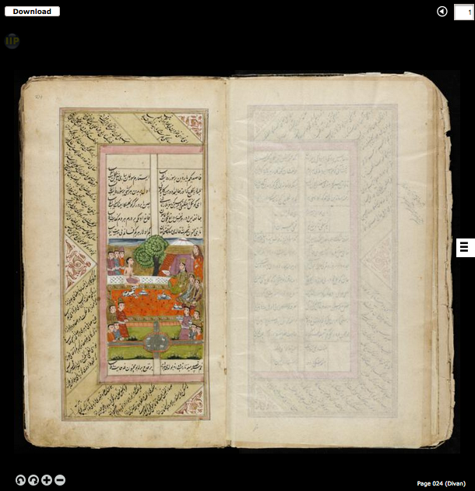
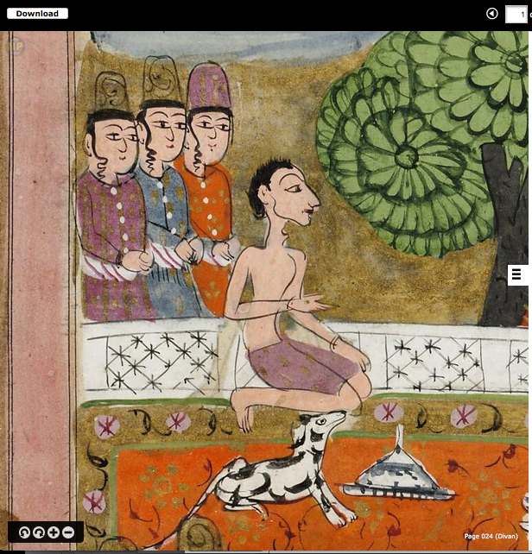
…to manuscripts

Slide 7
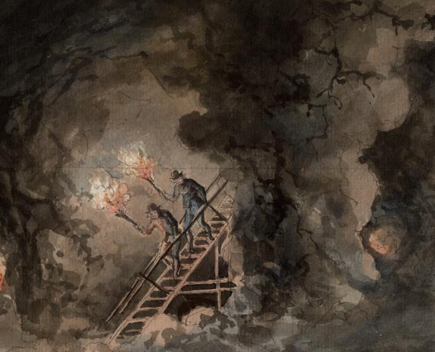
Uppsala university was founded in 1477
Lund University was founded in 1666
etc.
Collections
We are entering a gold mine
of collections!

Slide 8
Obstacles
•Digitization needs investments for increased production
•Mass digitization
•Co-funding is an available option for Open Access digitization
•Transcription
•Metadata challenge
Digitization

Slide 9
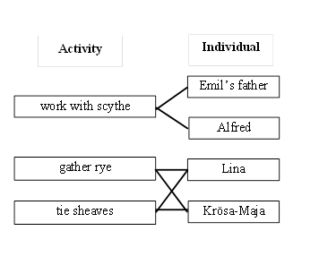
Text analysis – Gender and Work
GaW at the Department of History
Digital
humanists
Tools

Slide 10
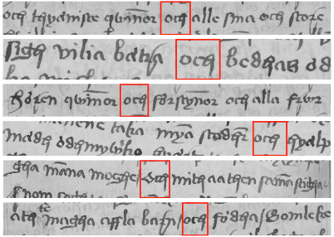
Department of Information Technology
Digital
humanists
Word-spotting for
och (and)

Slide 11
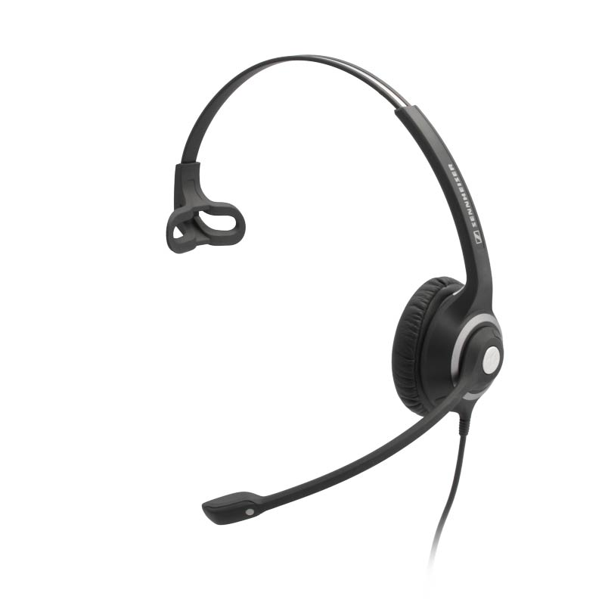
Text- related
HTR
Text-mining etc
Visualization
Contextualized web-presentations
Transcription
Crowdsourcing
OCR
Dictation software
Etc….
Tools

Slide 12
I’m sorry Dave,
I’m afraid I can’t do that
1968
2016 Siri

Slide 13
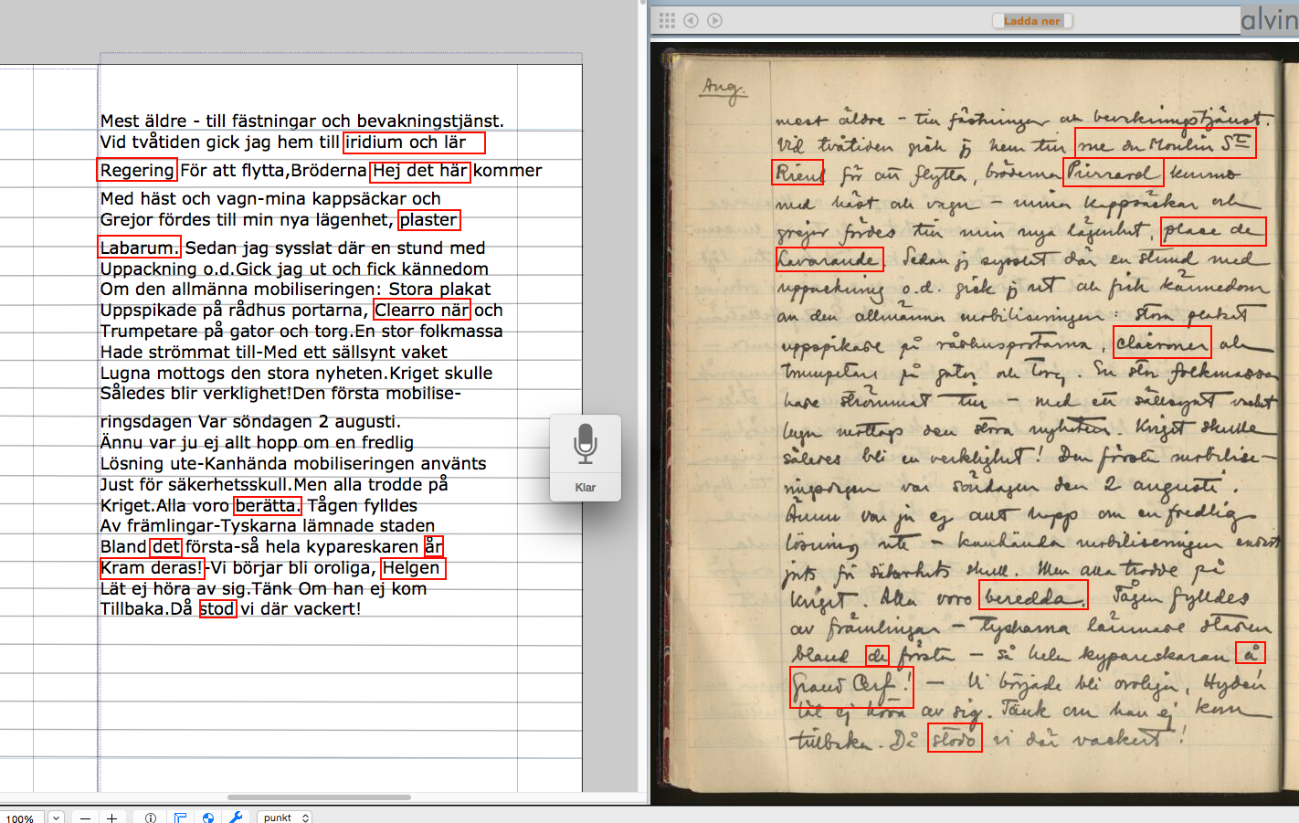
Dictation result – one page

Slide 14
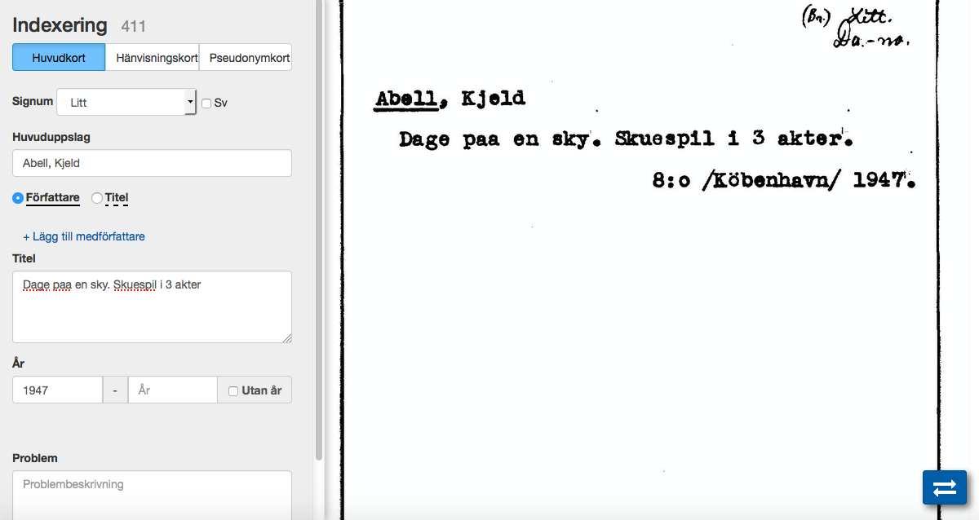
Crowdsourcing tool for the transcription of catalogue cards

Slide 15
2016 - Forum for Digital Humanities
Tools
Collections
Digital
repository
Digital
humanists
Digitization
Digital
library

Slide 16
Challenges
•A production- oriented publishing organization
•A tools- oriented organization
•A ”little help from my friends”- oriented organization
•A data-oriented organization
•A marketing- oriented organization
Digital
library

