Slide 1
How are archival services in Scottish research libraries meeting the challenge of digital archives?
John MacColl, University Librarian & Director of Library Services, University of St Andrews
LIBER Forum for Digital Cultural Heritage
Patras, 5 July 2017

Slide 2
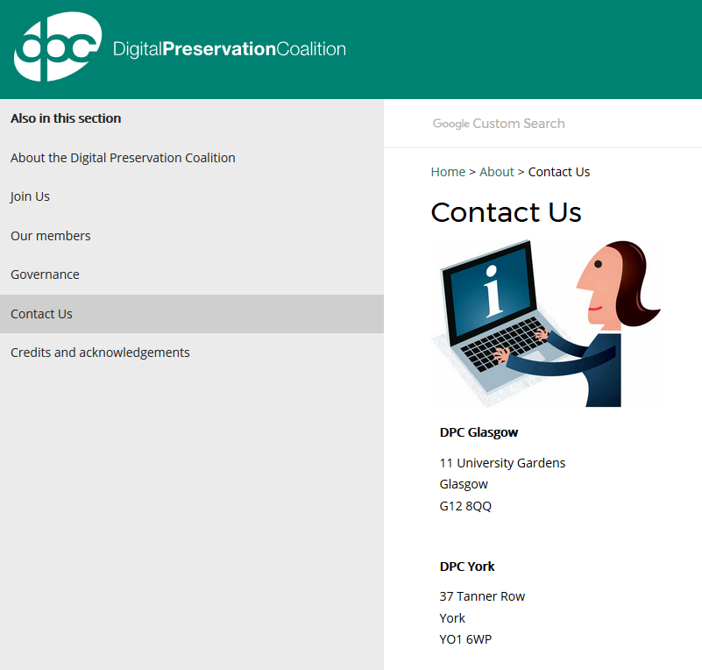
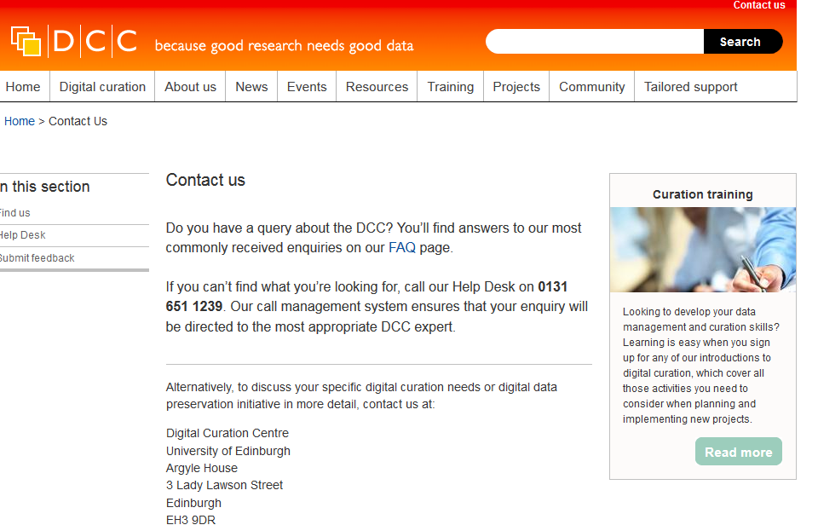
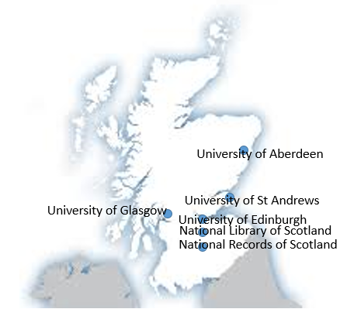
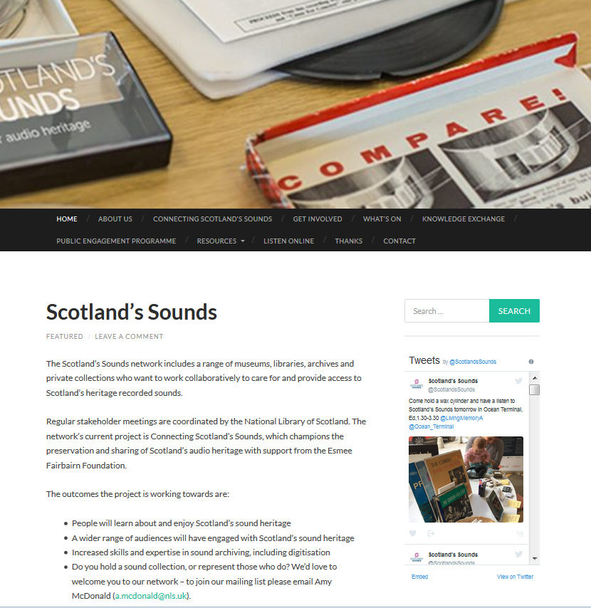
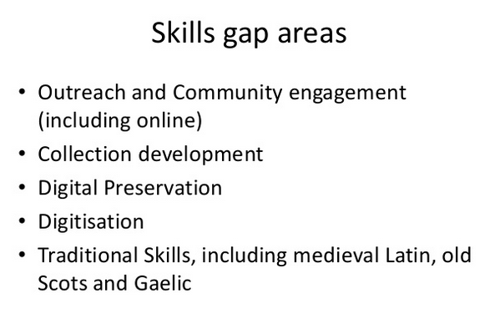
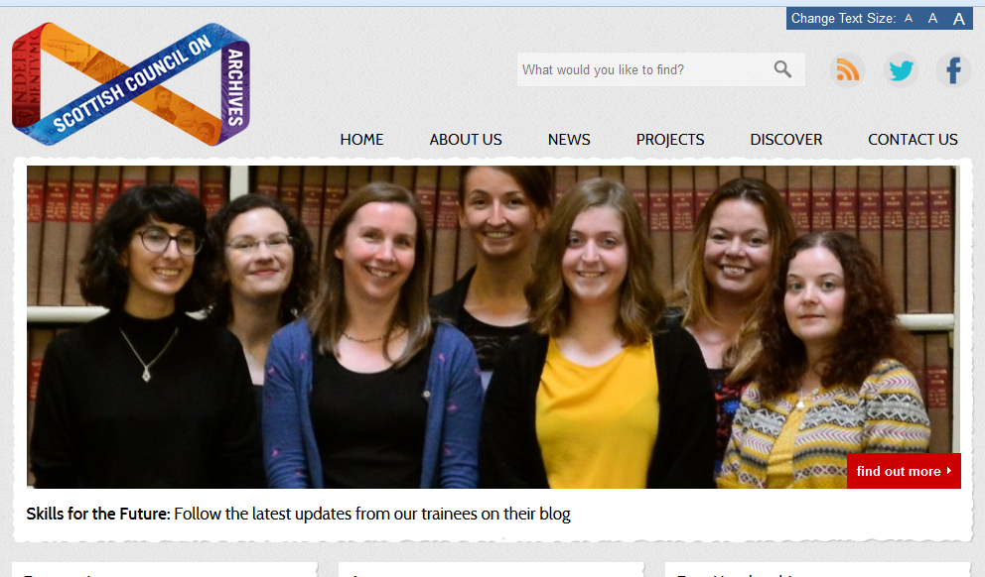
Who is doing what?
Digital Preservation Coalition (University of Glasgow)
Digital Curation Centre (University of Edinburgh)
Ancient university libraries and archives
St Andrews
Glasgow
Aberdeen
Edinburgh
National Records of Scotland: digital output of Scottish government
‘Skills for the Future’ programme (Scottish Council on Archives & The National Archives)
‘Scotland’s Sounds’ (National Library of Scotland)

Slide 3
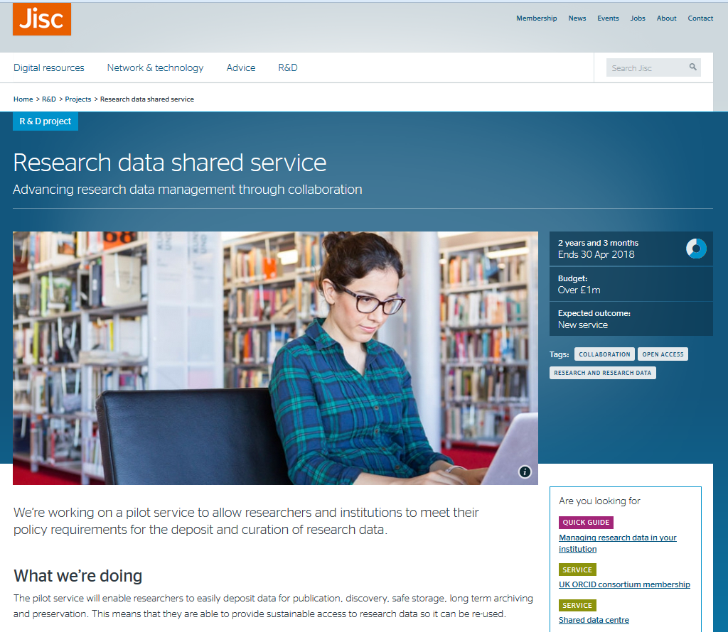
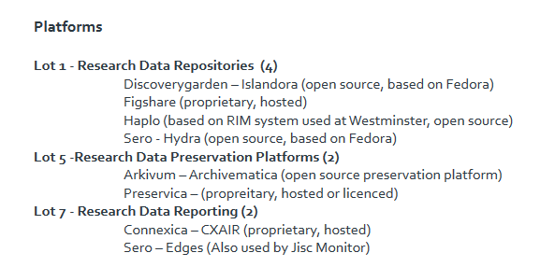
Who is doing what?
Jisc Research Data Shared Service project
Arkivum Archivematica – Edinburgh
Archivematica vs Preservica (St Andrews)

Slide 4
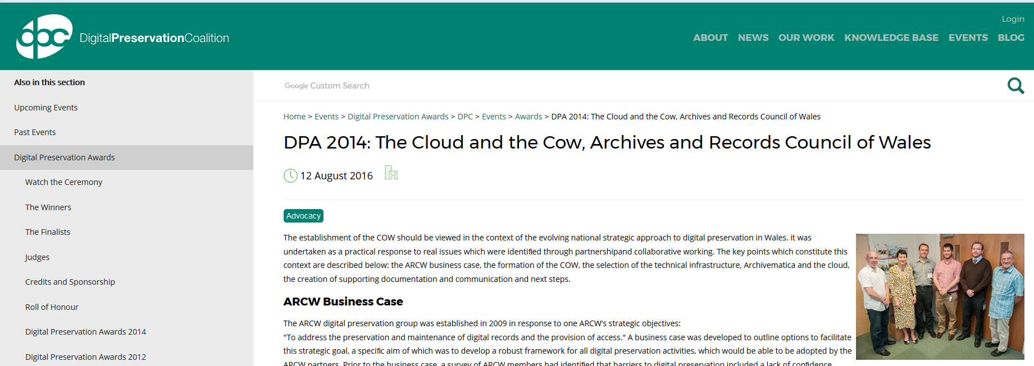
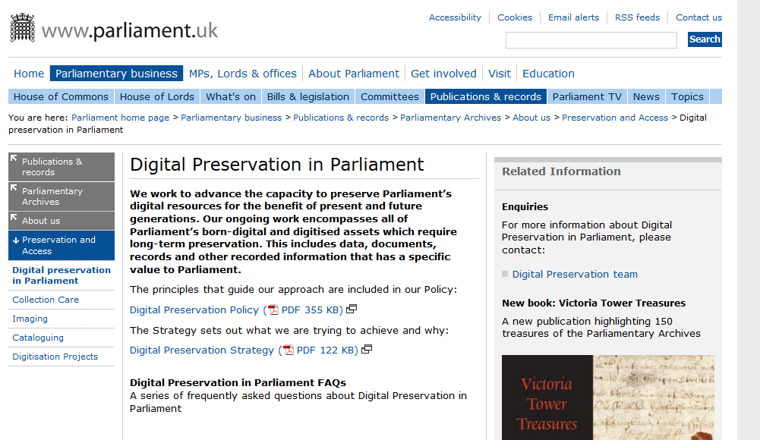
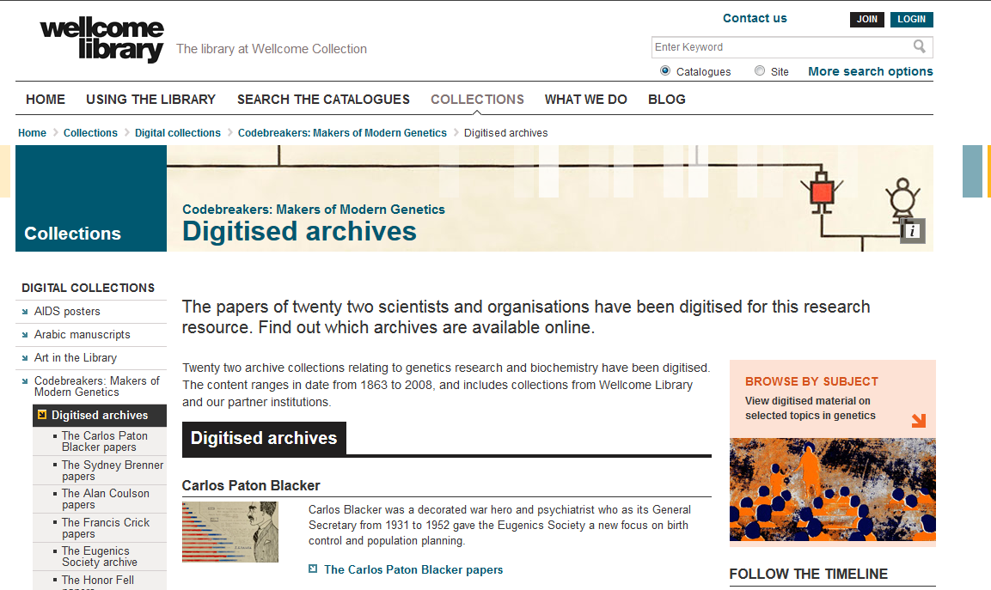
Who is doing what?
DPC digital preservation infrastructure for Wales
Rest of UK
Parliamentary Archives
British Library
Wellcome Library
St Andrews (for example)
Literary archives
University Principal papers (‘muniments’)

Slide 5
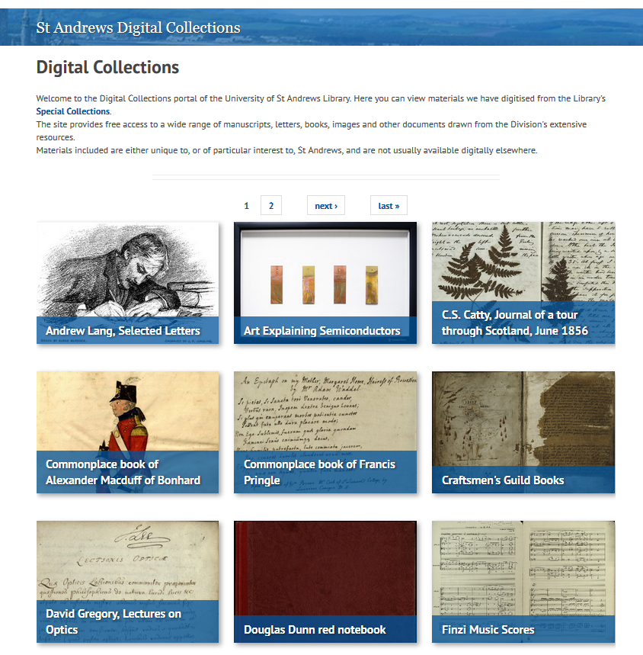
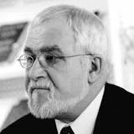
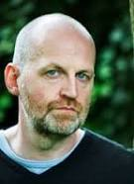
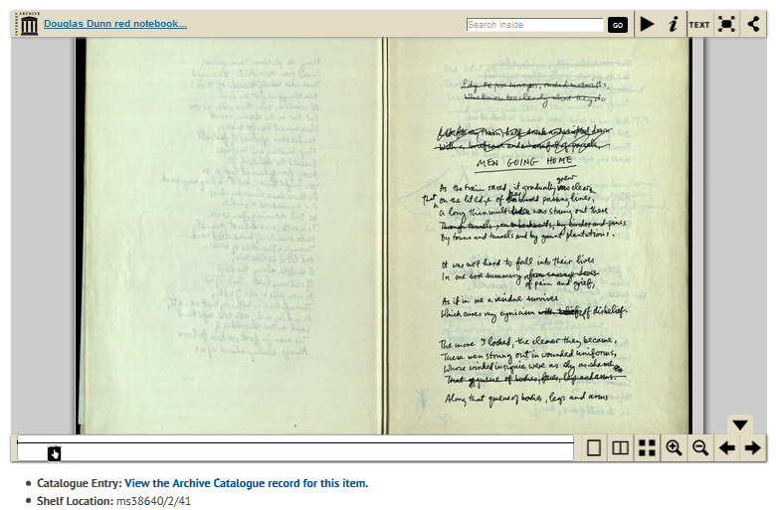
Poets at St Andrews
Douglas Dunn
Don Paterson

Slide 6
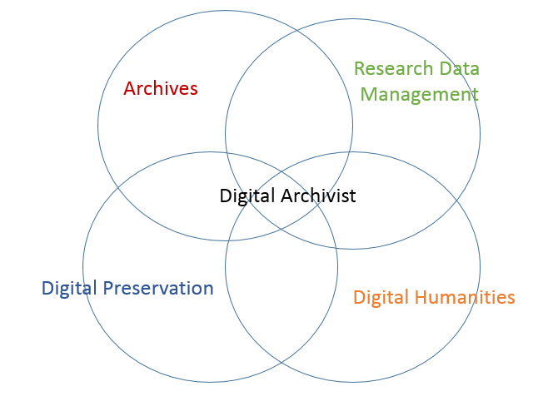
Issues
Literary archives in digital form: problem of valuation
What is the ‘professional home’ of the digital archivist?
Archives associations?
Digital humanities?
Research data management?
Digital preservation community?
Can be more difficult to select files to make available from a digital archive (eg email): ‘embargo the whole deposit’
Significance assessment: RLUK; UNESCO/PERSIST Guidelines for the selection of digital heritage for long-term preservation

Slide 7
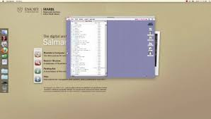
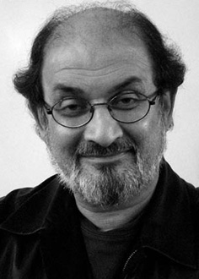
Issues
Archiving the digital environment (eg Emory emulated Rushdie’s own computer)
Robust contracts needed
Authors selling to highest bidders
Getting archivists with the right skills
Young archivists turning their back on the digital
Less hybridity now than 10 years ago

Slide 8
Thank you!

