Slide 1
Storytelling with primary source collections: livingstone’s zambezi expedition
LIBER 2016 Forum for Digital Cultural Heritage
The Wood for the Trees: Discoverability of Digital Collections
29 June 2016

Slide 2
ITHAKA is a not-for-profit organization that helps the academic community use digital technologies to preserve the scholarly record and to advance research and teaching in sustainable ways.
Images, Video, Audio Shared Shelf
Journals, Books, Digitized Primary Sources
Research and Consulting Services
Preservation Services
Notes:
Good morning!
I am Colleen Campbell, director of European participation in JSTOR and the Portico digital preservation service. Thank you very much for welcoming me into this workshop.
I really hope we will have a chance to talk more about ITHAKA—including the newest member of our family, the Artsor Digital Library and the web-based digital media management system, Shared Shelf, but now I want to talk with you about a wonderful project put together by two teams within JSTOR and some of our very special Institutional partners.

Slide 3
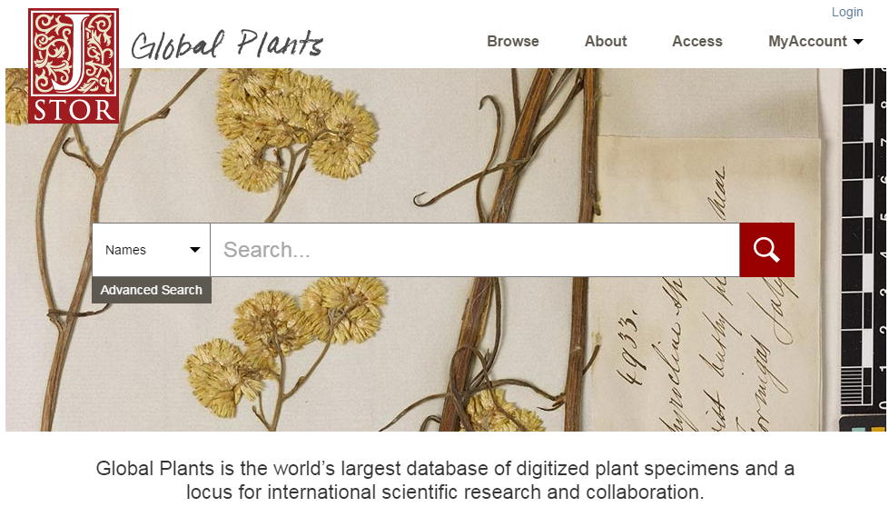
Notes:
First, Global Plants is the world’s largest database of digitized plant type specimens and a virtual space for international scientific research and collaboration.
It enables herbaria to share their digitized plant type specimens, giving scientists all over the world the opportunity to analyze them and to determine and update plant names. Partners of the Global Plants Initiative now include more than 300 herbaria institutions from over 70 countries.
There are now nearly two million high resolution images of plant type specimens in Global Plants, and tens of thousands of complementary primary source materials--correspondence and diaries, paintings, photographs, drawings—coming from the special collections of Partners like
Botanic Gardens and Herbarium of Heidelberg
The Musée National d’Histoire Naturelle in Paris
And the Royal Botanical Gardens in Kew, London
By including the digitized plant specimens in context with other types of primary sources, scientists, historians, students, and
the general public can explore the diverse flora of Africa, Latin America,
Europe, and North America and enjoy a comprehensive learning and research experience through a variety of media.
Special collection highlights include Carl Linnaeus’s original published books in Latin from 1736 to 1747, as well as unpublished materials from 1736 to1776. There are handwritten annotations by Linnaeus in all copies and botanical and zoological illustrations from Cook’s First and Second Voyages.

Slide 4
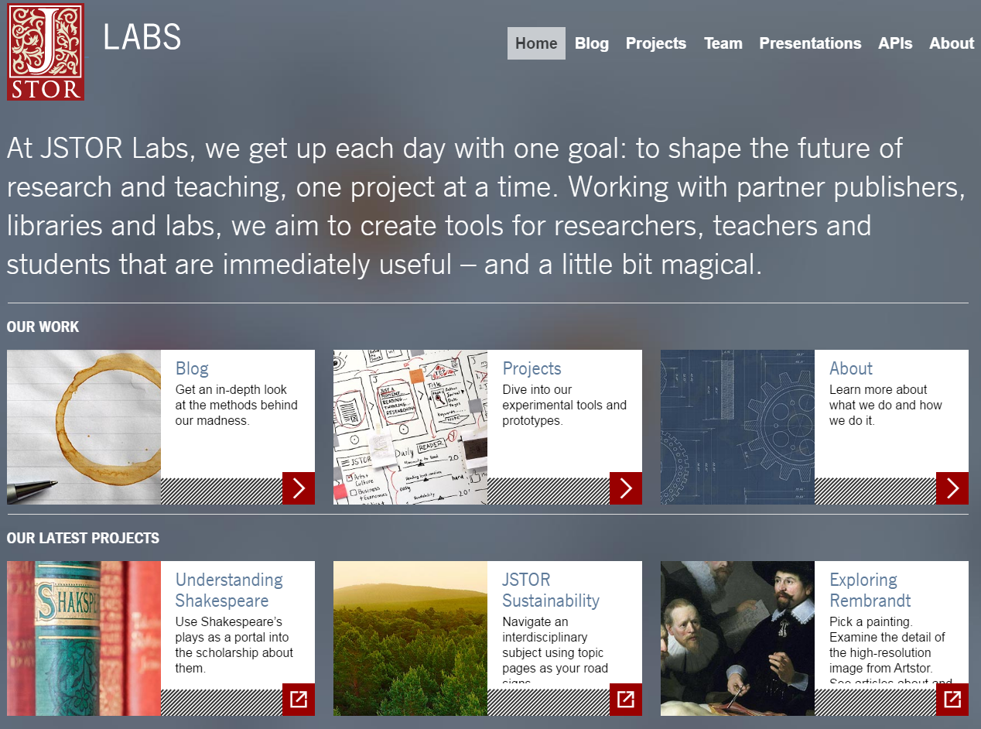
Notes:
Second, JSTOR Labs
The Labs team has a strong focus on innovation and holds to the value of working with partners to build something greater than what either could achieve on their own. They collaborate with the academic, library, and digital humanities scholarship communities to create tools that are immediately useful and broadly applicable.
Now I’d like to introduce you to Livingstone’s Zambezi Expedition, which our two teams created.

Slide 5
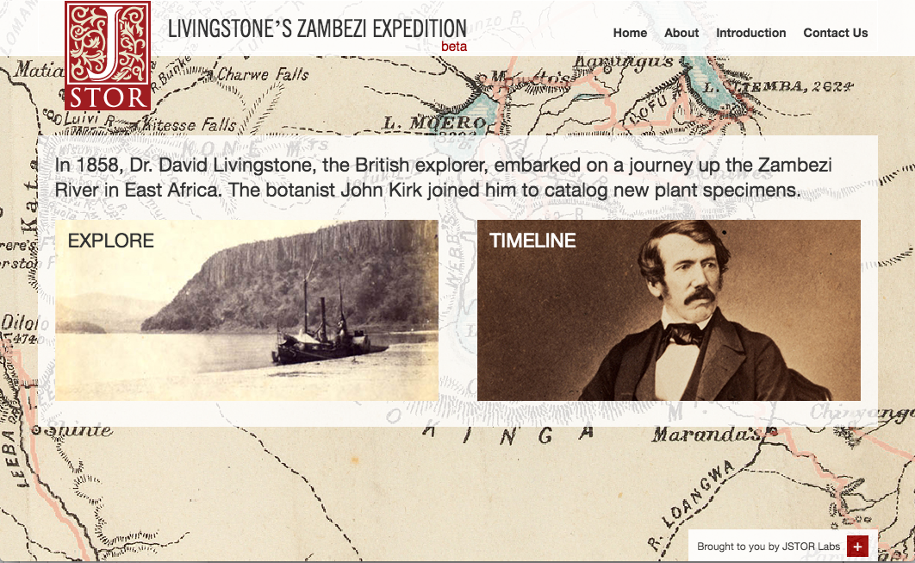
labs.jstor.org/zambezi
Notes:
DEMO video at http://labs.jstor.org/blog/#!livingstones_zambezi_expedition_-demo_video
This project curates and organizes select primary source content from Global Plants and research on JSTOR as an experiment in story-telling and story-discovery. The site brings together more than 550 plant specimens collected on the expedition and more than 150 personal letters, reports, maps and related materials, placing it along side journals and pamphlets from other relevant JSTOR collections.
On this site, users can explore Livingstone’s expedition both chronologically and geographically, discovering stories along the way, like Livingstone’s dawning awareness of the horrors of slavery, the conflict and correspondence with the expedition funders, and personal stories like the tragic death of Livingstone’s wife.
The site provides students, teachers, and scholars with a greater understanding of the scientific, historical, and cultural contexts of the expedition, offering users both a high-level overview of the expedition and the ability to perform a detailed analysis of the materials.

Slide 6
Getting there is ½ the fun…*
JSTOR Global Plants
Mission: partner with herbaria and botanical gardens to digitize vital information about plants
Collaborated with our content partners Royal Botanic Gardens Kew and Royal Geographical Society
Mapped content using articles and books in JSTOR archive
Set location and dates of journal articles and primary sources
JSTOR Labs
Mission: partner with publishers, libraries and labs to build innovative tools for researchers and teachers.
Labs works quickly to test out new ideas with users
Used a three-day “flash-build” to create core site
Combined multiple tools (mapwarper, timeline.js, etc.) into a unique interface
* … is what Livingstone didn’t say. But we did!
Notes:
HOW WE BUILT IT
Global Plants contains a wealth of materials from Livingstone’s Zambezi Expedition that. Armed with the idea to build a map connecting the specimens with the other materials, we began the hunt for more Zambezi Expedition materials in Global Plants and the JSTOR archive.
We chose Zambezi because we knew we had an interesting range of content types about the expedition but realized they were not linked in a meaningful way to understand the experience. We also knew that we had many clicks on some of the Zambezi maps and primary source materials included letters, specimens, and botanical illustrations. So, we began the hunt for more Zambezi Expedition materials in Global Plants and the JSTOR archive.
We worked closely with a librarian and archivist at Royal Botanic Gardens Kew to select and curate the key items of content, to map the content and to write the contextual materials. We did this in an iterative approach, getting up a demo site first and changing it as it developed.
From a practical perspective, the process involved four steps:
1 - we used a wide-net approach and keyword searching to identify content in both Global Plants and the JSTOR Archive relevant to «Zambesi»; this allowed us to find content from the Journal of the Royal Geographical Society of London the very organization that funded the expedition .
2 – we exported the records and then trimmed out unrelated content
3 - the next step involved standardizing and refining the data; in some cases this work was automated but in other cases, identifying dates and locations required examinine the items individually.
4 - The last step was to provide geographical context. We used a number of sources to identify and find the coordinates for 118 localities, and the Labs team provided functionality to overlay historical maps of the expedition on top of current maps. This part was especially difficult as many names on the historical maps are no longer in use, but the impact and value added was enormous.
A major benefit of Global Plants is that plants that were collected in the same locality or on the same expedition can be reconnected and discoverable in one place. But the size of Global Plants can make it difficult to uncover these connections if you don’t already know you’re looking for them. We see projects like the Zambezi Expedition as a way to help strengthen these connections and increase the types of discovery Global Plants facilitates to better encompass browsing and exploring

Slide 7
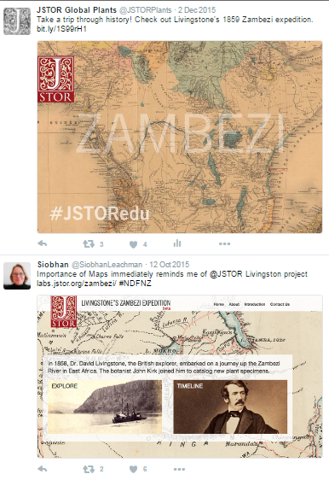
and there are more stories to tell!
“ …we have been dreaming of doing such a thing with our content on George Forrest, a plant explorer and hunter who collected throughout China in the early 20th century…”
--Royal Botanic Gardens Edinburgh
“This is an amazing use of secondary sources as primary sources and of combining the two…”
--Royal Geographical Society
Notes:
When we showed Livingstone’s Zambesi Expedition to other partners, including Linnean Society of London, Royal Geographical Society and Natural History Museum, their immediate reaction was “hey, we have more in our archives we should add to this!”
Several are now digitizing a select amount of additional materials of interest to the project and we will be adding them over the next few months.
But the impact of the project is already felt by means of replication. Royal Botanic Gardens in Edinburgh is pursuing doing a similar module for George Forrest (1873-1932), a botanist who travelled and collected widely throughout China.
Since the site is still considered a «beta», we have not promoted this widely, but we are seeing usage.
And, we believe the project is already a success, as it has inspired our institutional partners to think of new ways to surface their primary sources to tell stories and engage with their users in a more impactful way.

Slide 8
THANK YOU
VISIT
labs.jstor.org
plants.jstor.org
labs.jstor.org/zambezi/
Colleen CAmpbell
Director, INSTITUTIONAL PARTICIPATION & Strategic Partnerships, EUROPE
Colleen.Campbell@IthakaInternational.org
www.jstor.org
www.portico.org

Slide 9
Appendix

Slide 11
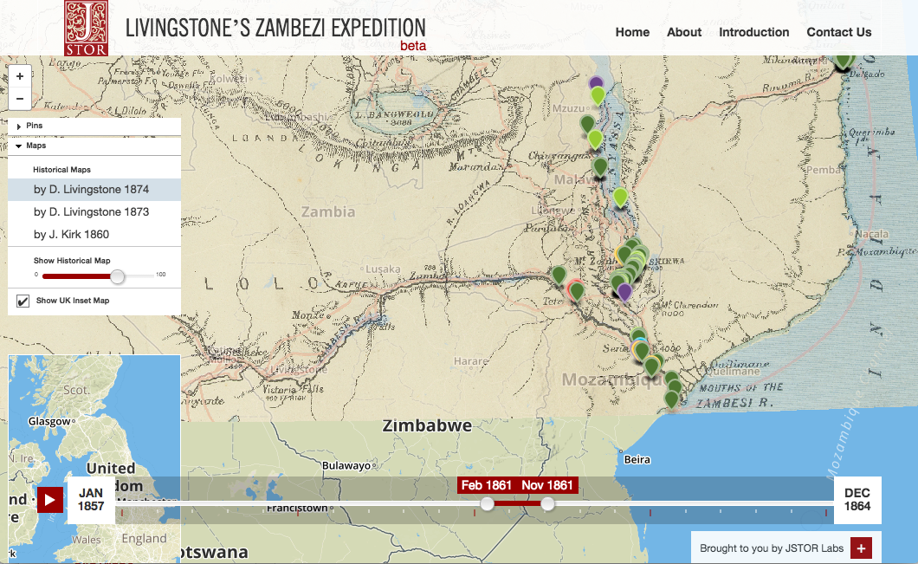

Slide 12
