Slide 1
Collection Security and
Exhibition Work at the British Library
Adrian Edwards
Head, Printed Heritage Collections

Slide 2
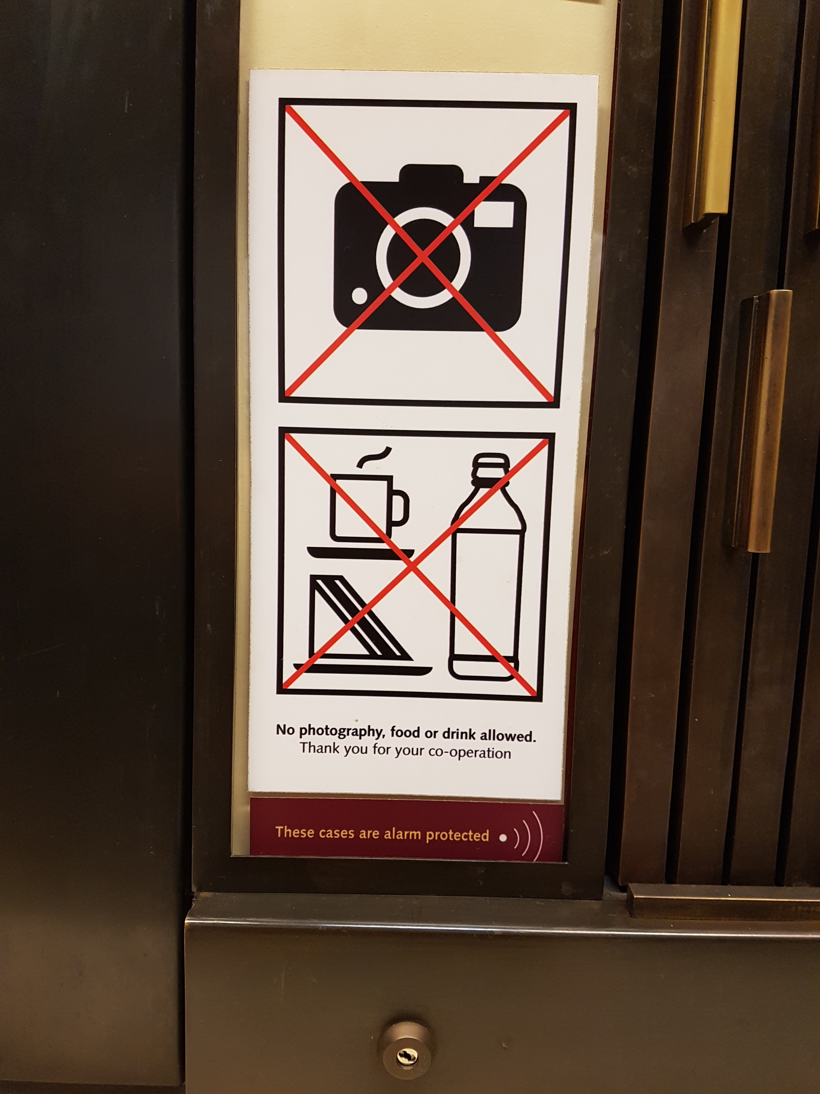
Collection Security and the British Library and the management of risk
Some background about the British Library, collection risk, and the governance of collection security issues
Our on-site exhibition spaces
How we plan exhibition security
Object installation / de-installation
Inward loans
Day-to-day physical security in the galleries
Security guidelines and training for exhibitions
Touring exhibitions and individual outward loans
Concluding remarks

Slide 3
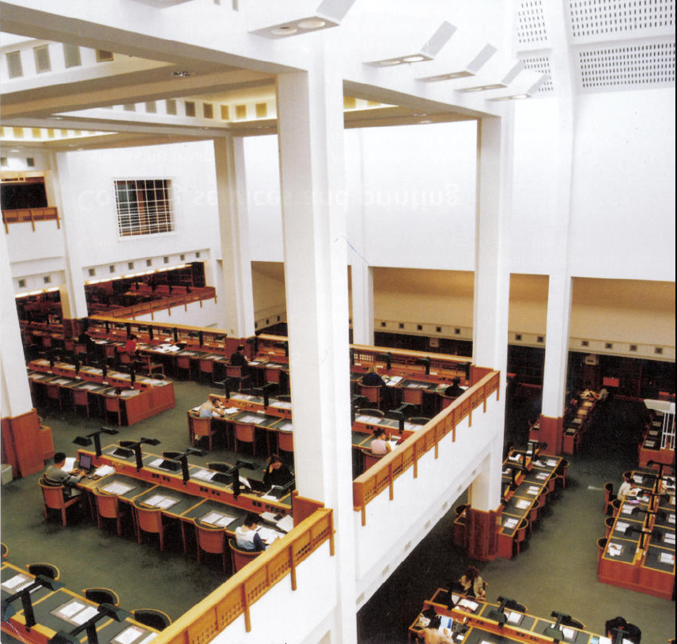
Some context
over 150 million collection items
399,000 visits to our reading rooms each year
1,296 reader desks in our reading rooms
11 reading rooms
1.65 million items issued to readers in our reading rooms each year

Slide 4
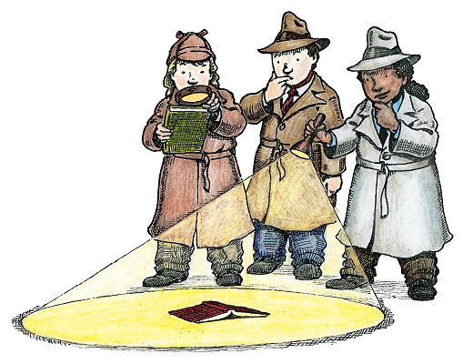
What are the risks?
Lost books
Accidental damage
Criminal damage and theft
Image: USF Reference blog

Slide 5
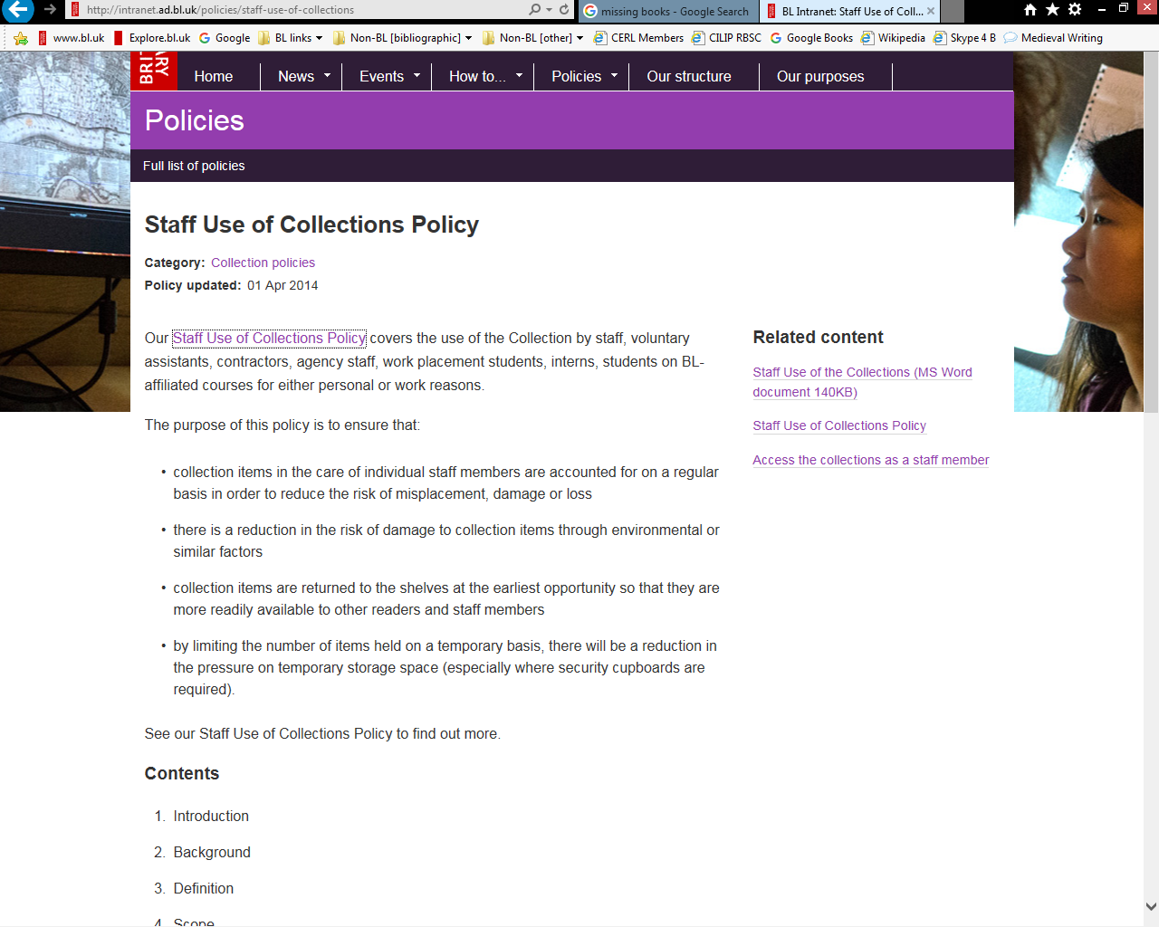
WHAT ARE THE RISKS?
Lost books
Flawed systems
Poor housekeeping
Failure to comply with our ‘Staff use of the Collections’ policy

Slide 6
WHAT ARE THE RISKS?
Accidental damage
Poor book handling by staff and contractors.
Poor book handling by readers.
Failure to maintain storage areas and their shelving.
Failure to operate rolling stacks/automated shelving systems correctly.
Failure to transport books in an appropriate manner.
Failure to use authorised safe routes around the building.

Slide 7
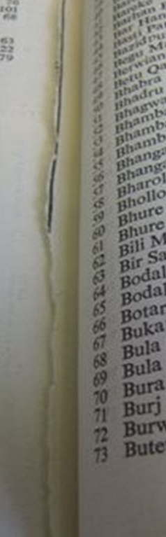
WHAT ARE THE RISKS?
Criminal damage and theft
  Career criminals.
  Opportunistic thieves.
  External (readers / visitors).
  Internal (staff / authorised contractors).

Slide 8
GOVERNANCE OF COLLECTION SECURITY
British Library’s Legal Obligations
British Library is a non-departmental government body, formed by act of parliament.
The Secretary of State in our finance settlement requires us to “protect our world-class collections”.
We are accountable for the safety of the collections to the parliamentary Public Accounts Committee.
Under the Freedom of Information Act 2000 (Section 19), we are required to publish our database of missing items.
As a charitable organisation, we also have financial and governance obligations under the Charities Act of 1993.

Slide 9
GOVERNANCE OF COLLECTION SECURITY
Collection Security Group
Purposes
To be responsible for the Library’s Collection Security Policy.
To oversee the assessment of risks to the collection and ensure that appropriate mitigations are in place in line with the risk appetite agreed by the British Library Board.
To determine and monitor action planning to respond to new and changing collection risks, and risks inherent in all Library processes. Monitor progress and review benefit realisation.

Slide 10
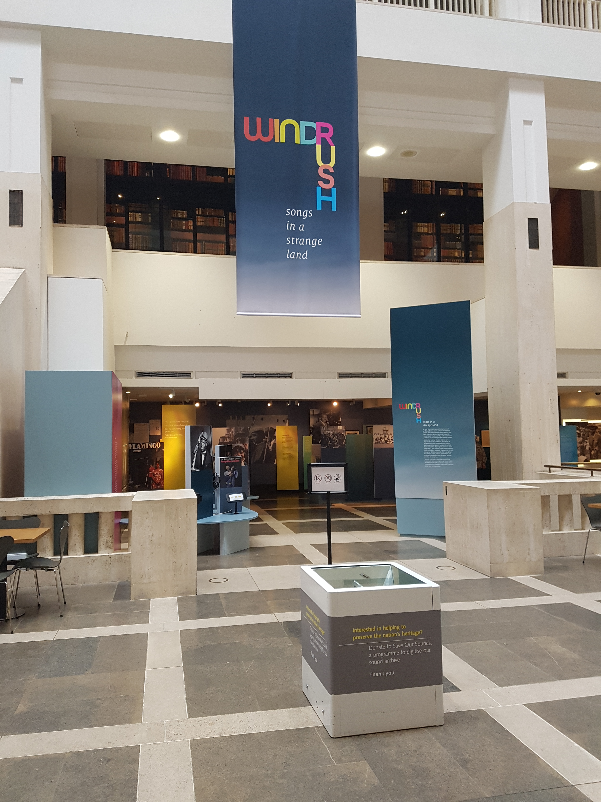
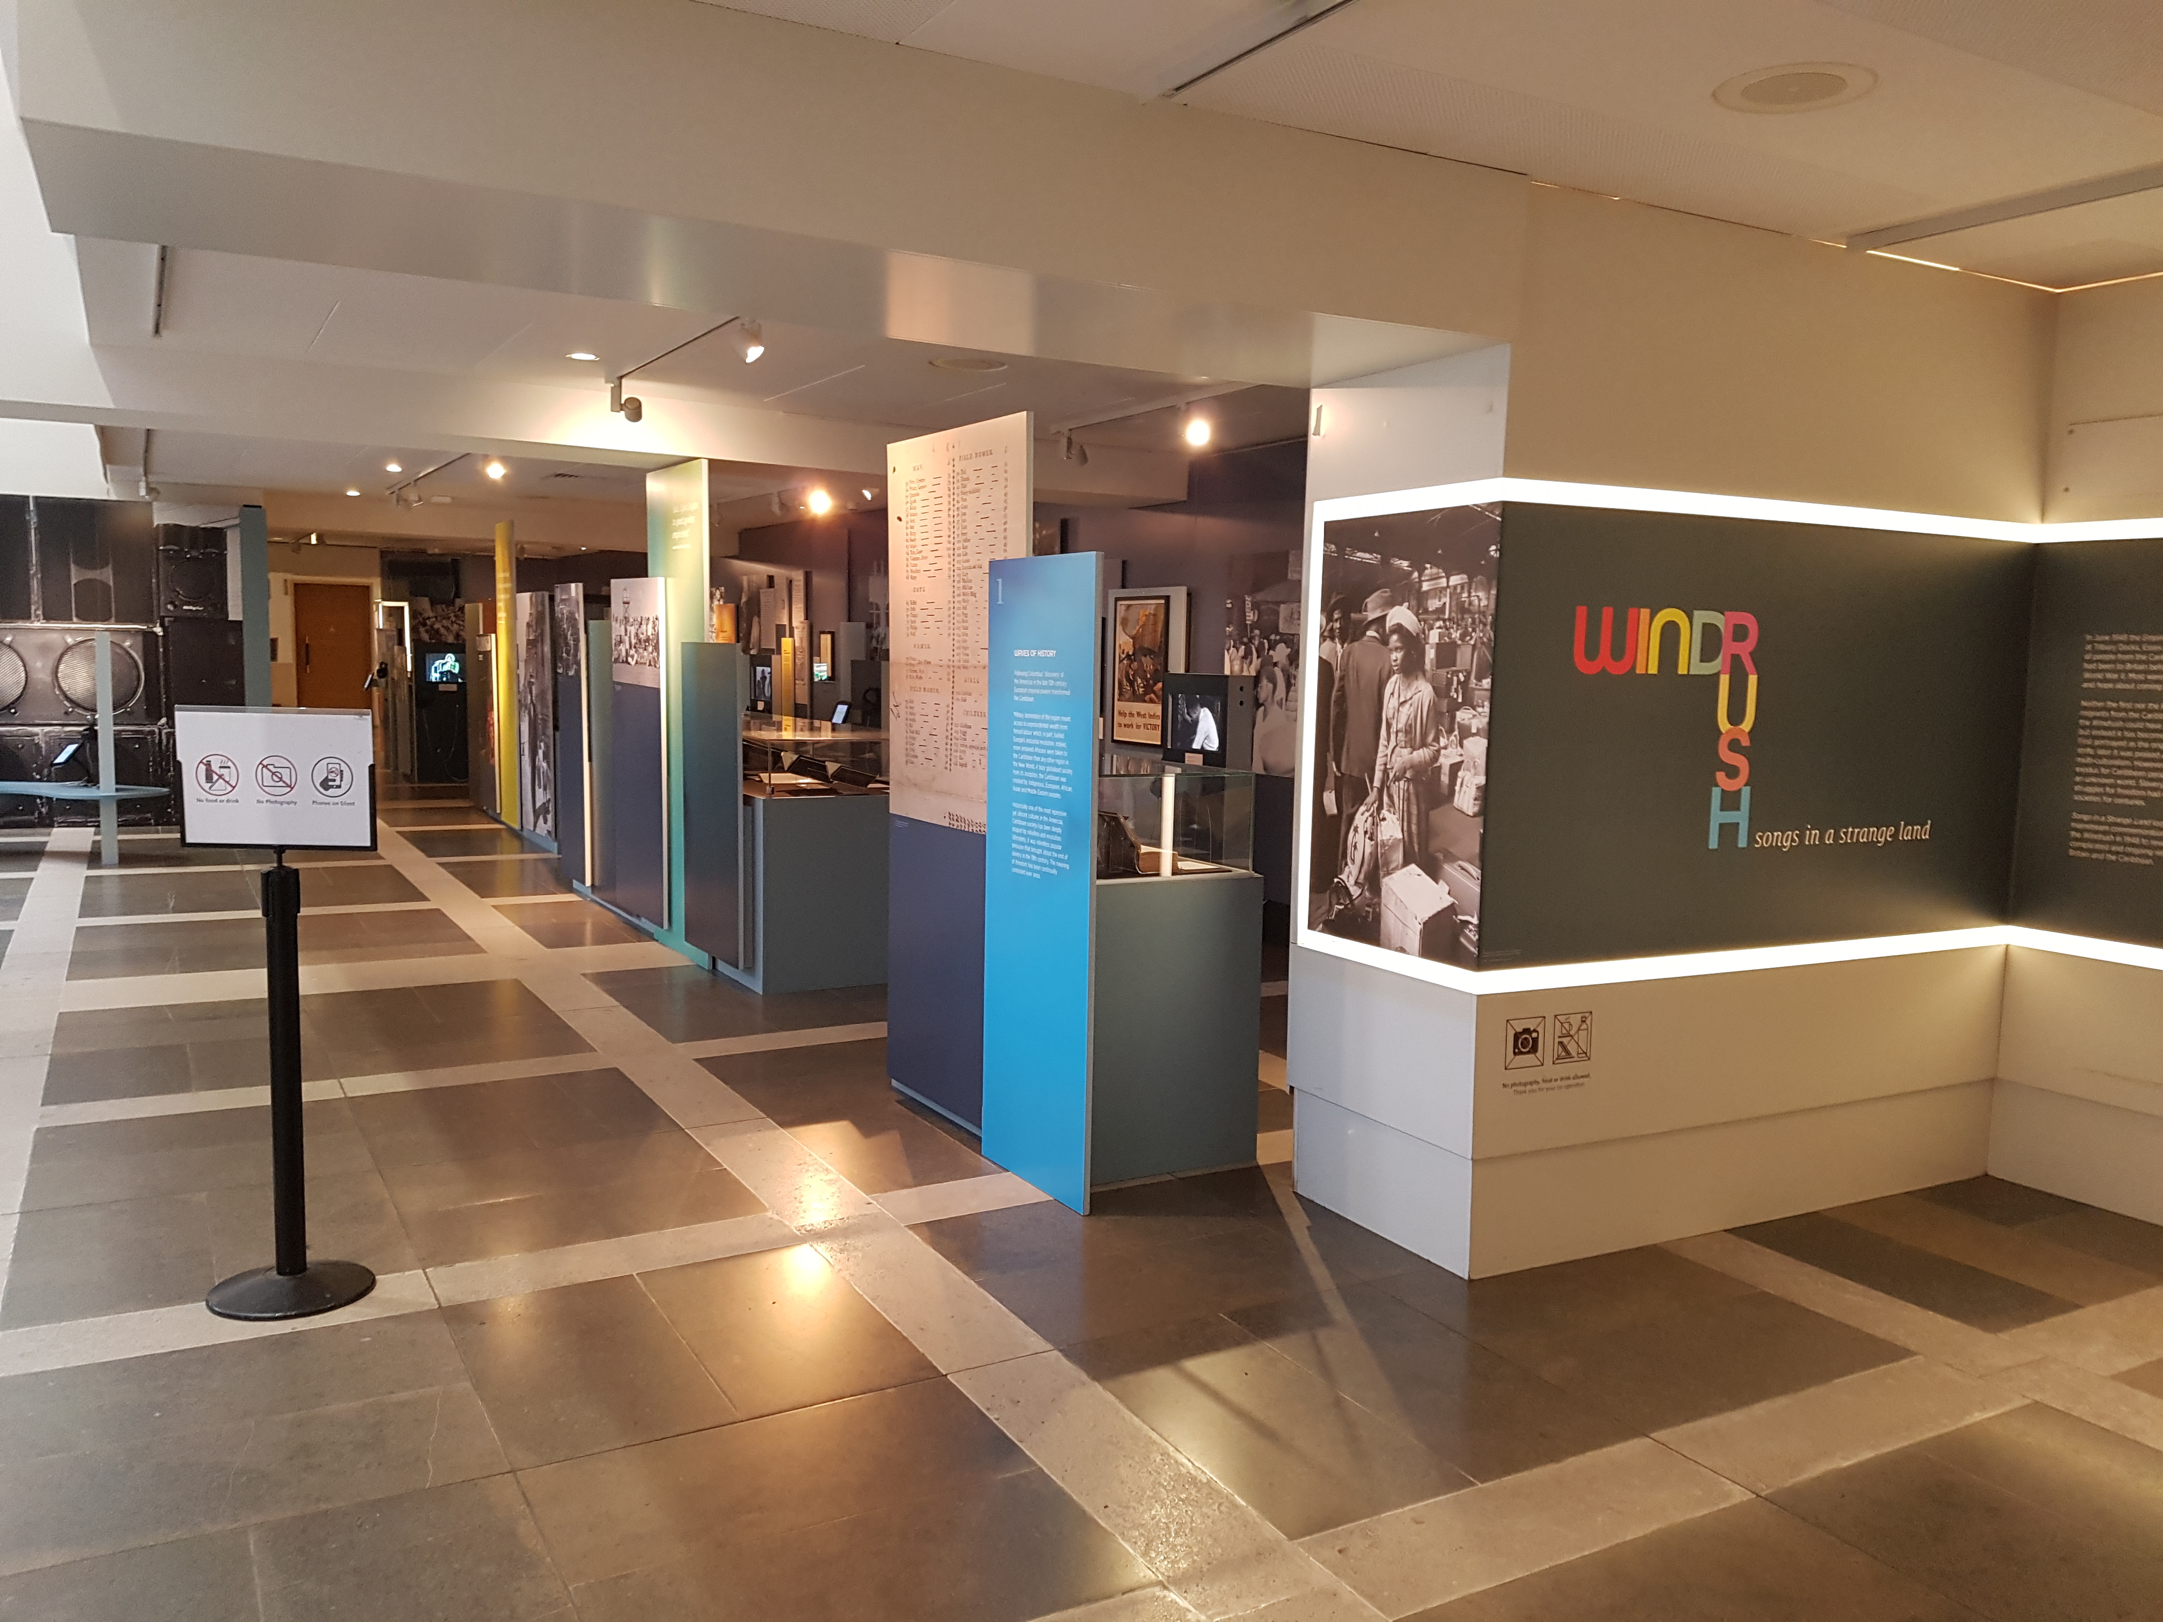
BRITISH LIBRARY LONDON -- EXHBITIONS
On-site Exhibition Spaces
Front Hall Exhibition Space

Slide 11
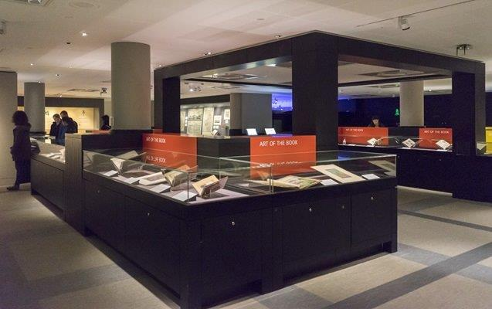
BRITISH LIBRARY LONDON -- EXHBITIONS
On-site Exhibition Spaces
Sir John Ritblat Treasures of the British Library Gallery

Slide 12
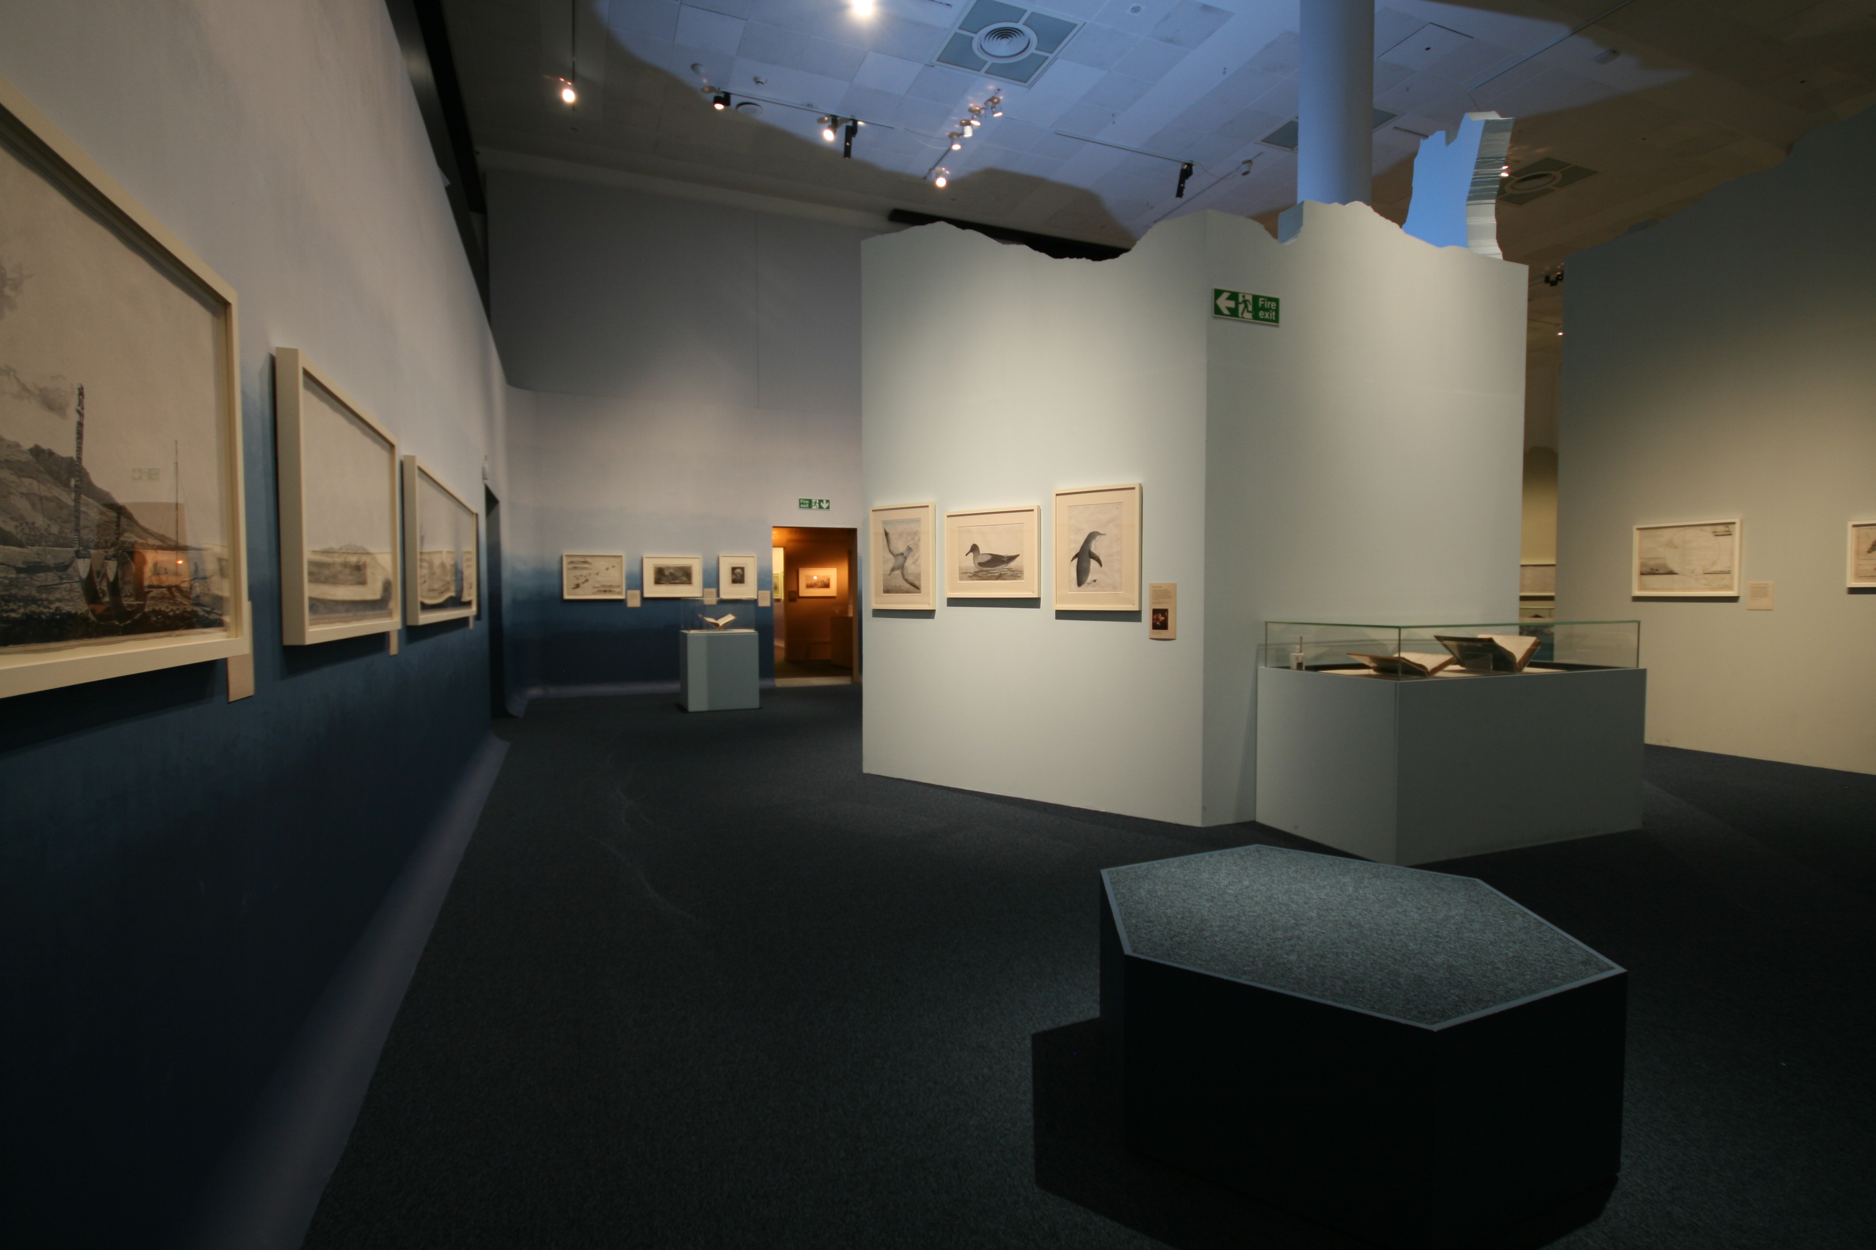
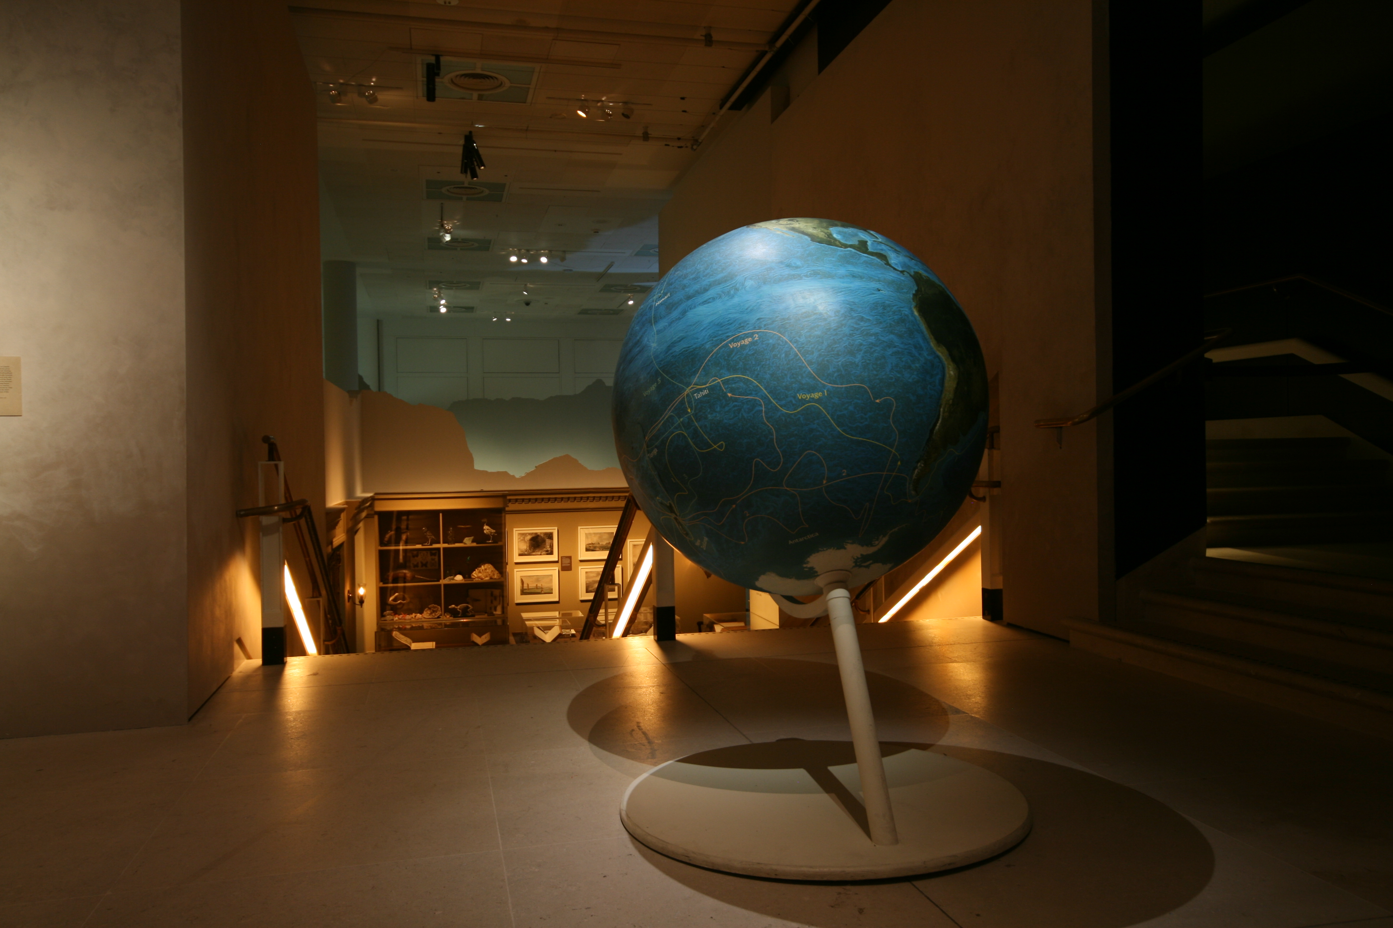
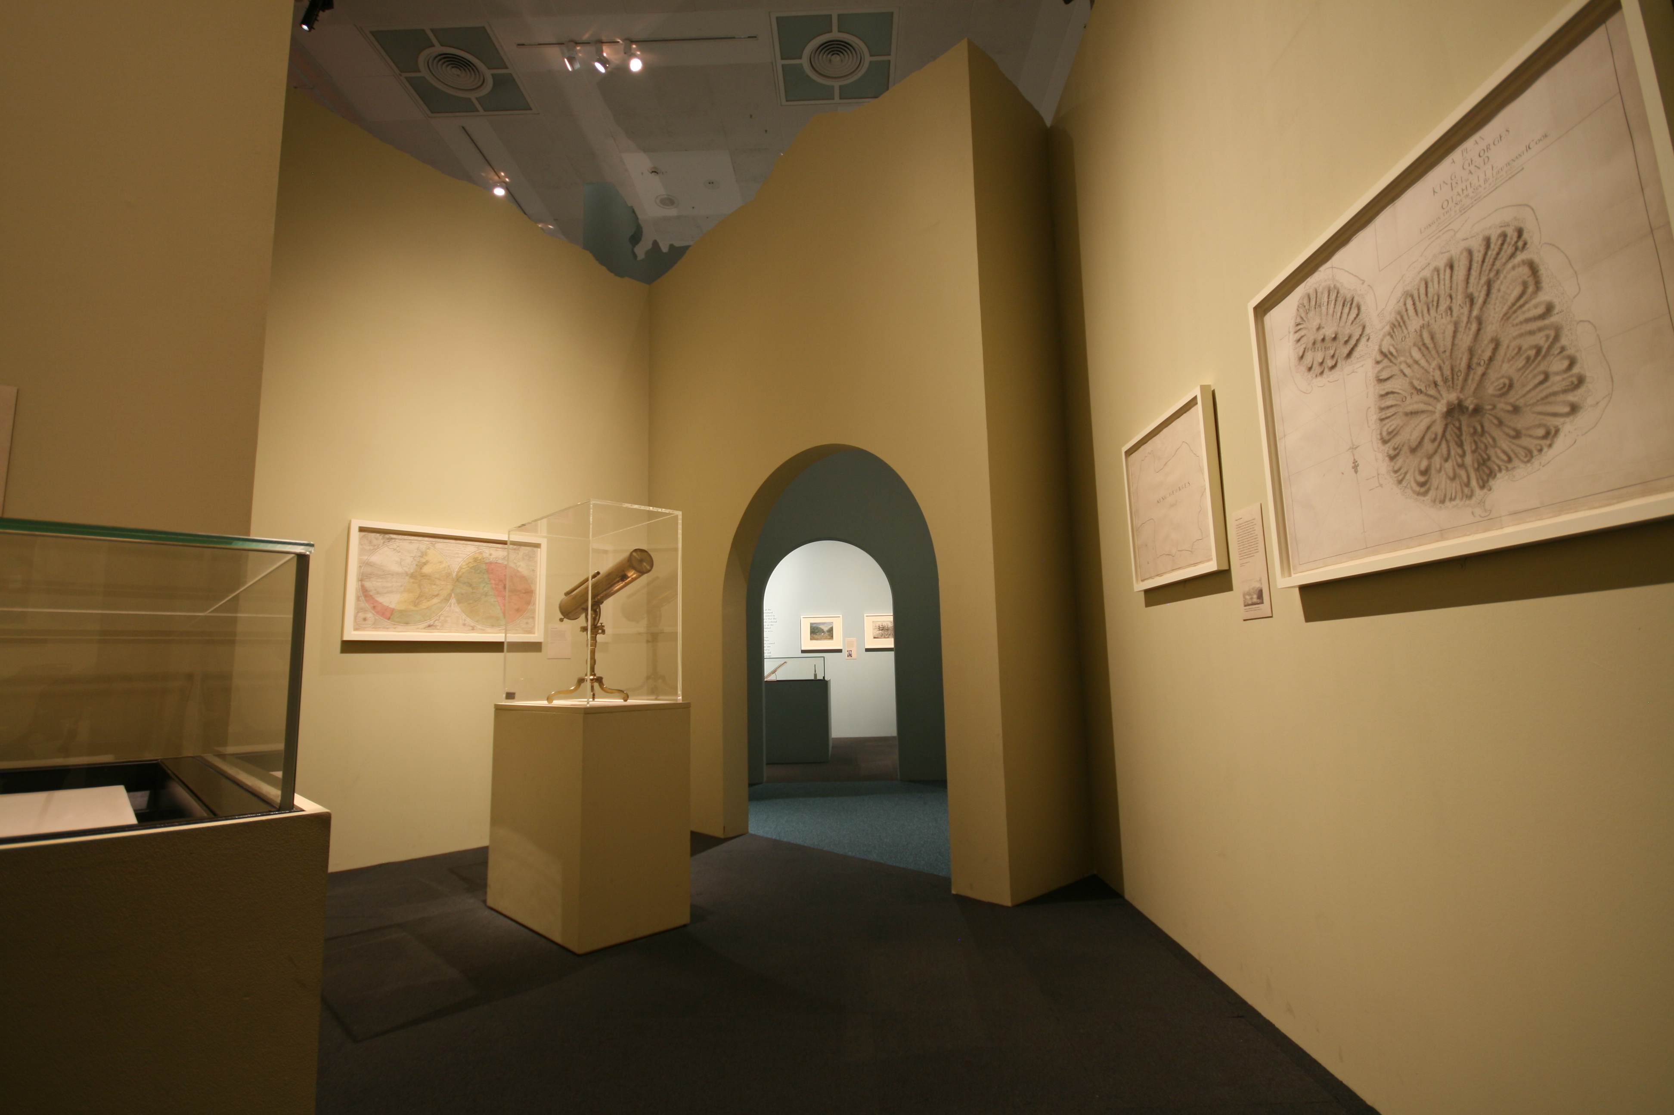
BRITISH LIBRARY LONDON -- EXHBITIONS
On-site Exhibition Spaces
Main PACCAR Gallery (temporary exhibition space)

Slide 13
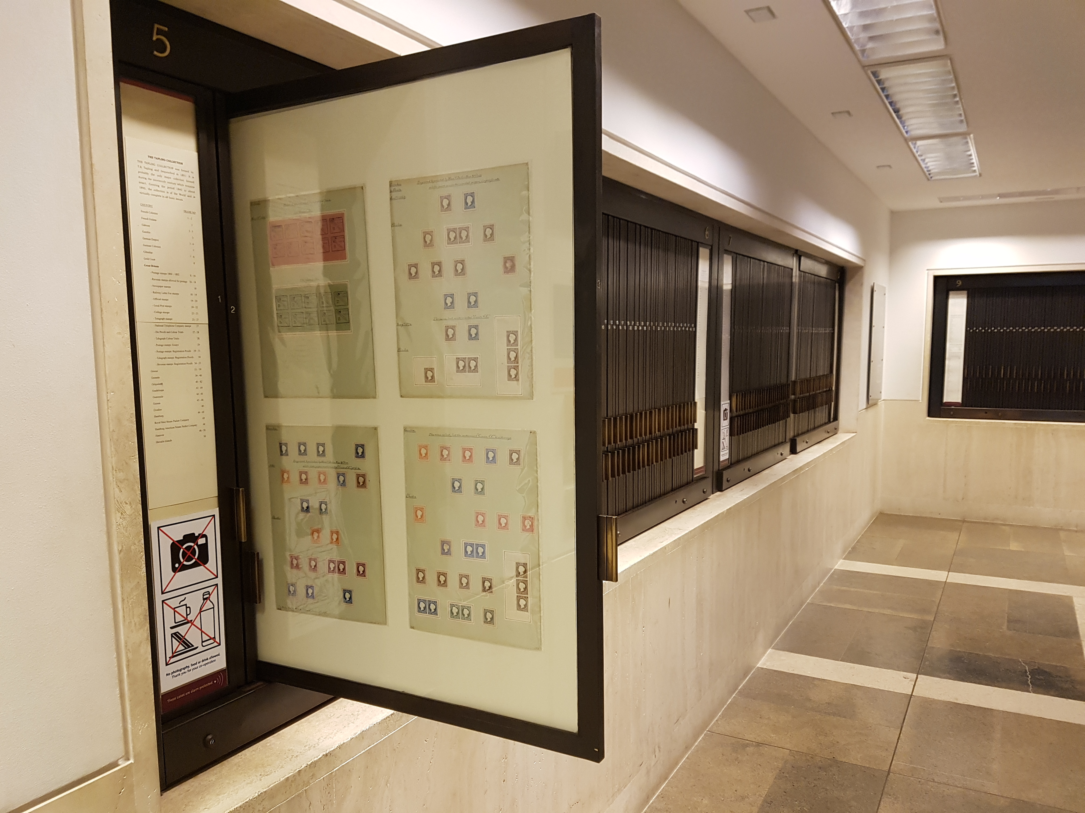
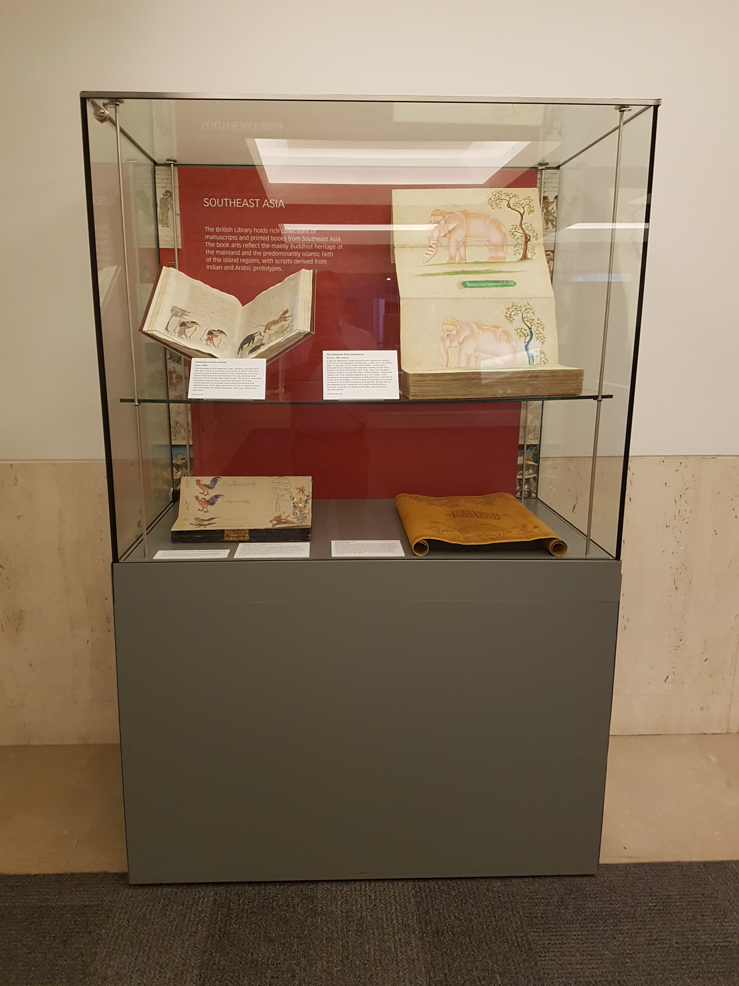
BRITISH LIBRARY LONDON -- EXHBITIONS
On-site Exhibition Spaces
Postal history display
Single exhibition case (outside Asian & African Studies Reading Room)

Slide 14
ON-SITE EXHIBITION SPACES
Planning
Exhibitions Department holds meetings with Security, Health & Safety, and Building Management to discuss collection security at three points:
  1. Concept design stage
  2. Scheme design stage
  3. Detailed design stage

Slide 15

ON-SITE EXHIBITION SPACES
Planning
Topics may include:
Location and sightlines for CCTV-cameras.
Sightlines for security guards.
Height and robustness of the build.
Which display cases will be used.
How display cases will be fixed to the floors or walls.
How some individual objects might be fixed to floors or walls.
Access routes to display cases and visibility of locks.
Alarm systems that will used.
Special considerations for high profile loans (e.g. the US constitution required a dedicated security guard at all times).
Sensitive collections on display (e.g. material that might shock visitors or provoke a protest).

Slide 16
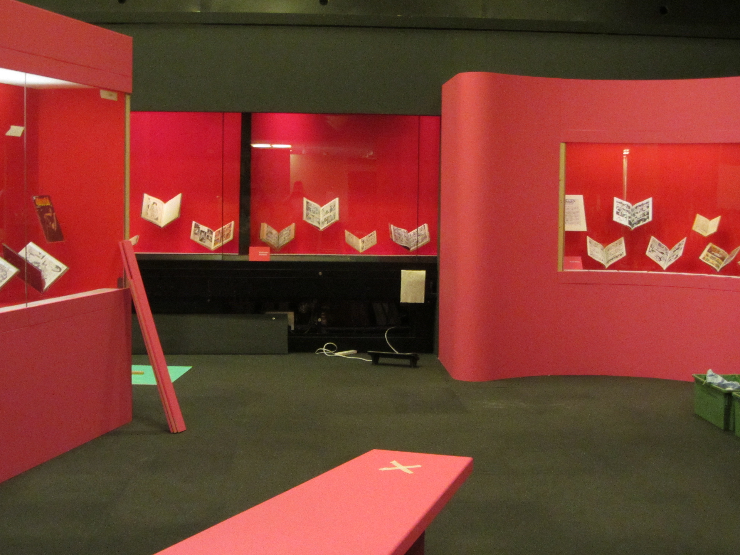
ON-SITE EXHIBITION SPACES
Object Installation / De-installation
Storage of objects before installation / after de-installation.
Gallery access.
Number of cases open at
any one time.

Slide 17

ON-SITE EXHIBITION SPACES
Inward Loans
Lender requirements.
Use of couriers and fine art transportation companies.
Escorting couriers within the BL site.
Timeliness.
Back-up plans for storage.
Image: myelitedetail.us free clip art

Slide 18
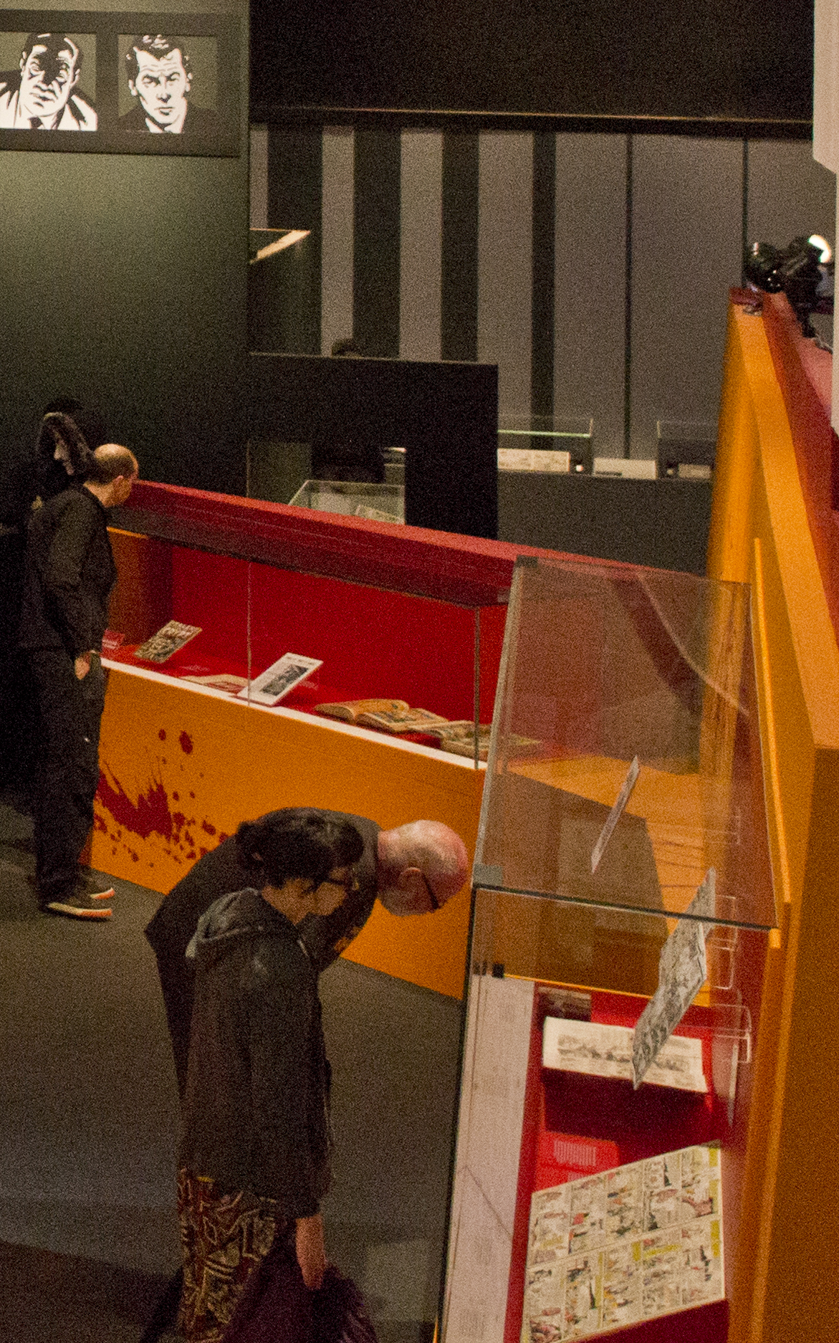
ON-SITE EXHIBITION SPACES
Day to day physical security in the galleries
WHEN GALLERIES ARE OPEN TO THE PUBLIC
Perimeter security controls.
Gallery guards.
CCTV in the gallery.
Alarms in display cases.
Gallery environment (45%-55% RH,
18⁰–22⁰C, maximum 50 lux)
No food or drink in the galleries.
No large bags / no bags at all in the galleries.

Slide 19
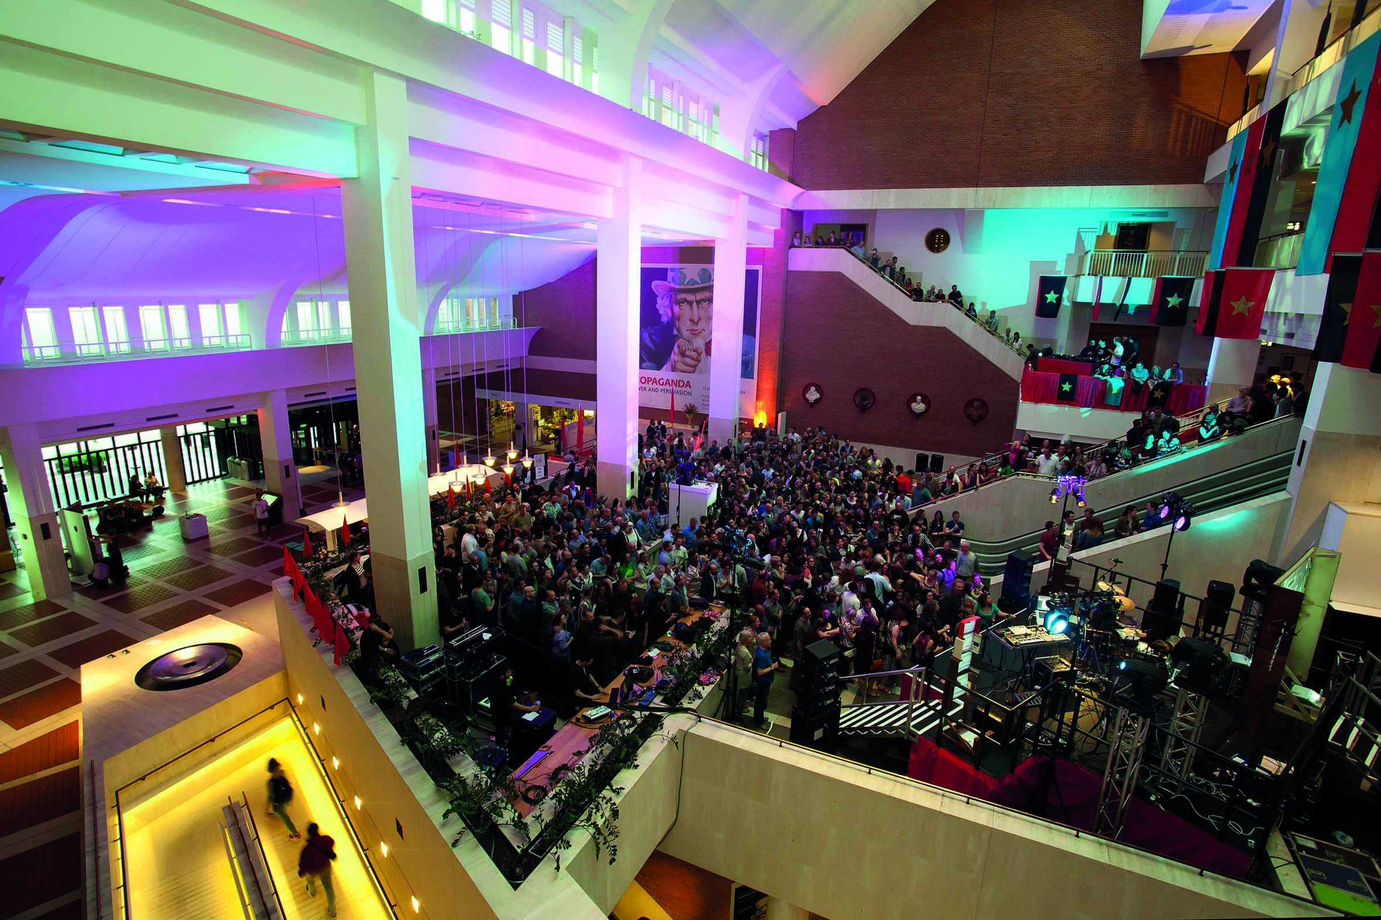
ON-SITE EXHIBITION SPACES
Day to day physical security in the galleries
WHEN GALLERIES ARE OPEN FOR PRIVATE VIEWS
Exactly the same.

Slide 20
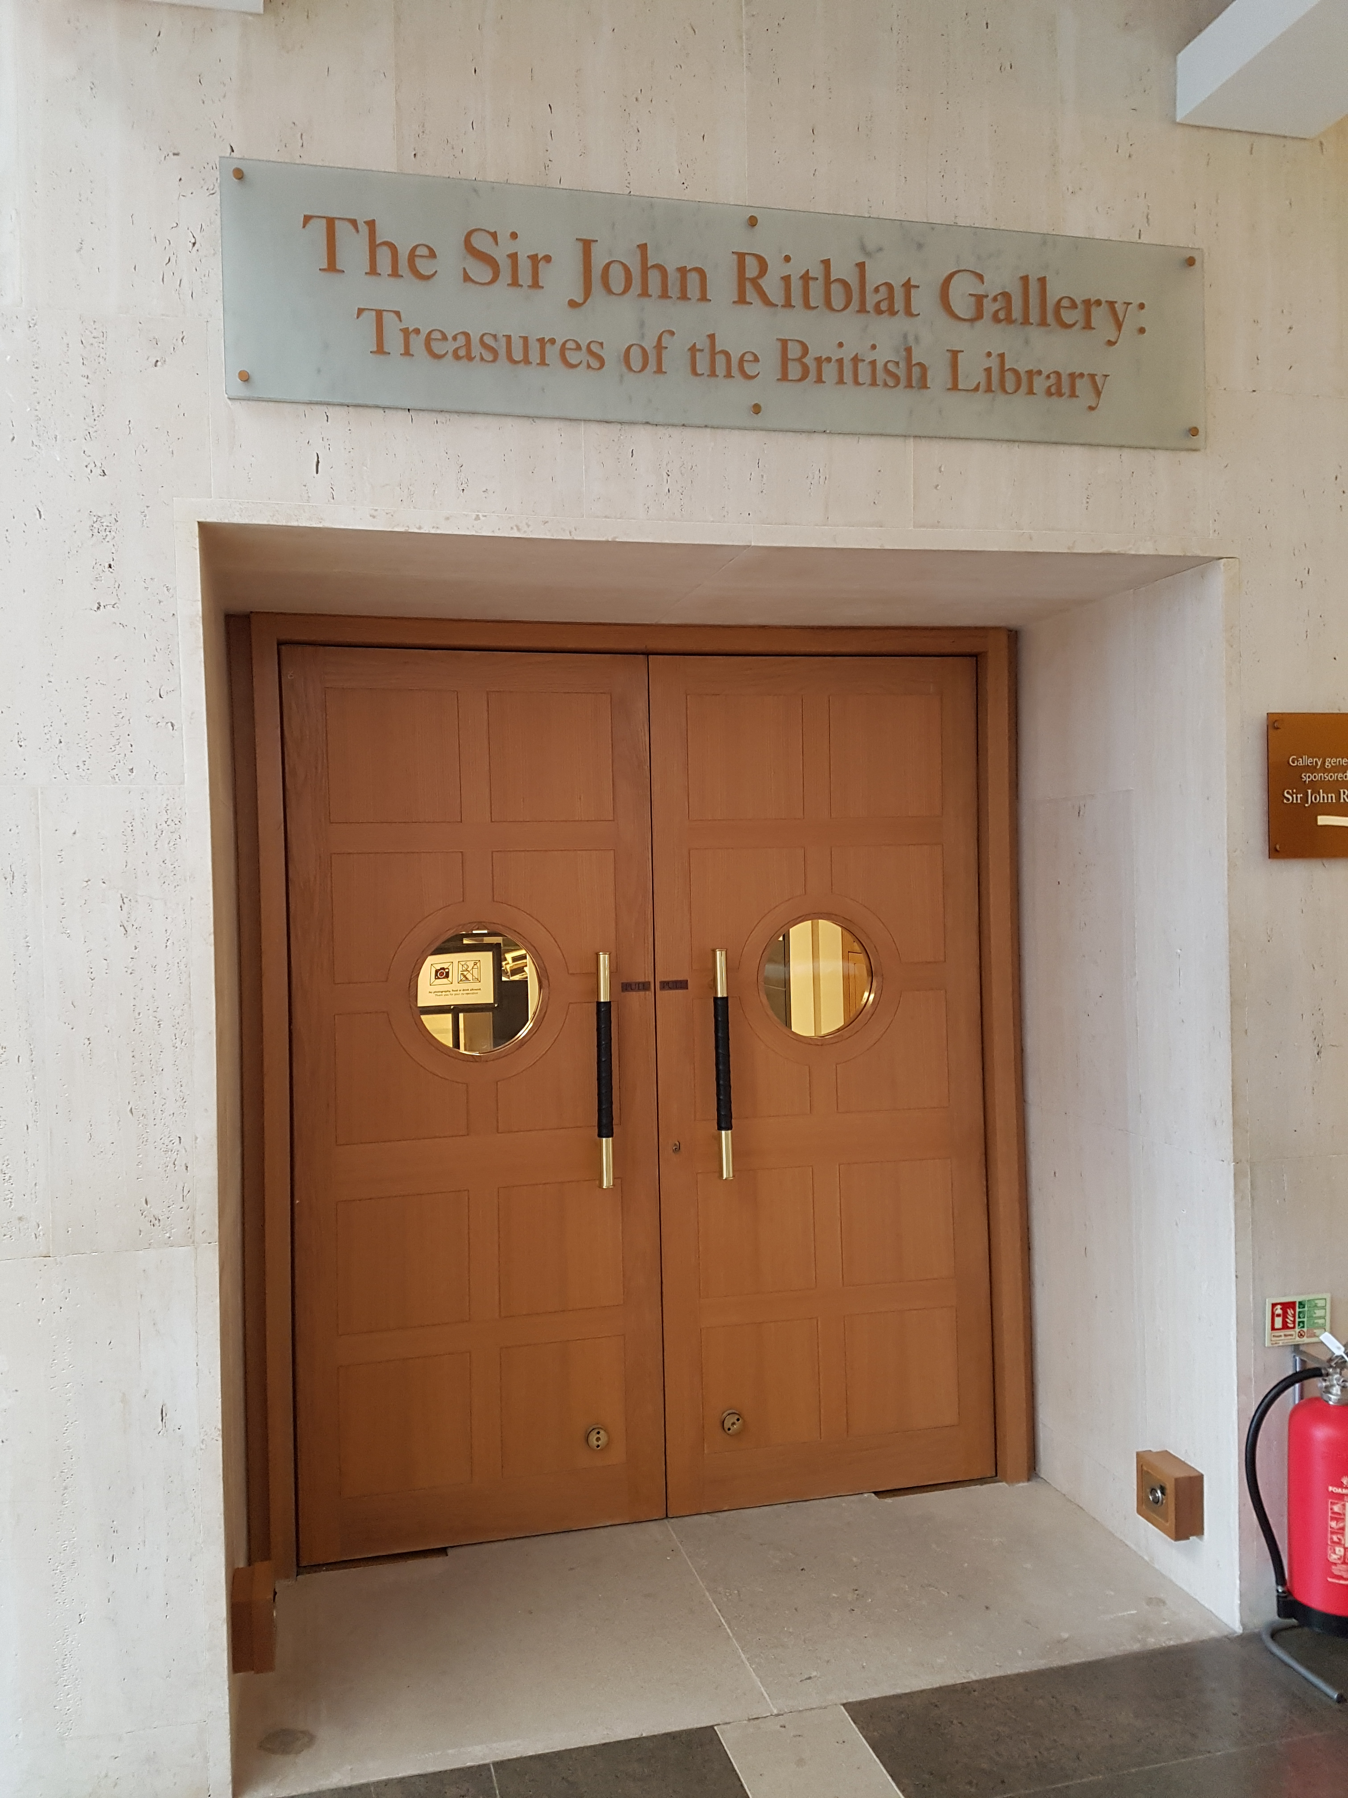
ON-SITE EXHIBITION SPACES
Day to day physical security in the galleries
WHEN THE GALLERIES ARE CLOSED
Doors are locked.
All CCTV and alarms remain on.
Staff access is controlled.

Slide 21
ON-SITE EXHIBITION SPACES
Security guidelines and training
Staff Use of The Collections policy has to be followed, includes instructions on:
Correct use of the internal circulation system for collection items.
Requirement for collection handling training.
Requirement to store collections items appropriately.
Guidelines on how to transport
collection items around the building.

Slide 22
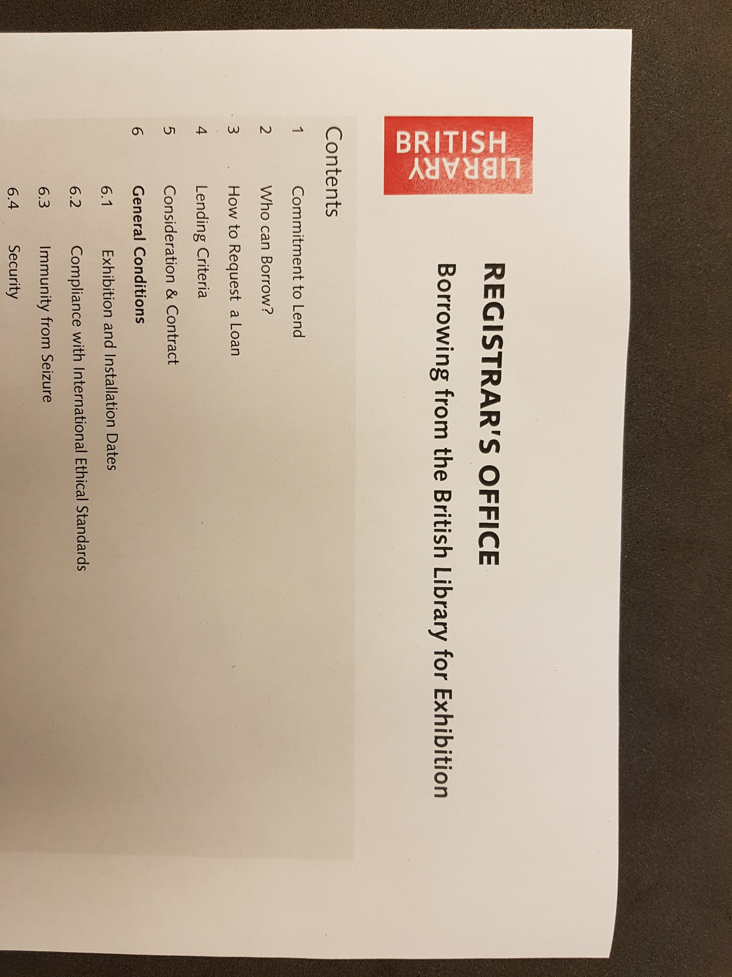
OFF-SITE EXHIBITIONS AND LOANS
Touring Exhibitions & Individual Loans
British Library Loans Registry oversees:
  our own exhibitions touring to other venues,
  individual collections items lent to other venues.
Guidance to borrowers is given in document “Borrowing from the British Library for Exhibition”.
Venues must meet the demands of the UK National Security Adviser.

Slide 23
Concluding remarks
Ensure clear governance and ownership of collection security issues within the institution.
Build collection security into the planning process for new galleries and temporary exhibitions.
Think about security during installation / de-installation of exhibitions for both your own objects and for inward loans.
Have policies and procedures that ensure the security of objects in the galleries on a day-to-day basis.
Ensure that all staff who work with exhibitions are aware of their responsibilities and receive appropriate training.
For touring exhibitions and individual outward loans, be explicit about your institution’s collection security requirements from the outset.
Help borrowers to build their capacity to accept heritage loans, rather than compromise your own security requirements.

Slide 24
Thank you
Adrian Edwards
Head, Printed Heritage Collections
The British Library
adrian.edwards@bl.uk

