Slide 1
Material Evidence in the Incunabula of the University of Groningen Library
Anna de Bruyn
27 January 2021
Groningen, UB 125

Slide 2
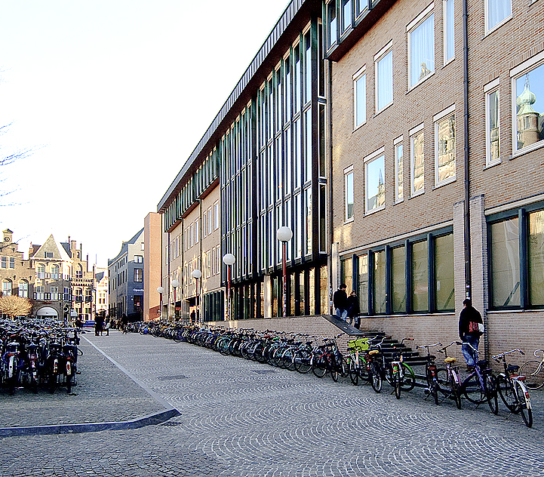
University of Groningen Library
university founded in 1614
208 incunabula
Photo: ©UG

Slide 3
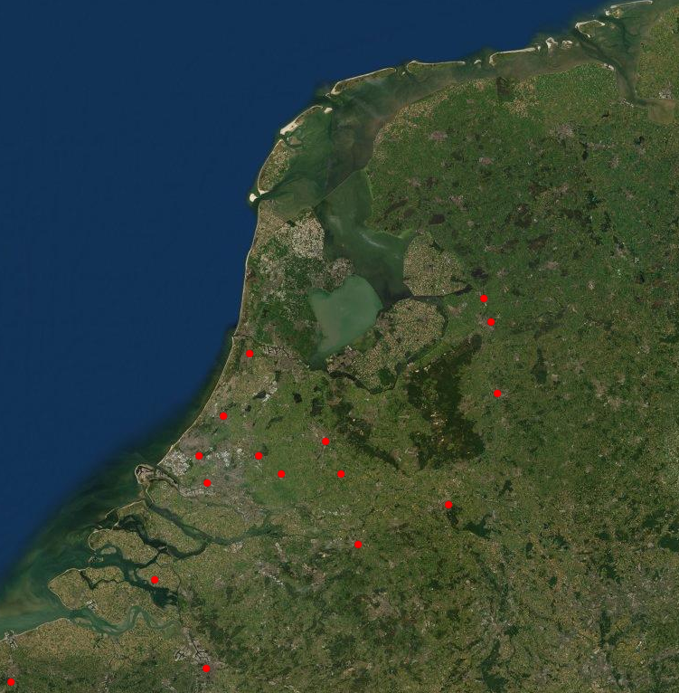
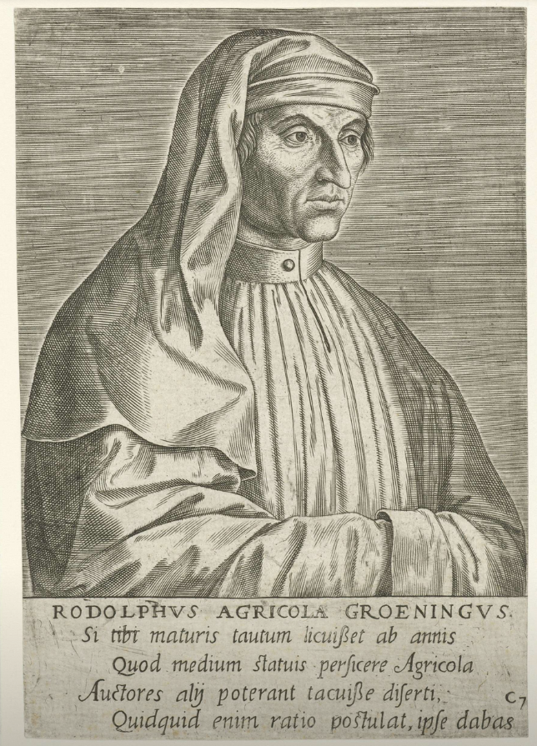
Groningen
Groningen
no incunabula press
active religious and scholarly communities
Rudolphus Agricola
Gouda
Zwolle
Delft
Philips Galle, after
Lucas Cranach (I), 1572. Rijksmuseum, RP-P-1906-2870
Source: Atlas of Early Printing, https://atlas.lib.uiowa.edu/

Slide 4
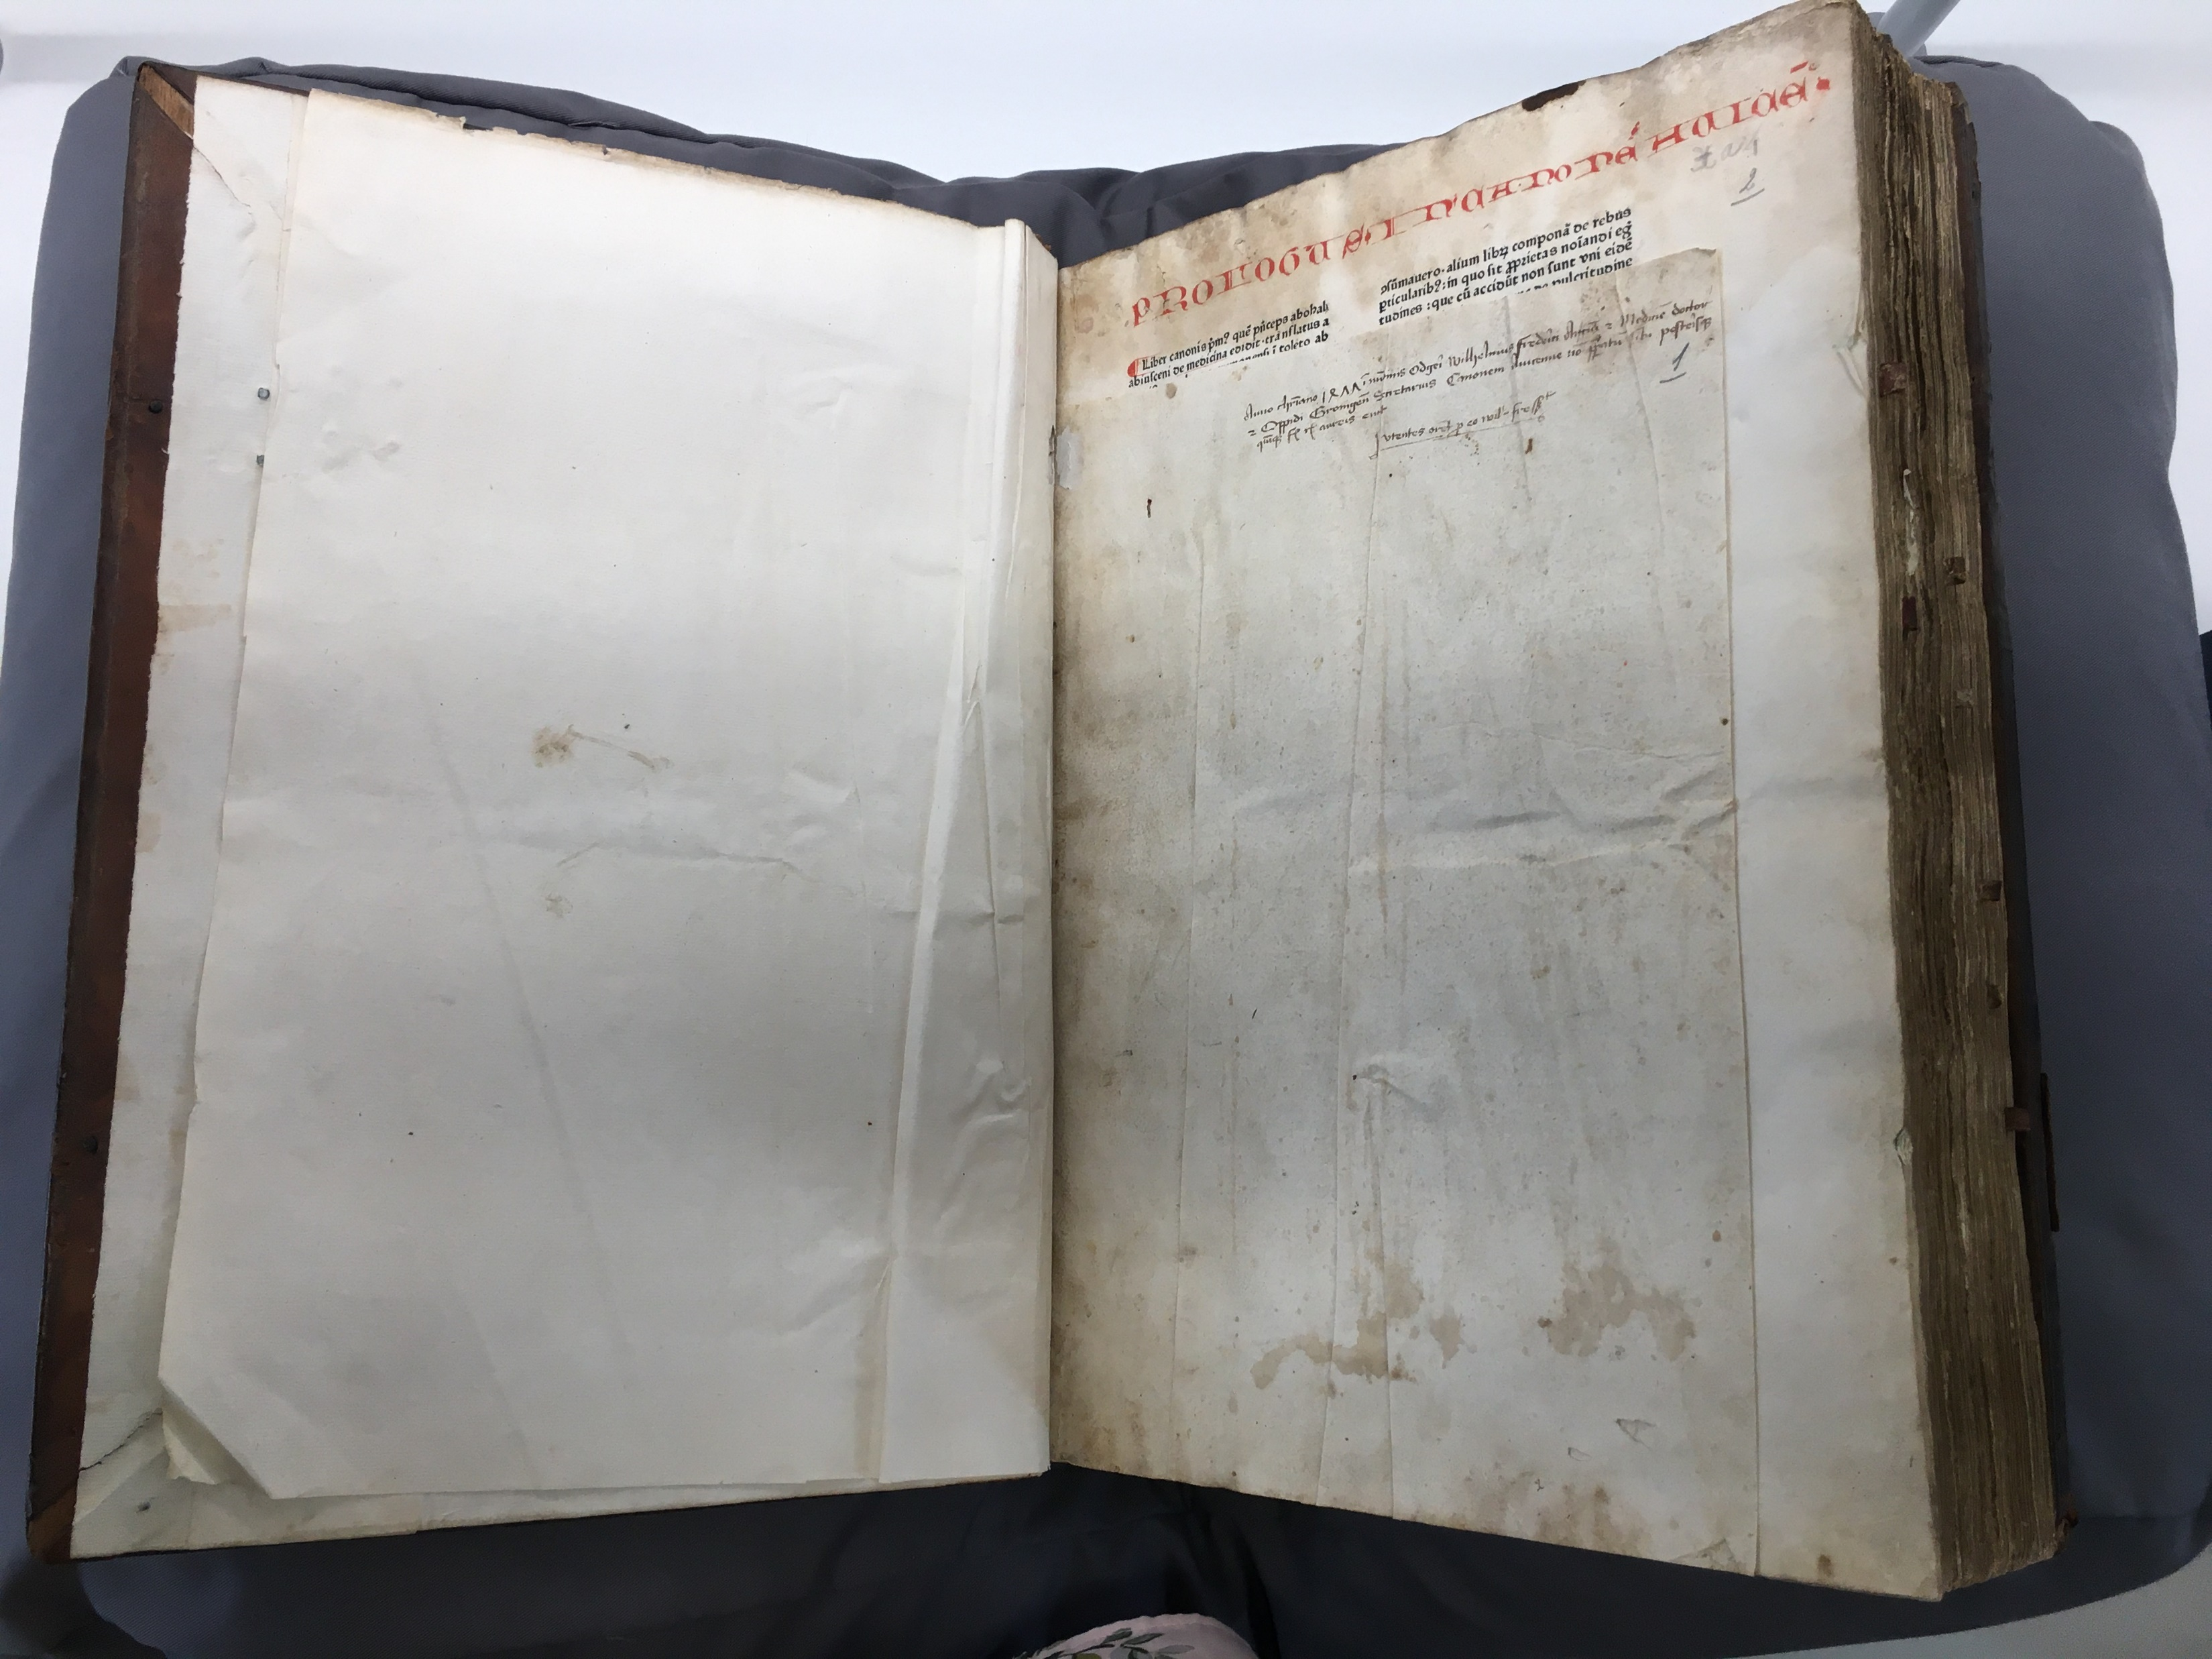
Martinikerk & Wilhelmus Frederici
Avicenna, Canon medicinae, [Strassburg : The R-Printer (Adolf Rusch), after Feb. 1473], Groningen, University Library (NL) INC 34.

Slide 5
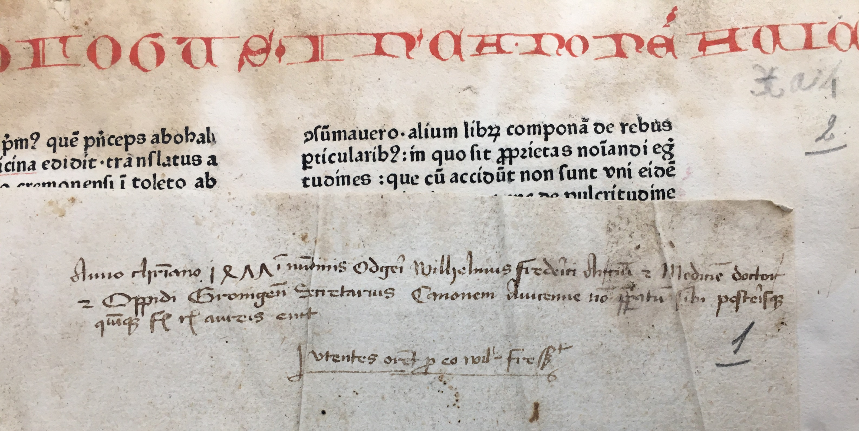
Wilhelmus Frederici
Avicenna, Canon medicinae, [Strassburg : The R-Printer (Adolf Rusch), after Feb. 1473], Groningen, University Library (NL) INC 34.

Slide 6
‘mijn lieue broeders’
transl.: my dear brothers
Passage in Latin
Bernardus Claravallensis, Sermones de tempore et de sanctis [Dutch], Zwolle: Peter van Os, 27 May 1495. Groningen UB, 40.

Slide 7
Material Evidence in Incunabula
Wilhelmus Frederici
...
...
Martini Church
UL Groningen
Petrus Hofstede de Groot
(Professor in Groningen)
...
Convent of St Agnes, Amersfoort

