Slide 1
Education and Training Approaches IN the PARTHENOS Research Infrastructure Cluster
Dr Jennifer Edmond
Trinity College Dublin & PARTHENOS

Slide 2
Digital Research Infrastructures and Digital Cultural Heritage Institutions may look similar, but they stem from different epistemic cultures or: We need to talk about Transnational History and about ‘Data Soup’

Slide 3
CENDARI Data Collection
800K+ Datasets, from over 1200 Institutions
How? From API to FTP to RWP
The three people we needed in every archive
White Paper: “The CENDARI White Book of Archives” (TCD Tara Repository)
Notes:
Workflow for Working with Providers
Variety of approaches (depending on what they have)
Data Sharing Agreement and License
DARIAH MOU
FAQs, videos
JIRA as internal contact management system
Sustainability Modelling
Network and user community processes
Technical processes
Knowledge mapping and capture
Specific recommendations for DARIAH affiliate projects during project lifetime and afterward

Slide 4

DARIAH “Open History”
CENDARI, plus EHRI (NIOD, DANS) and others (BE, CZ)
The three types of archive: closed, open and inside out
Focus on dialogue and support, but, at the end of the day: we don’t trust each other (yet)!
DARIAH: Data Fluidity and Sustainable Publishing of Archival Catalogues WG
White Paper “Sustainable Digital Publishing of Archival Catalogues” (DARIAH HAL Repository)
Notes:
Workflow for Working with Providers
Variety of approaches (depending on what they have)
Data Sharing Agreement and License
DARIAH MOU
FAQs, videos
JIRA as internal contact management system
Sustainability Modelling
Network and user community processes
Technical processes
Knowledge mapping and capture
Specific recommendations for DARIAH affiliate projects during project lifetime and afterward

Slide 5

EU Open Science Agenda
FAIR Research Data to become a requirement for European funding (machines are users too)
European Open Science Cloud to be the enabling über-infrastructure
Open Science Policy Platform founded to work through the social and cultural barriers
Only LIBER at the table from a CHI perspective – not ideal if this is to work for humanists!
There are carrots too, though: reuse, sustainability, contextualisation, richer collections…
Notes:
Workflow for Working with Providers
Variety of approaches (depending on what they have)
Data Sharing Agreement and License
DARIAH MOU
FAQs, videos
JIRA as internal contact management system
Sustainability Modelling
Network and user community processes
Technical processes
Knowledge mapping and capture
Specific recommendations for DARIAH affiliate projects during project lifetime and afterward

Slide 6
PARTHENOS INFRA Cluster
WP 7
Integrated Training Plan

Slide 7
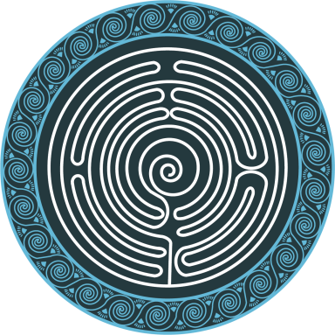
Training for Infrastructure?
Not just ‘how to use our own tools’
  Things people need to know about
  Things people need to know how to do
Variety of audiences, including CHIs
Variety of disciplines

Slide 8
Phase 1 Developments (F2F and on line)
INFRA 101
Project Leader ‘Basic Training’
  Communications
  Sustainability
  Users
Collaborations (and epistemic cultures)
  Humanists
  Computer Scientists
  Collections Experts

Slide 9
Cultural Heritage Institutions and RIs
What skills/knowledge/competencies do libraries need to get more out of research infrastructure developments?
What do research infrastructures needs to know to engage more effectively with this community (and it’s data) and support it?
How can we work together to shape the discourse on Open Data and Open Science? How can we reinvent concepts like ‘sustainability’ and ‘finding aid’ to better serve users? How we can we be creative in the promotion of new paradigms, eg for ‘big enough data’ or ‘augmented research environments’?

